Slide 1
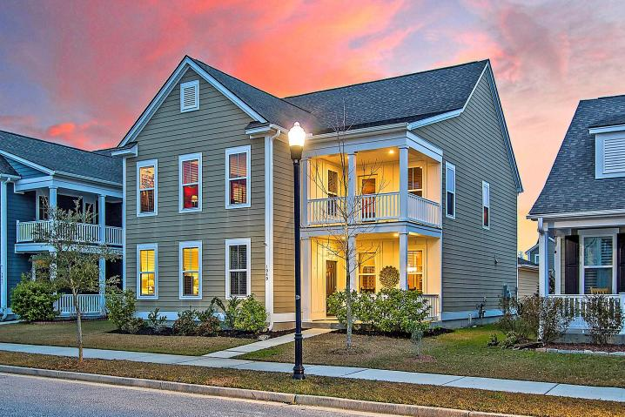



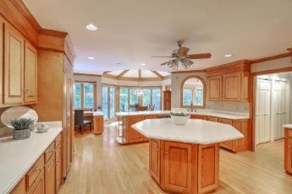
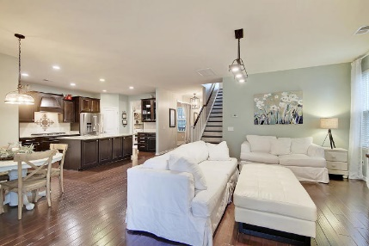



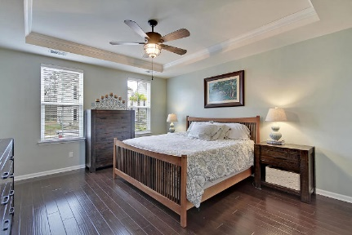

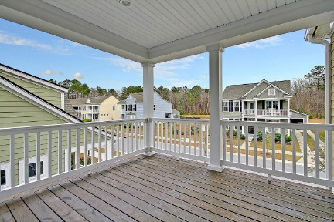
Parkshore Marshfront
Stunning Two-Story Move-in Ready Home
1949 Gammon Street
Carolina Bay ~ Charleston, SC 29414 ~ MLS# 20005636 ~ $419,900
Carolina Bay is an incredible community to be a part of and this stunning, two story move-in ready home is the perfect one to pick! You will love this floorplan with its first floor master suite, an added sun room off of the living room, an open concept layout and a great size loft area with access to the balcony. The main living room flows into the granite kitchen with its center island, breakfast bar seating, SS appliances, gas range and subway tile backsplash. A separate dining room is perfect for enjoying meals. The master suite features a tray ceiling, two walk-in closets and an en-suite bath with dual vanity and walk-in tile shower. The screened-in porch is great for enjoying the outdoors and there is a nice fenced-in portion of the backyard next to the detached two car garage.
Your safety is our #1 priority. Sellers are open to showings, but will be prescreening buyers and agents regarding any COVID-19 symptoms.
Additional features include:
Fantastic quiet street with low traffic
Walking distance to West Ashley High School, new middle school and library
Walking distance to the park for many activities including Food Truck Fridays
Convenient to all shopping including downtown Charleston
Close to area beaches
Great walking community and friendly neighborhood
Community has a pool, park, playground, miles of walking trails, a kayak launch and green space where food trucks come for events
Book your showing today!
Christopher Smith christopher@mattoneillteam.com 843-267-0735

