Slide 1
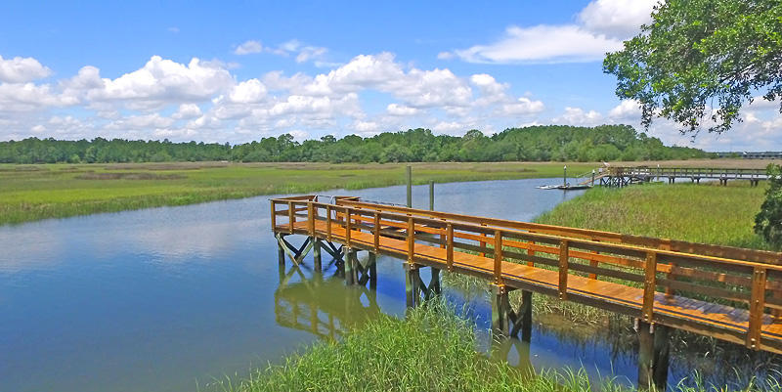
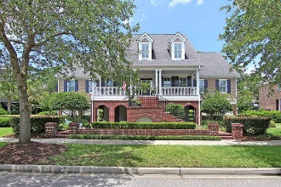
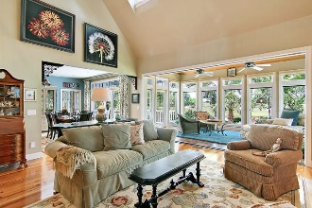
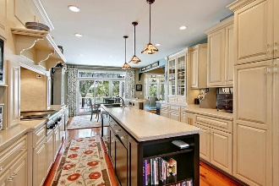
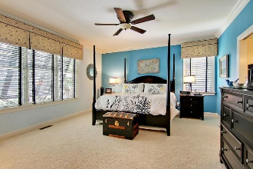
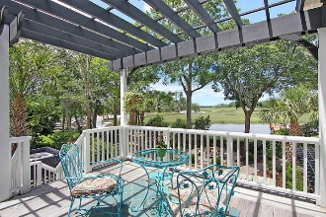
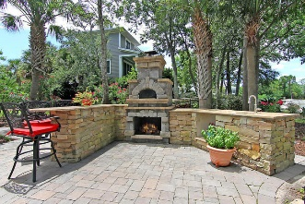
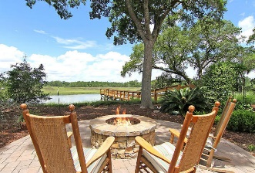
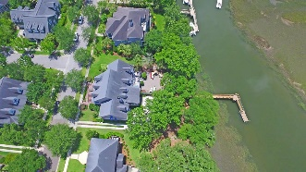
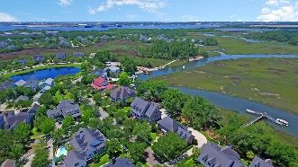

194 Beresford Creek Street Charleston, SC 29492 MLS# 17017567 $2,200,000
The Only Deep Water home on Daniel Island
The Only Deep Water Home On Daniel Island
Located on DEEP WATER, PRIVATE DOCK in the highly desired Codner's Ferry Park section on Daniel Island. This home features an 86' long private dock with floater allowing you access to the deep water in Beresford Creek. Take your boat out at low or high tides - no worries! Breath-taking views, especially as the sun sets each evening. Have it all right in your own backyard: this gorgeous creek is active with wildlife such as dolphin, fish, shrimp, blue claw crab, otter, and birds of many varieties. The backyard offers a spacious area for outdoor entertaining, including a custom designed outdoor kitchen which houses a built-in Italian pizza oven, and nearby, a large masonry fire pit. Go inside this immaculately maintained home to enjoy comfortable and spacious living and entertaining.
Be enchanted by the many architectural touches such as the two-story custom cypress fireplace and surround including cabinetry, storage and shelving. In addition, throughout the main floor you will enjoy custom designed cypress woodwork - something you'll not find in any other home as it is one-of-a-kind craftsmanship and adds a very special touch to this home's personality. In addition, throughout the main living areas, you will find antique heart-of-pine floors obtained from the Hyram Walker Distillery in Chicago after it was torn down.
This home's large kitchen has ample cabinetry and counters for storage, cooking and baking and entertaining. The back of the kitchen overlooks beautiful Beresford Creek and invites diners to sit in the large open viewing space.
The master bedroom is located on the main floor, down the hallway, away from the central, active portion of the home. It includes a spacious master bath and walk-in closet. Off of the kitchen area is a large recreation room, housing a full size pool table, a large sectional sofa, a wet bar, refrigerator and cabinetry. Even with all of this, there is still ample walking around space and in addition, there is a full bath off of the Rec room and is just one more place inside this home that offers a great opportunity for entertaining.
The home's elevator can take you, your guests and/or groceries from the garage level to the main floor and then up to the third floor where four bedrooms and two bathrooms are located. The sunroom at the back of the house has tiled floors, six foot tall hurricane-proof glass windows with capability to fully open and houses full-length pull down (hidden) screens. This room has a cypress-lined ceiling to compliment the rest of the fine woodwork. Access the outside upper-level deck (with pergola) from either the dining area, the sun-room or the recreation room to enjoy an elevated view of the creek, marsh, wildlife, kayaks and/or boats. The garage and attic spaces are approximately the same square footage of the second and third floors which offers plenty of work and storage space.
You'll also find ample heated and air-conditioned storage, Bahama and hurricane shutters, various smart home features, custom plantation shutters and window treatments, Hunter Douglas wood blinds and Pirouettes, a tankless hot water heater, and security system. Corners Ferry Park in Daniel Island, SC is a wonderfully landscaped community with golf course memberships available and clubhouse, boat launch, play parks, tennis courts, walking trails, and multiple community pools! The neighborhood is close to local shopping and grocery stores and is a short drive to downtown Charleston with 5-star restaurants, world class shopping and iconic history as well as a short drive to the beaches, the airport, and Boeing. Come take a look because you will not find another home that offers as much as this one: private dock, a chef's delight and entertainer's dream!
Stan Huff
843-670-2835 stan.huff@agentowned.com
Jill Marcacci
843-297-5590 jill@agentowned.com
www.agentownedrealty.com
AgentOwned Realty Co. Preferred Group, Inc. | 824 Johnnie Dodds Blvd | Mt Pleasant, SC 29464

