Slide 1
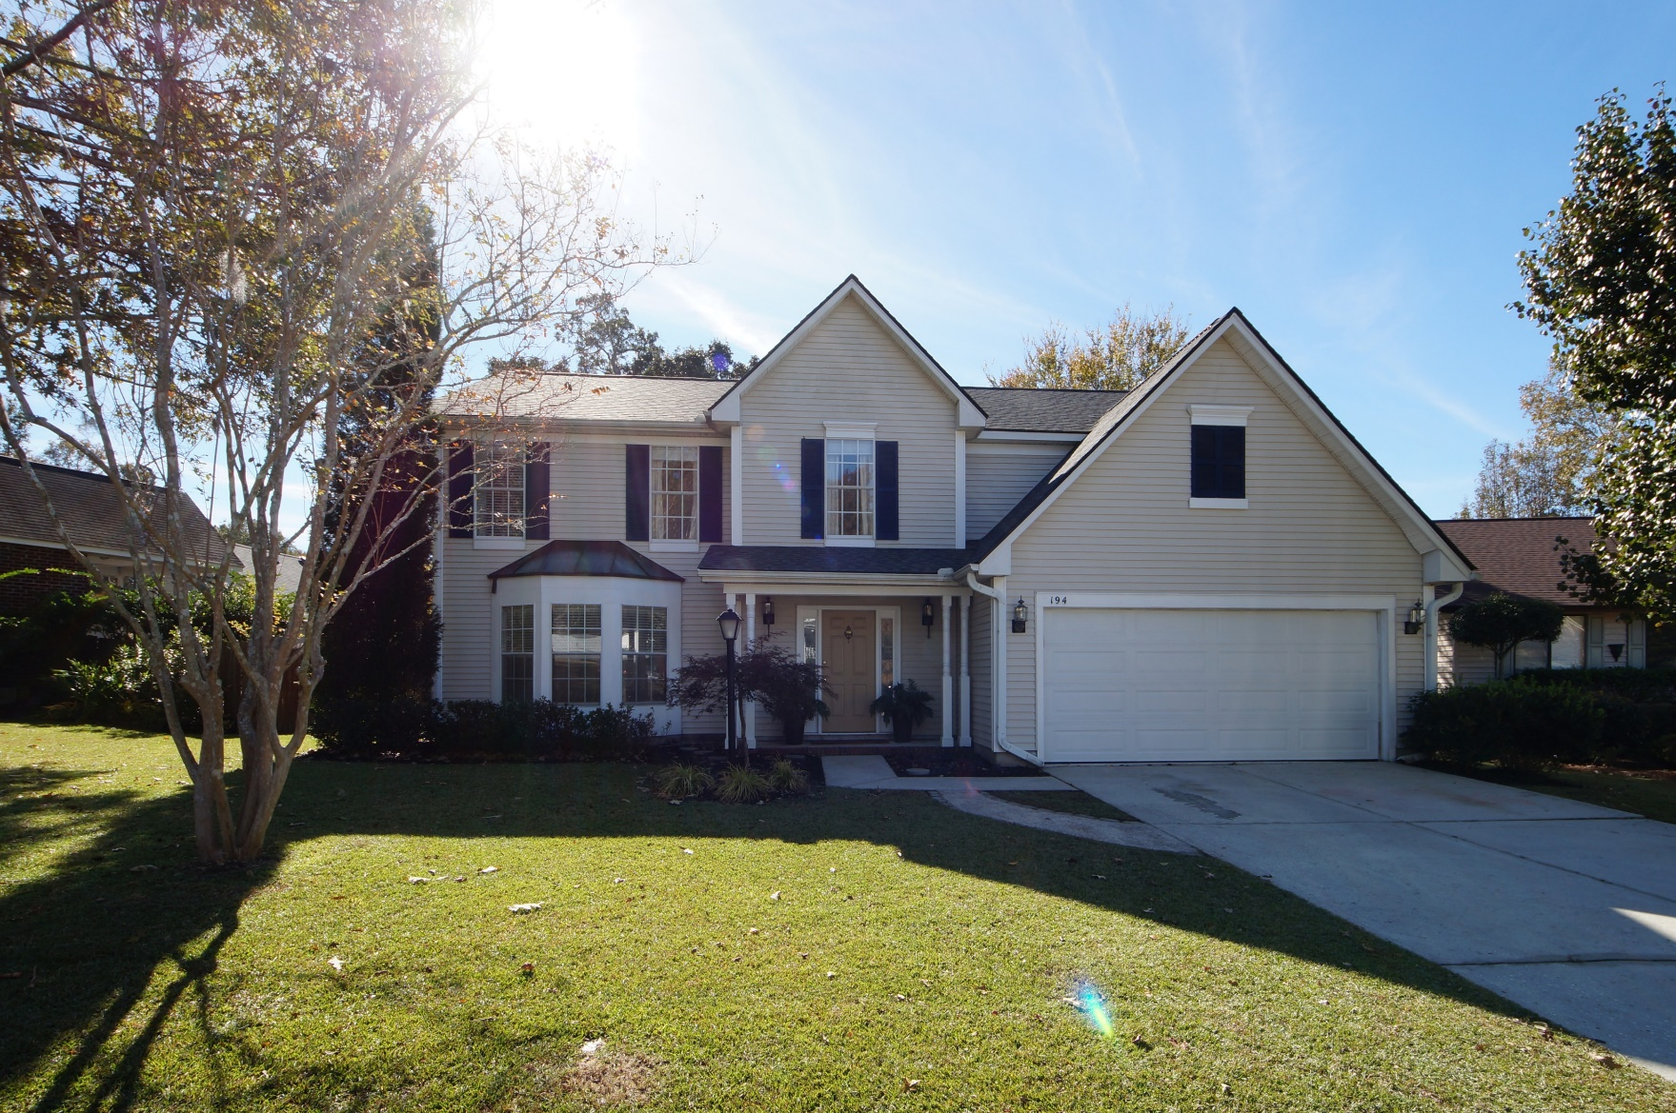
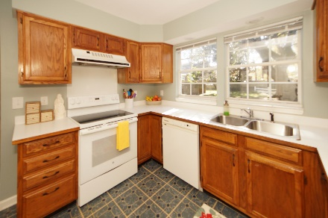
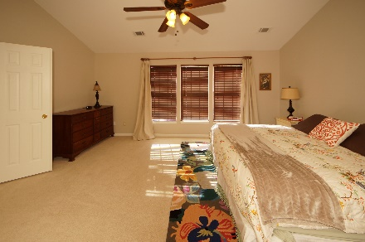
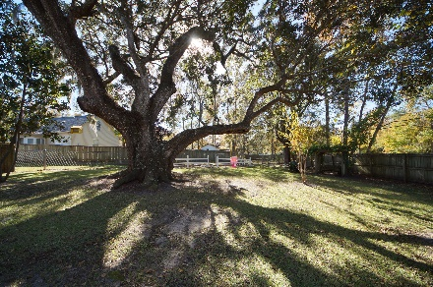


194 Winding Rock Road Crowfield Plantation :: Goose Creek, SC 29445 MLS# 17033506 :: $264,000 4 Bed / 2½ Bath
New Roof in 2016!!
Just Reduced
This spectacular home is located in desirable Crowfield Plantation. Sellers installed new carpet, fresh paint and new roof in 2016. Formal living, dining, each in kitchen, family room with fire place and over sized master upstairs make this home a must see and must buy!
Situated on an over sized lot, you can relax on your screened porch or follow the trail behind the house and walk to the lake!
Connie White, Broker
843-532-3356
conniesyouragent@gmail.com
Charleston Homes · 597 Old Mt. Holly Road · Suite 301 · Goose Creek, SC 29445

