Slide 1
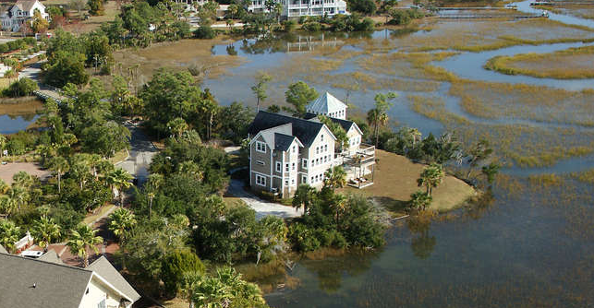
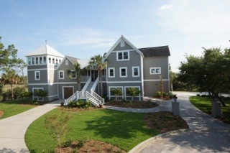
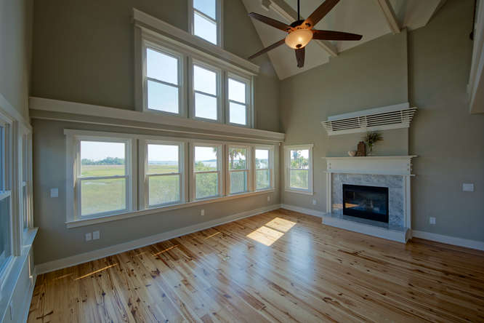
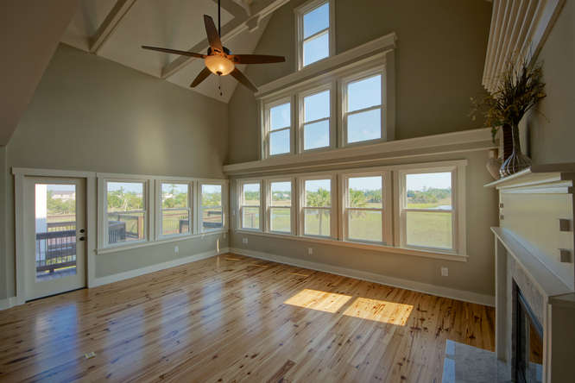
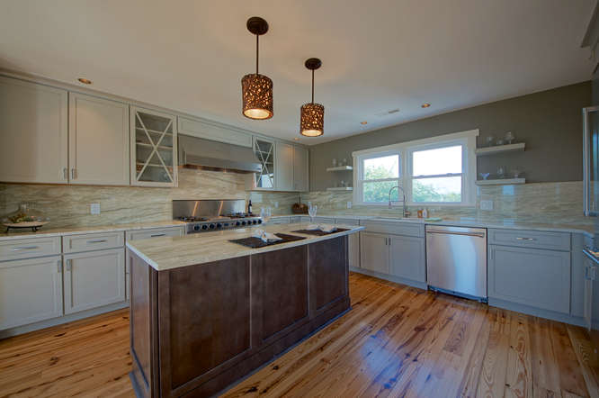
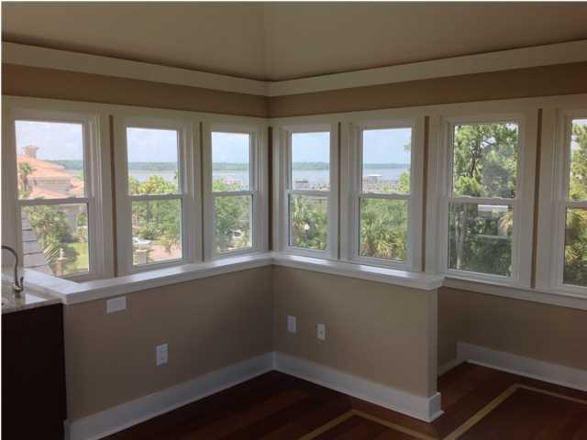
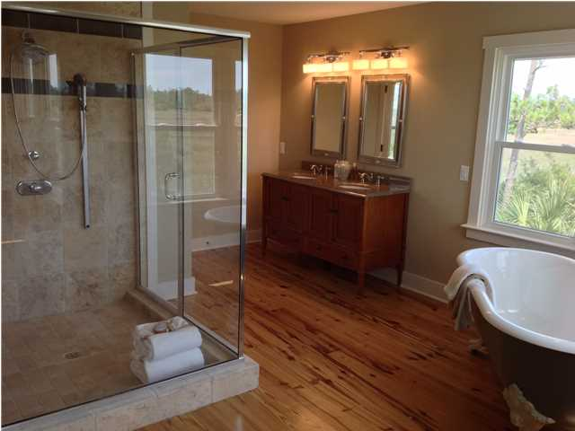
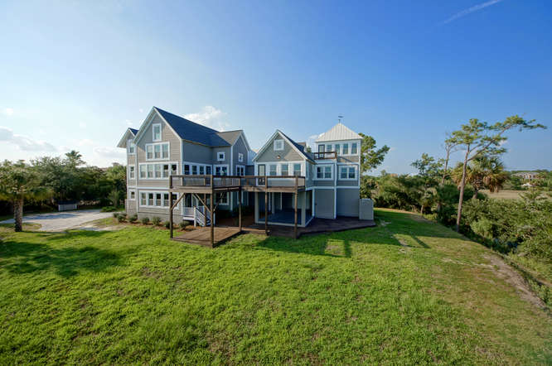
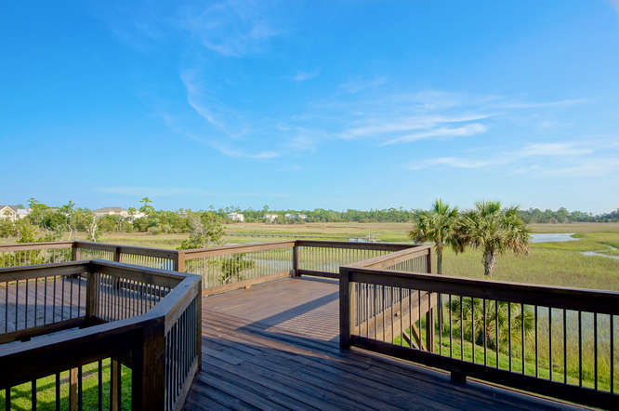
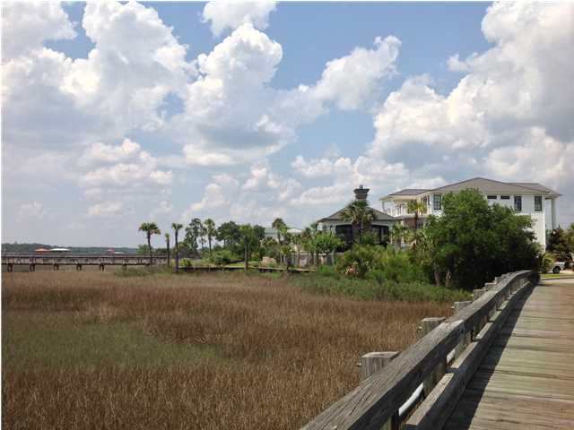


NEWLY RENOVATED! LUXURIOUS! PRIVATE, GATED ISLAND ESTATE!
1950 Sandy Point Lane
RiverTowne – Mt Pleasant – MLS# 1414604
Amazing, 360 degree water views of the Wando River and tidal creeks ~ Owner will build dock with acceptable offer ~ Private, gated island, located within the subdivision of Rivertowne on The Wando on Sandy Point Island ~ One of Mount Pleasant’s most exclusive neighborhoods ~ This extraordinary home contains a luxurious, fully equipped Mother In Law floor on the ground level with 2 bedrooms, bath and kitchen with water views and a private entrance ~The feel is totally Kiawah as you head over the private wooden bridge and find the estate straight ahead ~ This 4,746 square foot home sits on .46 of an acre, fully permitted for a 4’ x 195’ walkway with a 8’ x 15’ floating dock on deep tidal creek with direct, short access to the River ~ Handsome metal roof with copula and weather vane ~ This home has a total of 6 bedrooms, with many of the rooms perfect for a playroom, office or additional den ~ Beautiful hand laid, natural Heart of Pine floors throughout ~ The Master Suite is large and has a spacious outdoor deck overlooking the Wando River, a giant walk in closet that could also be used as a nursery, and a master bath with spa shower and claw foot tub. Upstairs in the Master Suite is an “Eagles Nest” sanctuary with 360 degree spectacular views of the river, and features a coffee bar and sink, with inlaid wood floors ~ The new main kitchen includes a gas range, island, breakfast nook, bar, imported Brazilian granite with full wall back splash, custom cabinetry with glass and mullions, Thermador appliances and wine refrigerator ~ This home has wonderful storage space, beamed ceilings, granite counters, decks, large work shop, 3 HVAC systems, hot water heaters, extra insulation between floors and walls for sound protection and energy efficiency ,smart house interconnecting wiring, security system, central vacuum and the home was built to accommodate an elevator off of the entrance foyer ~ Renovations completed include: brand new, stunning kitchen, exterior painting and staining in historic collection palette (including the metal roof), new custom front double door, professionally landscaped and irrigated , copper post caps, dock permit obtained from State of S.C., re-blasting of driveway, re-building of cement pillars, construction of HVAC covering, re-stabilization of decks and porches, high end designer lighting and fans for interior and exterior,, coffee bar and sink in the Eagles Nest, re-configured floor plan, new interior balconies, new windows throughout~ Amenities include neighborhood pool, tennis court, club house, play park, dock facilities and a golf membership is available ~ Great AE flood zone ~ 1954 Sandy Point next door is also for sale and could be used for extended families to be together.
Just Reduced to $1,247,000!
Aviles Real Estate Brokerage
Susan Aviles
843-697-2383
Susan@Aviles-RealEstate.com
www.Aviles-RealEstate.com

