Slide 1
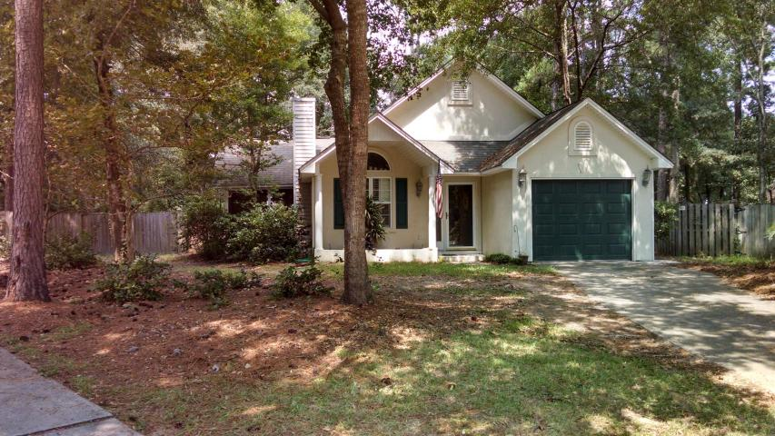
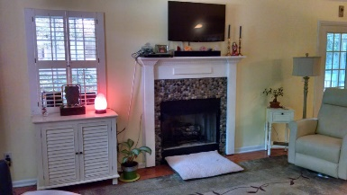
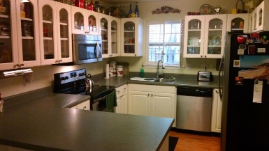
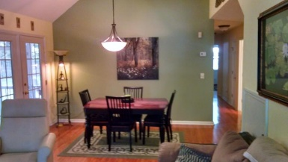
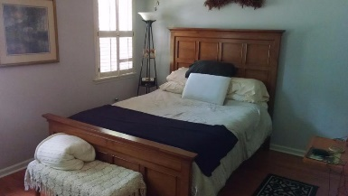
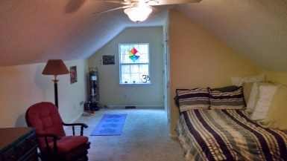
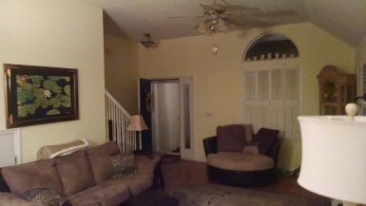
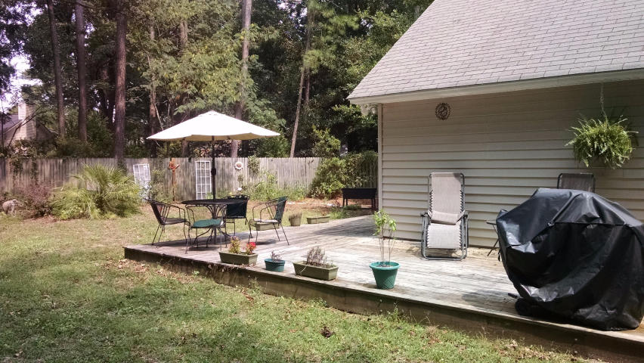


Great New Winnsboro Lake Listing 1950 Walkers Ferry Place Winnsboro Lakes Johns Island, SC 29455 MLS# 16027869 $235,000
This is a Very Well Maintained, and nicely Updated Ranch Style Home, on a Quiet Cul De Sac; in the desirable Winnsboro Lakes Subdivision. There are Three Bedrooms Down and then a Large Upstairs Bonus Room...with it's own 1/2 Bath ** Hardwood Floors through out the main living areas, and bedrooms. Nice size Kitchen with Stainless Steel Appliances, Open to a large Great Room with Custom Fireplace ** Large Fenced Yard ** Huge Deck & Screened Porch ** Conveniently located to both Downtown Charleston, and Kiawah Area (Bohicket Marina and Freshfields).
Frank Rutigliano
843-813-4961
frutigliano@kwchs.com

