Slide 1


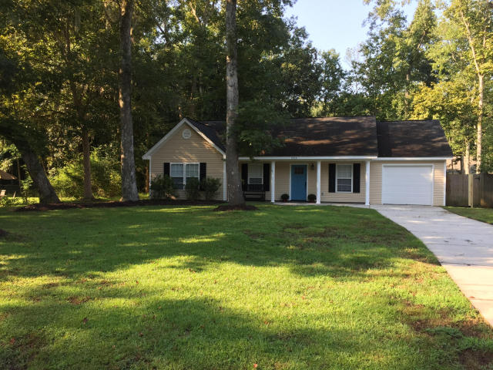
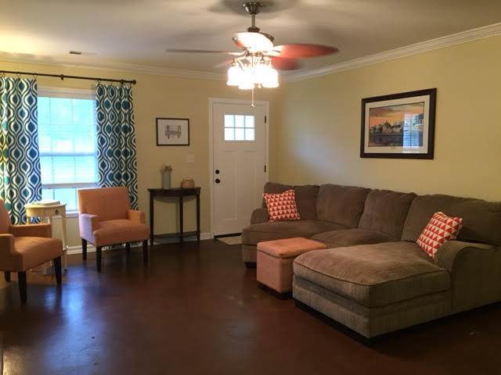
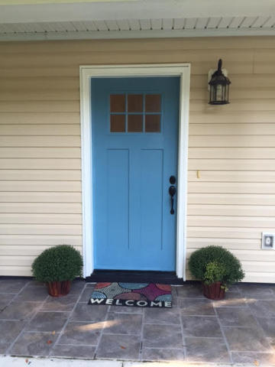
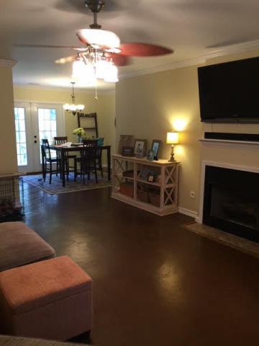
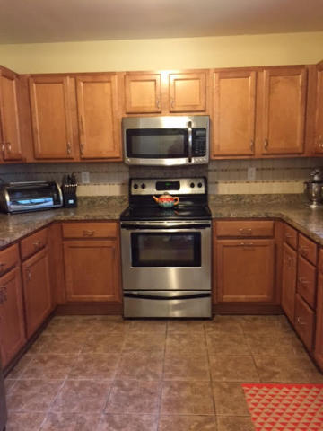
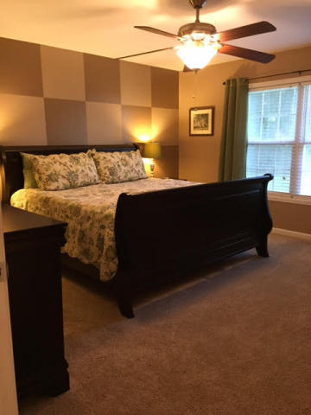
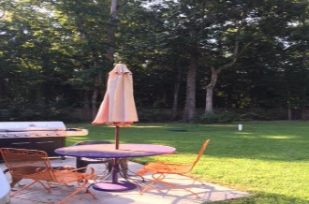
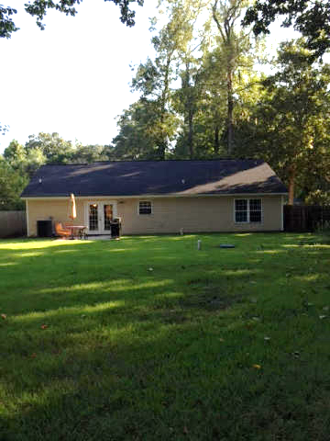


Country Living close to town
1952 Gasque Street
Cedar Springs - Johns Island
MLS# 15023456 - $240,000
Just
Reduced!
Country Living Close to the City! This move in ready Home is sure to be HOME SWEET HOME for those who love the trees and a large lot, a neighborhood free of HOA rules and a short commute to downtown and the beaches.
This Three Bedroom two bath home has a large kitchen with attractive backsplash and tile flooring.
The dining area overlooks the plush back yard and is open to the living area. A separate laundry room and a one car garage attached, make this a very charming, very comfortable home.
This established neighborhood has seen many new homes go up in the past few years. Easy to see don't miss it! Great fenced yard for children and pets to run and play.
Jan M. Miller, Broker Associate
jan.miller@goldenbearrealty.com
www.GoldenBearRealty.com
Golden Bear Realty | 654 Coleman Blvd, Suite 100 | Mt Pleasant , SC 29464
Cell (843) 345-9719 | Office (855) 352-9088 | Fax (561) 721-3311

