Slide 1
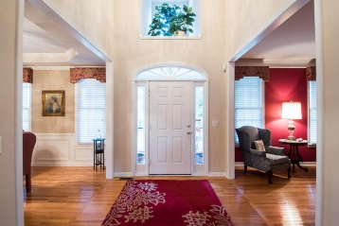
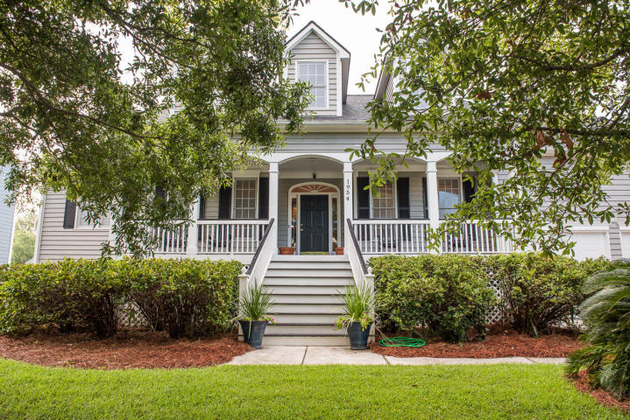
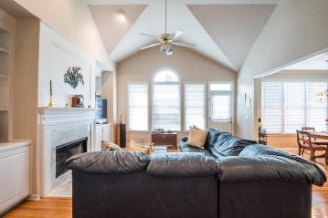
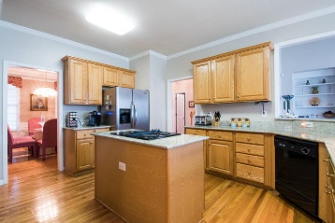
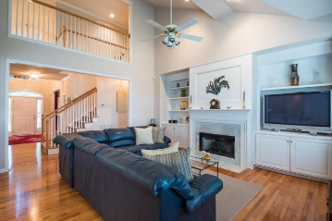
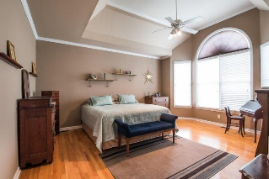
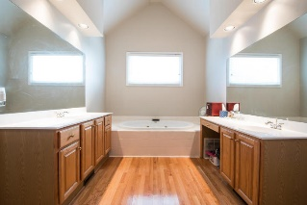
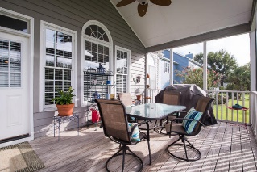
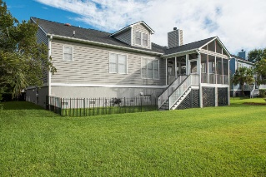
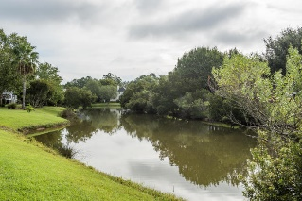


1954 Enclave Drive Longpoint ~ Mount Pleasant ~ MLS# 16023976 ~ $615,000
Just Listed in Longpoint!
Welcome home to 1954 Enclave Drive in The Enclave in Longpoint! Looking for a beautiful home and well maintained 5 bedrooms, 3.5 baths with approximately 3200 square feet situated on a salt water pond? This is it! The home welcomes you with front porch to enjoy the afternoons and mornings. As you enter the foyer, on the left is a sitting room or potential office and on the right is the formal dining room. The house has an open family room with gas fire place with vaulted ceiling that opens to the kitchen. The kitchen has upgraded granite countertops, separate island with electric cooktop. The cabinets are maple. The main floor has hardwood floors throughout except bedrooms. Also, kitchen has two pantries for extra storage. Located downstairs is the master suite with vaulted ceilings and a large master bathroom and walk in closet. The bathroom has a garden tub, two sinks and vanities and a separate water closet. Additionally, on the other side of the home are two more downstairs bedroom with a full bath. This space is a great "mother-in-law" suite on the main level. Laundry room also located on main level. As you enter upstairs, the flooring is carpeted on the stairs and the two remaining bedrooms. The fourth bedroom is oversized and has extra space in the dormer for tv or game room. There is a full bathroom attached to this bedroom as well. There is additional walk in attic space through the fourth bedroom closet, and the space is about 600 sqft or more. You could easily expand the closet. The fifth bedroom is also upstairs and is a good size, currently the sellers use as an office. The sellers have meticulously maintained this home. The roof was replaced in 2010, the ac units are new as of 2014 and has 10 year parts warranty includes compressor. The gas firebox was replaced a year ago. The yard has an irrigation system. Additionally, a two car garage with extended ceiling height for extra storage as well. The home overlooks a beautiful pond in the rear with privacy and nice back yard with screened in porch to enjoy the beautiful outdoors. Centrally located in South Mt Pleasant, The Enclave is one of the premier subdivisions in the area. The neighborhood as a community pool, clubhouse and tennis courts. Also, is close to I-526, Mt Pleasant Town Centre, beaches and 20 minutes to downtown Charleston. Additionally, the Palmetto Islands County Park is adjacent to The Enclave at the end of Needlebrush parkway. Great play park, summer waterpark, dog park and biking walking trails to enjoy around the beautiful marsh areas.
Charla McDonald Office - (843) 884-1622
Cell - (843) 343-1456
Fax - (843) 746-4845
cmcdonald@carolinaone.com
charlamcdonaldproperties.com
Carolina One Real Estate
628 Long Point Rd
Mt Pleasant, SC 29464

