Slide 1
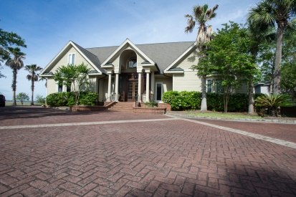
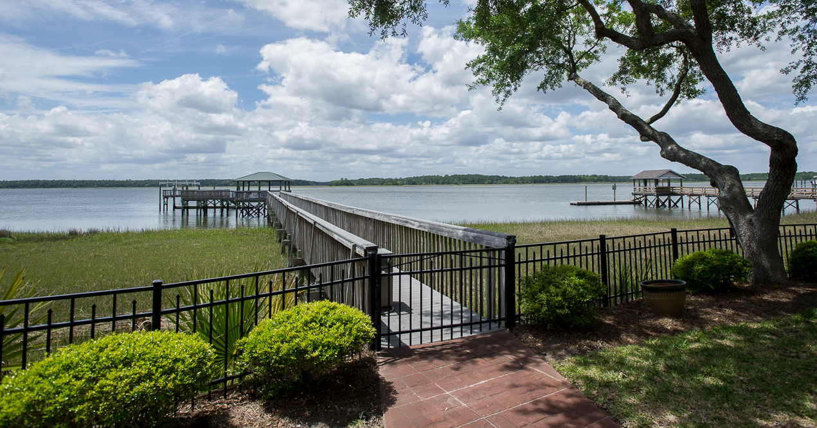
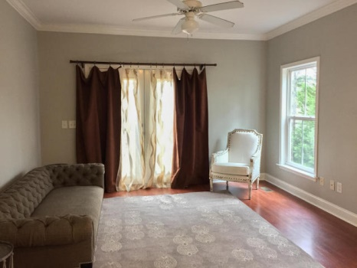
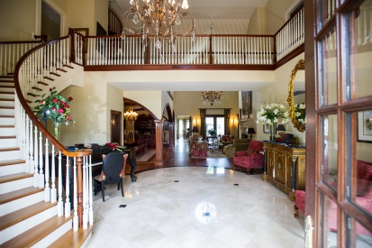
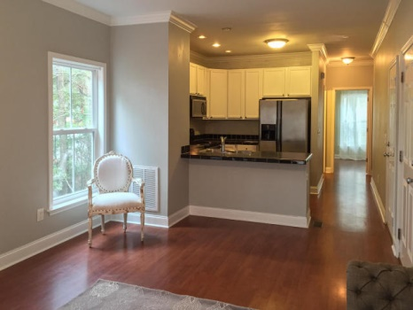
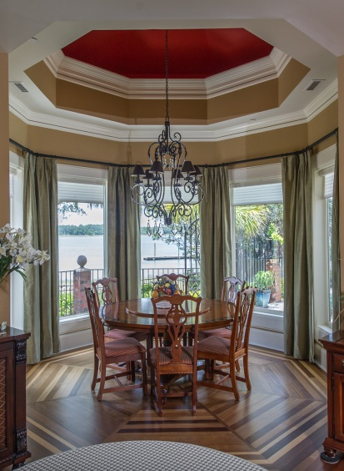
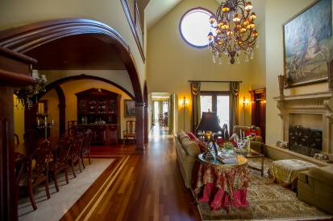
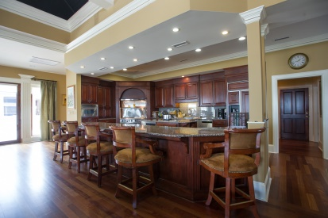
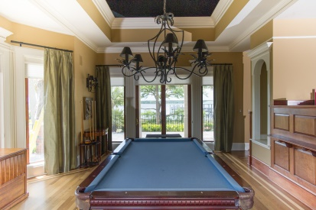
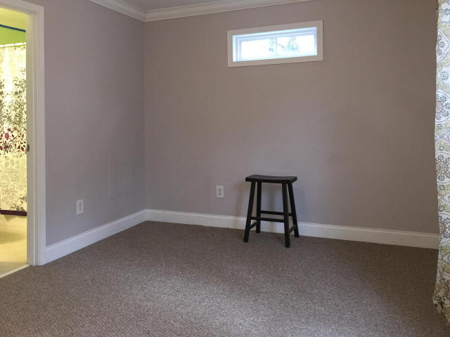
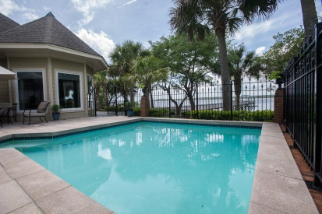
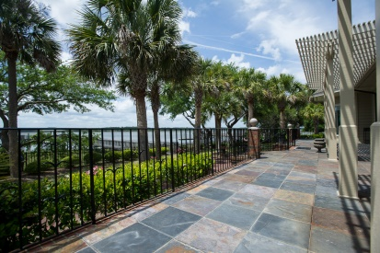
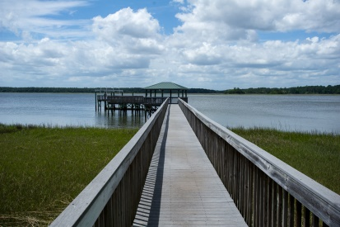


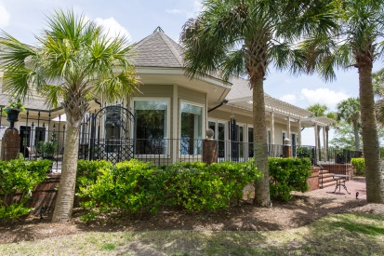
1954 Sandy Point Lane Rivertowne On The Wando ~ Mount Pleasant MLS# 15012069 ~ $4,000,000
Open House Thursday 6/25 11a-1p
Look no further. This is truly a gem. One of a kind home nestled on a small island inside of Rivertowne on the Wando. This home has everything anyone could ever want including an outdoor kitchen, panoramic views of the Wando river, a deep water dock with a boat lift, close to 8000 sq. feet of living space with ample areas for entertaining, a lovely pool and patio area, porches that cover then entire backside of the home, a master down with his and hers closets and baths, 4 guest bedrooms each with their own private bathrooms and to top it all off...a small apartment for either a live in housekeeper or nanny. The grounds for this property are stunning and are very low key and easy to maintain. The kitchen has beautifully crafted custom cabinetry with gorgeous granite counter tops and a large kitchen island and a separate section with a wet bar, wine fridge and a built in office area. There is a separate area off of the family room that is the perfect space for a pool table. There is seating for up to twelve people on the counter height bar that faces the kitchen and much more. No expense was spared in the construction of this home as it boasts beautifully made hardware and finishes not to mention the beautiful inlaid hardwood floors and the immense amount of trim work that you see throughout the house. Every inch was made with high end features! This home is a work of art and any buyer would be hard pressed to find or even build a home at this price with this level of luxury.
Carey Nikonchuk
(843) 276-1701 M
cnikonchuk@gmail.com
www.palmettoproperty.net

