Slide 1
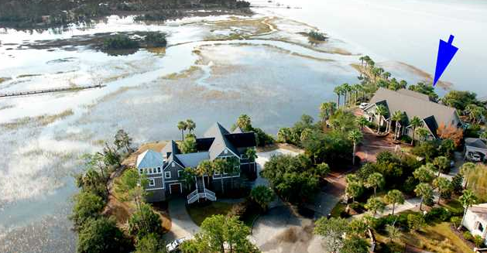
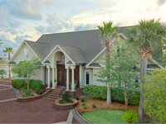
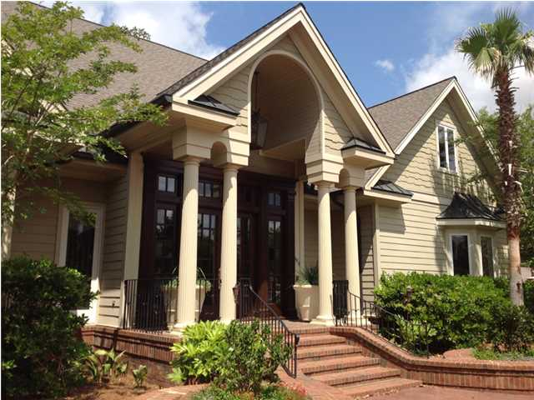
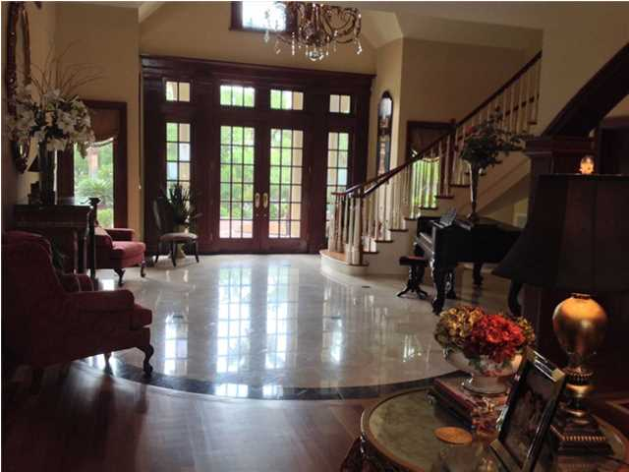
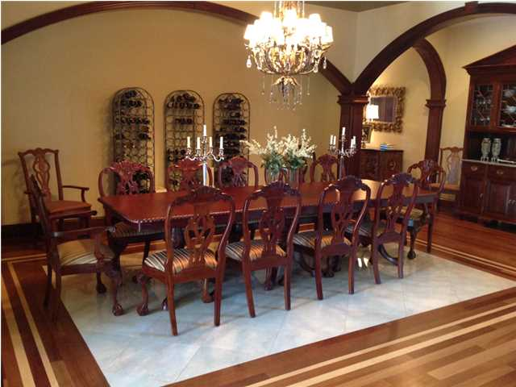
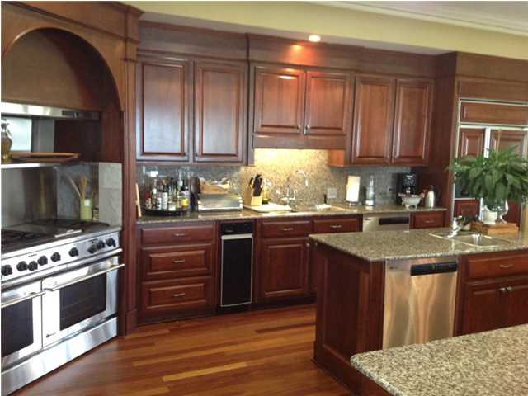
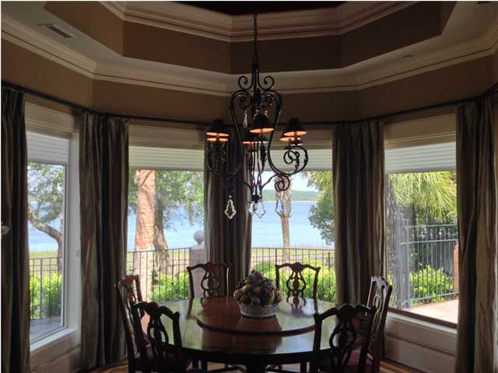
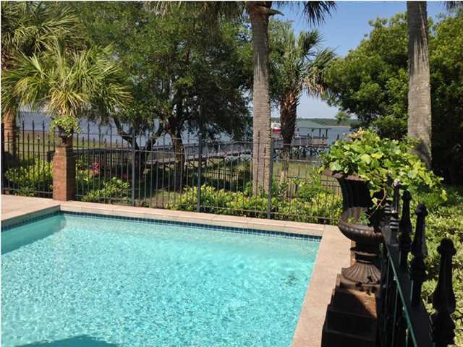
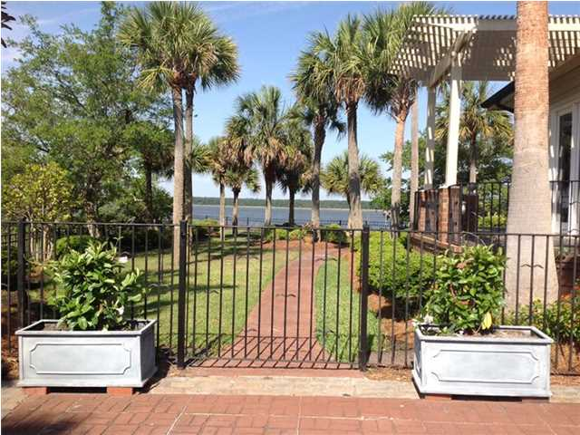
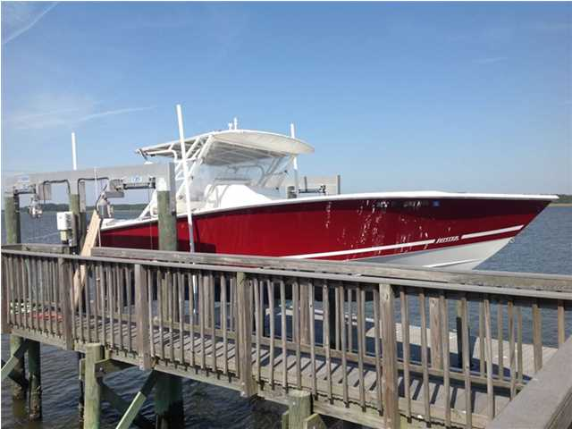


EXQUISITE WATERFRONT LIVING ON PRIVATE, GATED ISLAND!!!
1954 Sandy Point Lane
RiverTowne – Mt Pleasant – MLS# 1413610
Experience exquisite waterfront living in this awe-inspiring 8,000 sq' estate located on .75 acres on the gated, private Island of Sandy Point ~ Few properties enjoy such a privileged position with only 4 homes on the island ~ This unique and rare property was designed by architect Doug Cowden and was built by the owner and developer of the island ~ Savor the breath-taking views from most every room ~ Step out onto the private dock which cascades out over the deep water of the Wando River ~ There are 2 covered pier heads with power and water perfect for entertaining, a 22,000 pound boat lift securing a 32' Jupiter boat and 1 jet ski which all convey with an acceptable offer ~ Owner estimates that the dock can accommodate a 40'-50' boat and the River is approximately 6' deep at low tide ~ This stately property offers many hand crafted architectural features including mahogany archways, art niches, cornices, custom molding, imported beams/marble/tiles and inlaid Bavarian cherry wood flooring and designer lighting ~ Drive between the two majestic lions down the brick parkway and enter into the home through the grand double mahogany front door with transom and sidelights ~ A 20' foyer with imported Travertine marble floors, a grand staircase that curves to the 2nd floor and an exquisite chandelier ~ Continue on to the gathering room featuring a marble fireplace and a formal dining room ~ A magnificent eat in kitchen complete with: high end granite counter tops, abundant cabinetry, GE Monogram stainless steel appliances: 6 burner gas and electric stove, double wall oven, 2 dishwashers, and a breakfast bar that seats 8 comfortably ~ A large rotund like breakfast area overlooks the serene creek that flows from the Wando river into the island ~ A family room with 20' open beamed ceilings and a wall of windows across the entire back of the home that overlooks the Wando River ~ The modern elegance of this home is shown in the first floor master en-suite which includes a fireplace, large sitting area, hand carved mahogany shell sculptures set within the built in book shelves and a private entrance to the terraces and pool, two hers closets and one his closet that measures 8' x 10' ~ Additionally on the 2nd floor are 4 full master suites with full baths and private balconies ~ A handsome library that overlooks the Wando River ~ The 3rd floor provides a nanny/housekeeper suite with a full bath ~ Indulge in the tranquility found on the back deck of the house with the beautiful pool and multiple seating areas, fully equipped BBQ pavilion with granite bar area for 12+ people all surrounded by custom design decorative ironwork and gates perfect for summertime parties ~ The spacious 1,000 sq' 4 car garage is heated and cooled ~ Also three HVAC units, 1 year old water heater, a flood policy-$600/yr and home is under termite bond, full security system including video cameras, central vacuum ~ Refrigerator, washer, dryer, furniture, also convey with acceptable offer
Price Reduced Almost $400k!
Aviles Real Estate Brokerage
Susan Aviles
843-697-2383
Gil Aviles
843-697-5535
www.Aviles-RealEstate.com

