Slide 1
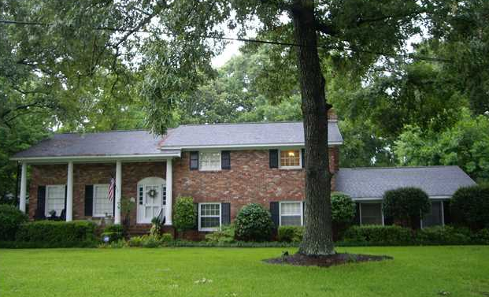
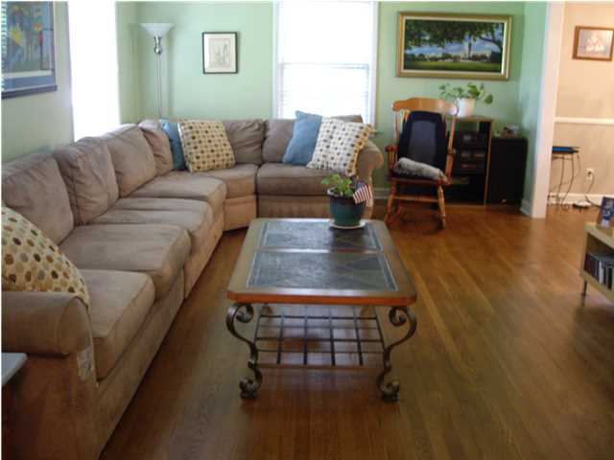
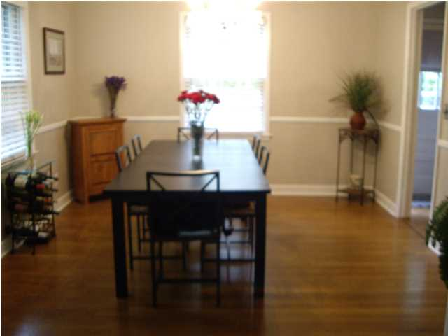
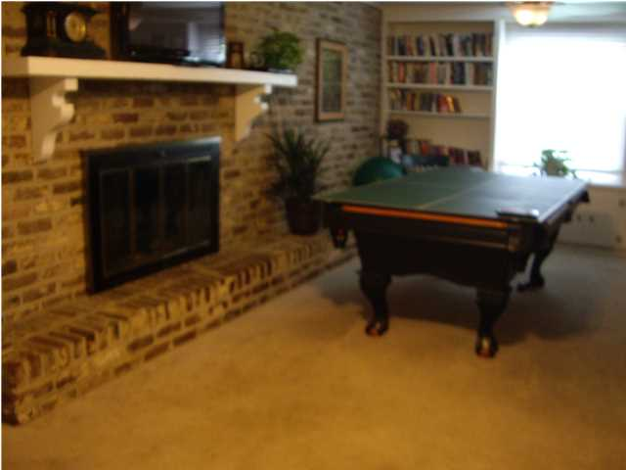
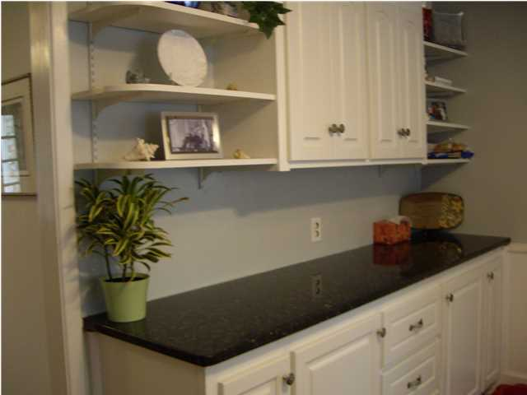
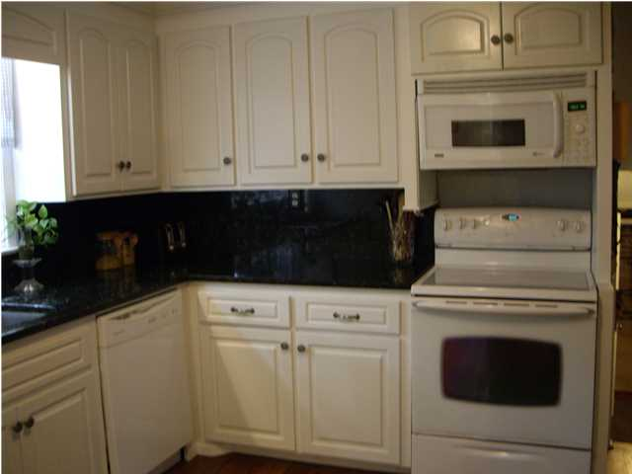
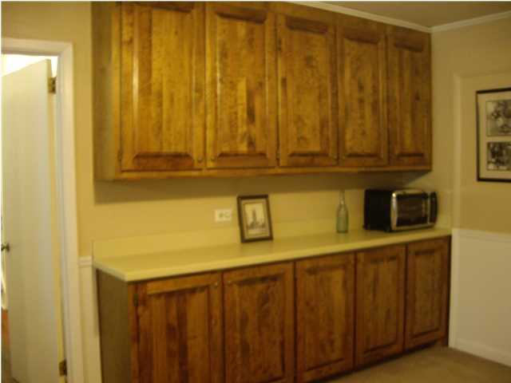
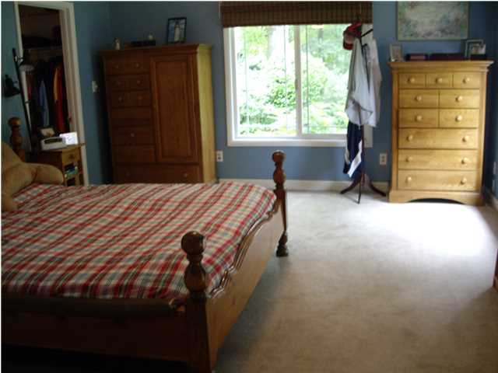
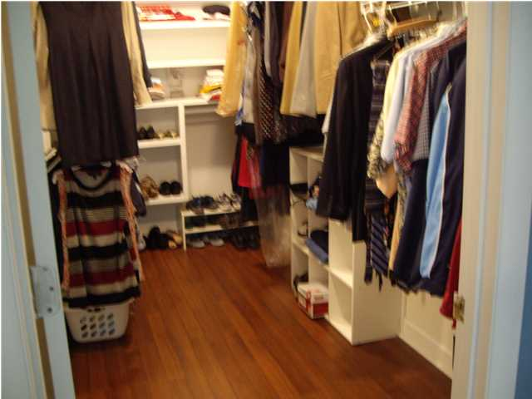
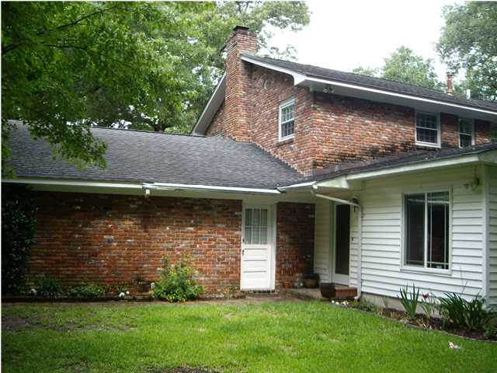


1954 Westminster Rd
Sandhurst | Charleston
MLS# 1414531
$430,000
This large Southern Plantation style Brick Exterior House will Welcome you with Towering Columns and Brick Steps and Wrought Iron. This home is located in a most Convenient and Desirable Neighborhood; SANDHURST! This large family home is a rare find with 6 bedrooms and 5 full baths on 0.44 acre corner lot. Two car side entry garage. Private Master suite is tucked into the rear corner for quiet and privacy, dual sink with extended counter space, Upgraded Mirrors and Skylight for natural light, Jetted Garden Tub/Shower with tile surround and built-in shelving. Private water closet and his & her walk-in closet. This Master suite can be easily converted to Mother-in-law suite which has separate entrance to outside. There is possible another master suite on 2nd floor with hardwood floor, ceiling fan with light, two closets, walk-in shower and ceramic tile floor. There are four other bedrooms for your growing family or use as office or guest room. Bonus room is a great extra space for 6th bedroom/teen suite/media room. It has own full bath, closet and large storage space. Great flex space to suit your needs. Laundry room is located on lower level features hardwood floor, wall mounted cabinets for storage. Formal living room features hardwood floor, crown molding and tell windows. Formal dining room is elegant with crystal chandelier, crown molding, chair rail trim and hardwood floor. Kitchen features granite counter top and back splash, good counter space and display shelving, hardwood flooring and door leading to back yard. Large family/game room with a wood burning brick masonry fireplace, a wall of built-in bookcases, crown molding and ceiling fan. Quick access to the Airport and Downtown Charleston. A mature neighborhood with lush shaded landscaping. The seller will provide one year home warranty with Global Home USA. Flood insurance is not required in this house. Thank you for showing.
Cathy Rosenblum
843-817-7869
crosenblum@comcast.net

