Slide 1
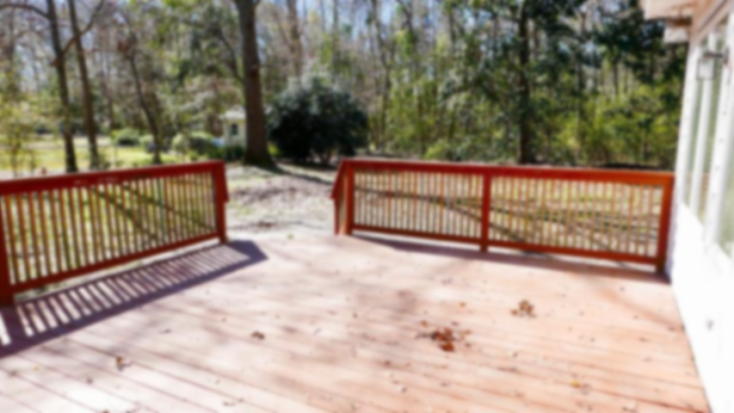
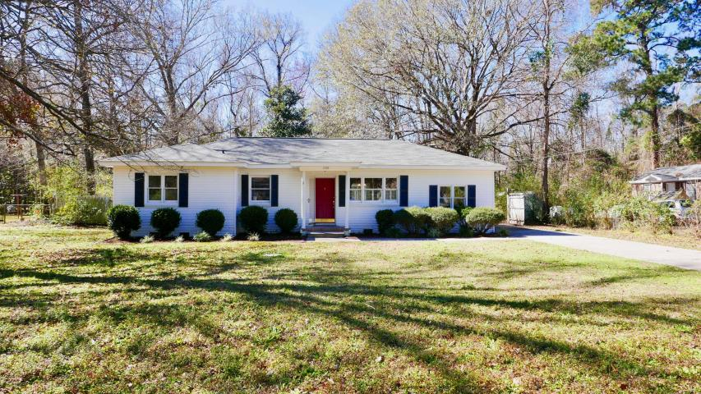
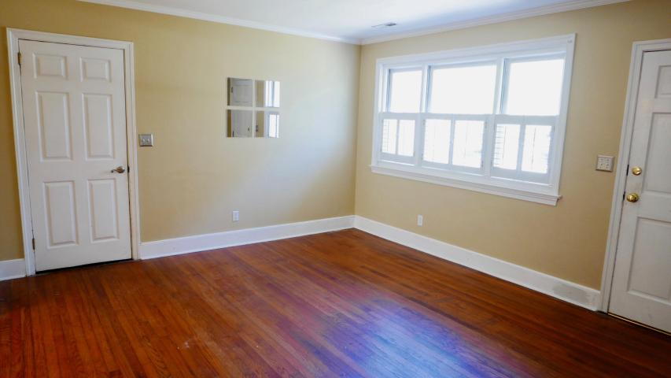
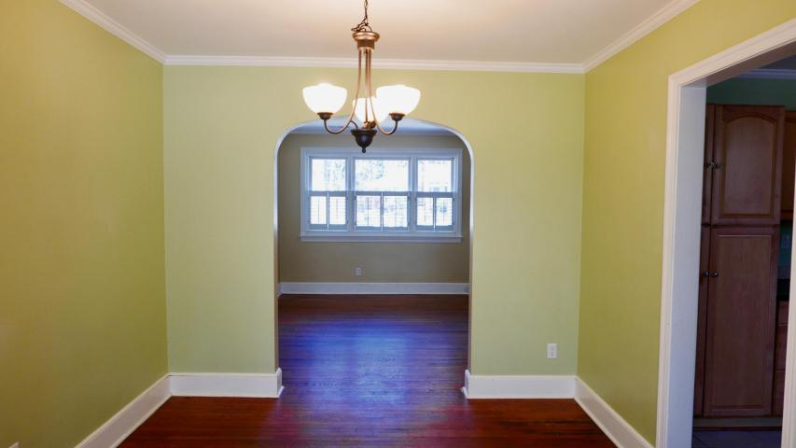
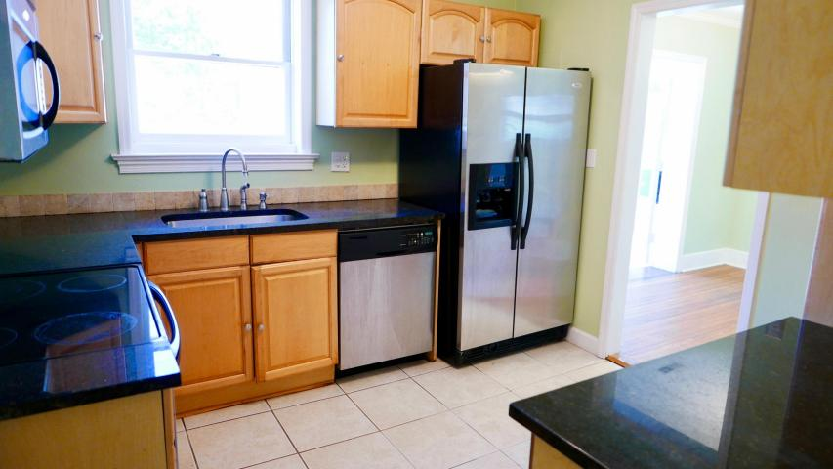
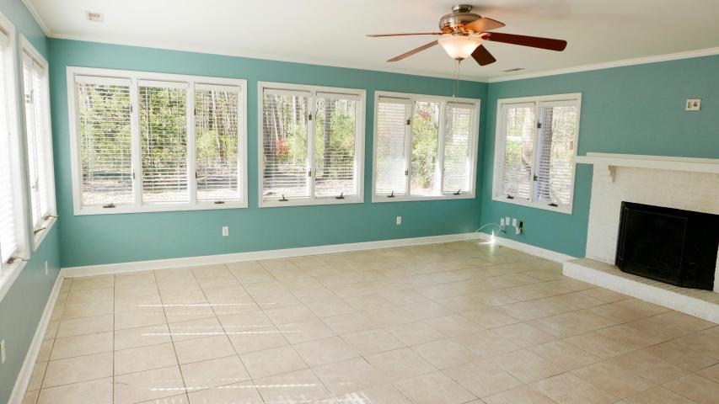
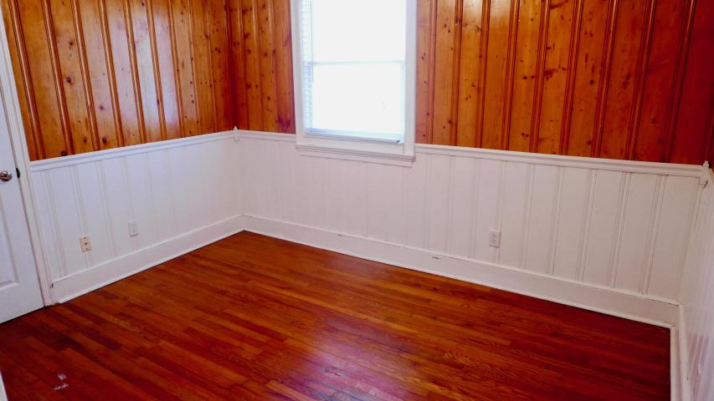
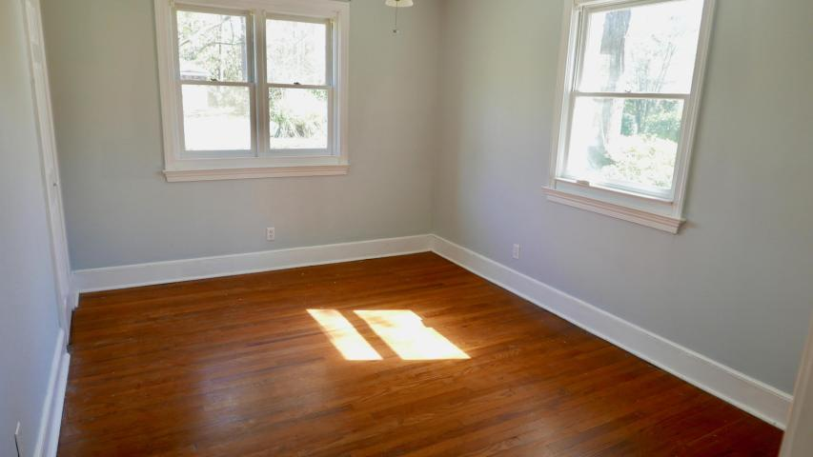
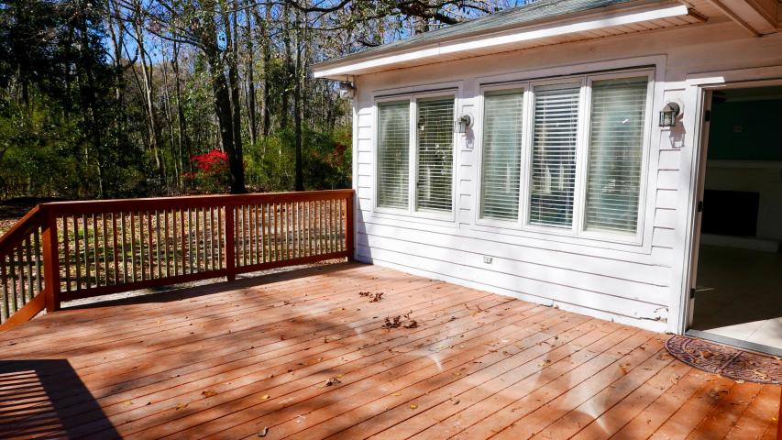
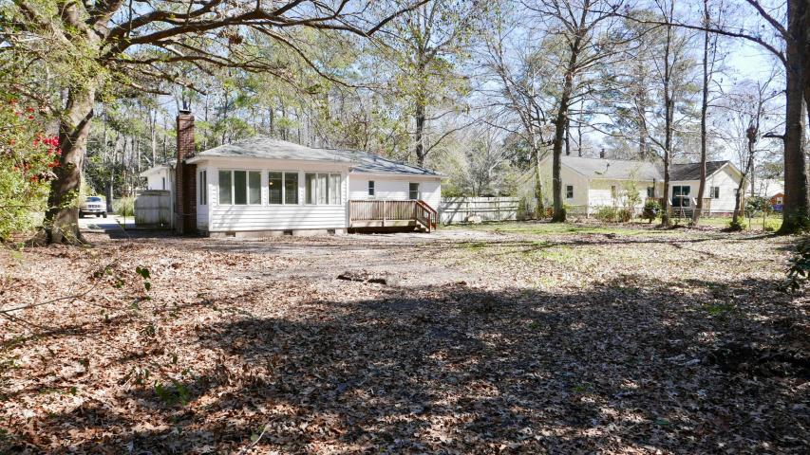


1959 Teakwood Road
Pierpont ~ Charleston, SC 29414
MLS# 17004511 ~ $239,000
SUPER VALUE & SO CONVENIENT with easy access to hwy 526, St Francis Hospital, shopping, restaurants, short commute to downtown or the Airport. BRING YOUR BOAT OR RV...NO HOA here!!! This 3 bedroom 1.5 bath home sits on almost HALF AN ACRE in an established neighborhood. The large deck off the family room leads to a fenced in back yard with mature trees. There are so many possibilities with a yard this size. Hardwood floors throughout except for tile in the bathrooms, kitchen, and family room. Kitchen has granite counter tops and stainless appliances. There is a great utility room with plenty of space for storage. Off of the utility room is a large laundry room. QUIET CONVENIENT STREET!!!
David Andrews
(843) 452-0113
charlestonda@gmail.com
AgentOwned Charleston Group • 902 Savannah Hwy. • Charleston, SC 29407
Real Estate • Mortgage • Insurance

