Slide 1
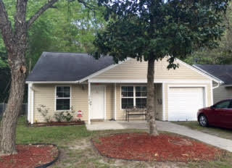
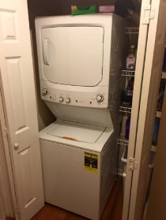
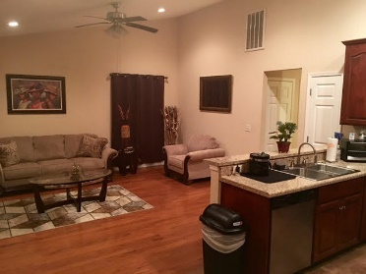
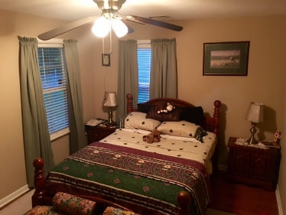
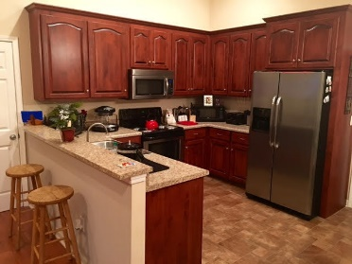
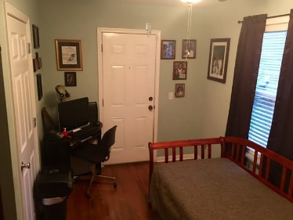
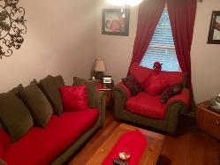
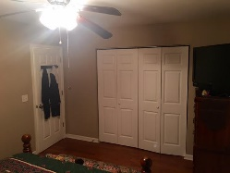
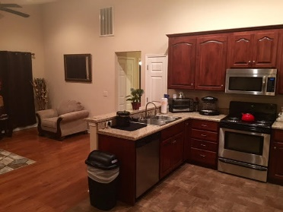
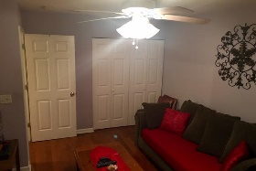
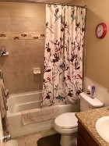
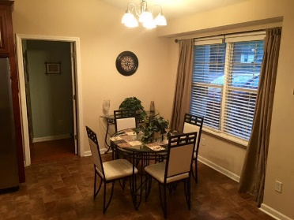
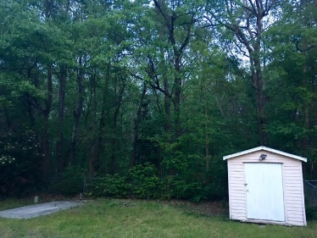

195 Tabby Creek Cir Sangaree Summerville, SC 29483 MLS# 16009672 $129,900 3 Bedrooms | 1½ Baths | 1,050sf
Adorable Home With A Motivated Seller!
Don't miss this little beauty in the Tabby Creek subdivision of Sangaree. This beautifully renovated home features an open floor plan. Enter your new home into the living room, dining area and kitchen area where the new cabinets, hardwood floors and recessed lighting with dimmers welcome you. There are 3 bedrooms, and 1.5 all ready for you to move your clothes right into the closets! The fenced-in backyard is perfect for the kids to play or your family dog to run around. The partial garage is great for storage and there is an extra storage shed in the back yard, which backs up to woods. It is so private in the yard. Come make an appointment today.
Susan & Greg Day
843-900-0477 | 732-757-2904 charlestonbyday@gmail.com
www.charlestonbyday.com
AgentOwned Realty Co. Premier Group, Inc. | 824 Johnnie Dodds Blvd | Mt Pleasant, SC 29464

