Slide 1
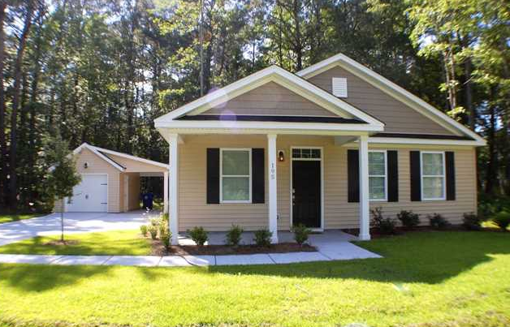
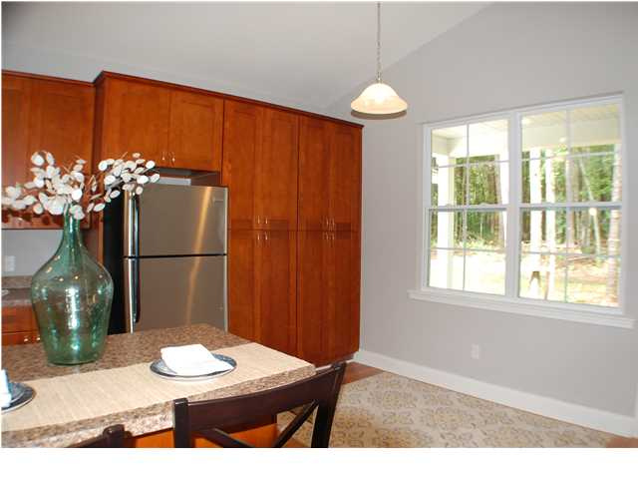
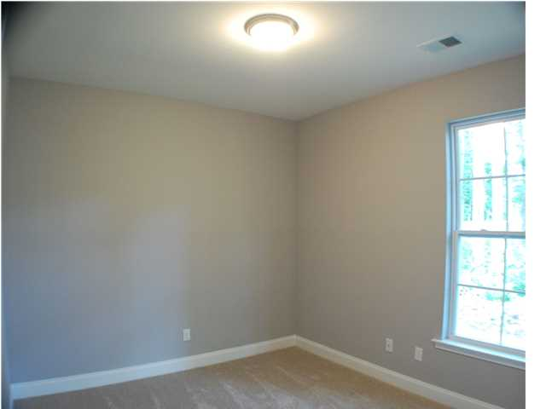
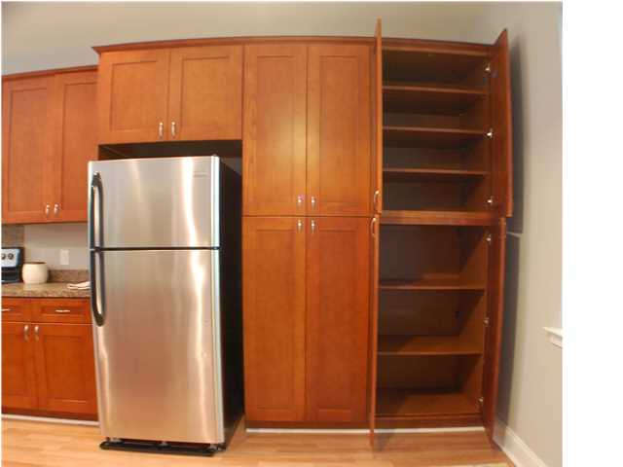
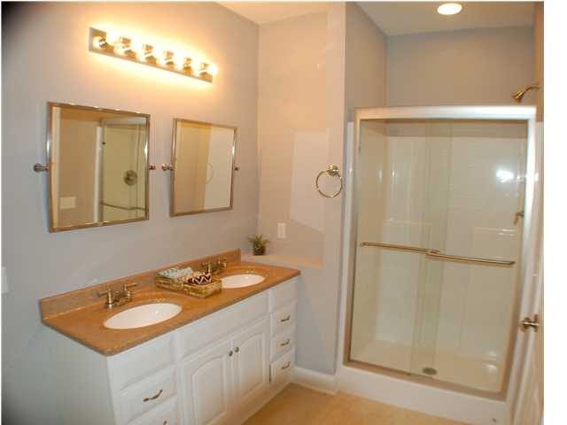
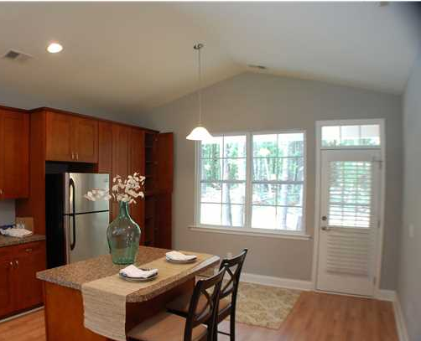
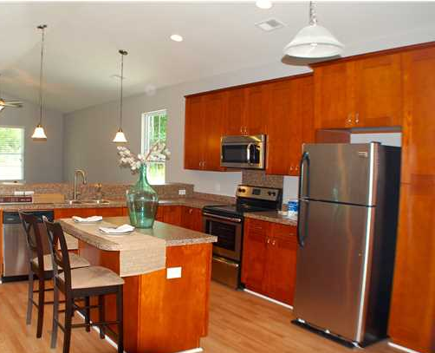
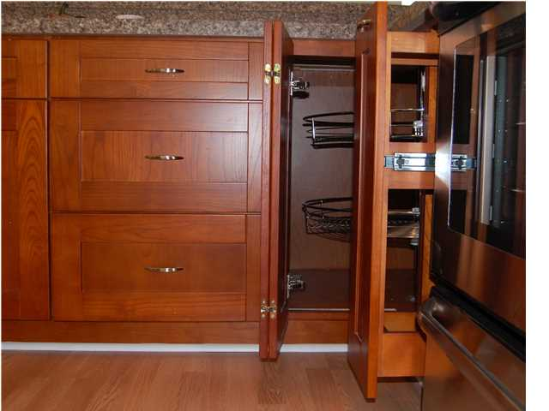
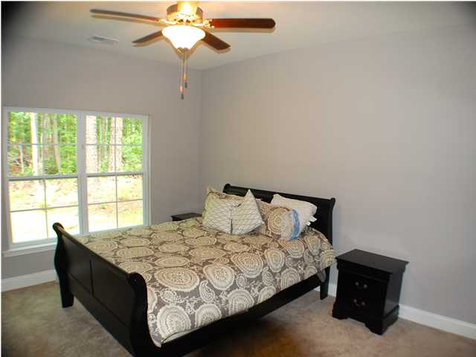
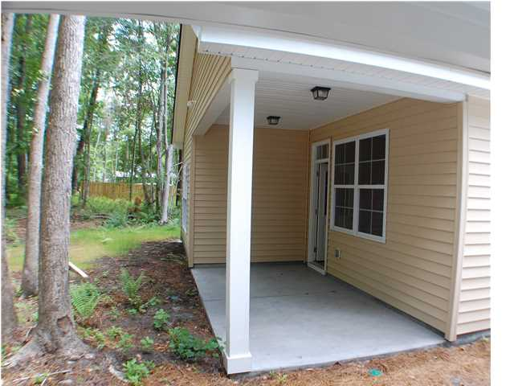
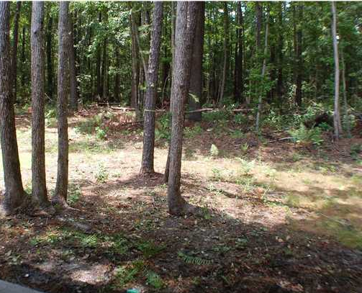
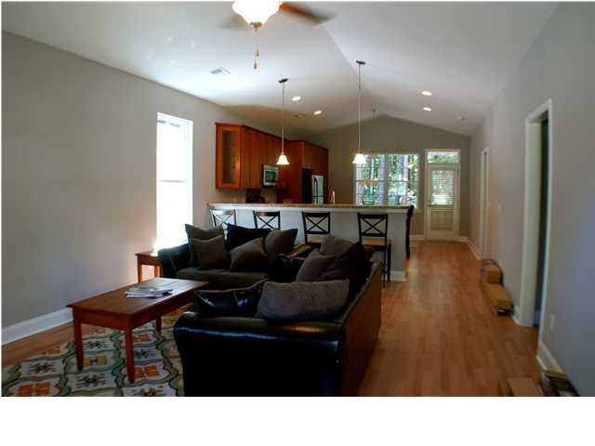
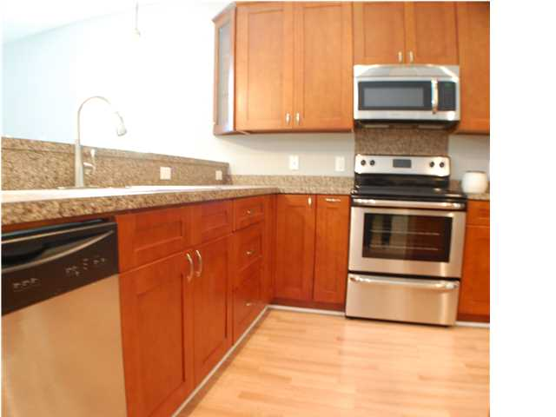


~ New Construction for $149k ~ Bike to Downtown Summerville
195 W Pine St
Lincolnville
MLS# 1415721
$149,900
3 Bedrooms / 2 Baths / 1,376 sf
Prepare to be amazed! Wow KITCHEN and LOCATION. Bike to downtown SUMMERVILLE !! Quality construction OPEN FLOOR PLAN Lincolnville Cottage: a 3Br / 2bath 1-story cottage with a detached Garage. Private wooded view off the back patio. New, beautiful, great price AND Stainless Steel Appliances, Open Floor Plan, High Vaulted Ceilings, Tile Flooring in spacious Baths, Wood Flooring in Kitchen and Living area, Ceiling Fans. So many extras in this house! Only 1.5 miles to Downtown Summerville and short walk to The Park at Gahagan! If you wish a HUGE back yard you can buy more land!
Di Johnson
ABR, EPRO
(843)-270-6448
dijohnsonsc@gmail.com
Keller Williams Realty Charleston
496 Bramson Ct, Ste 200
Mt. Pleasant, SC 29464

