Slide 1
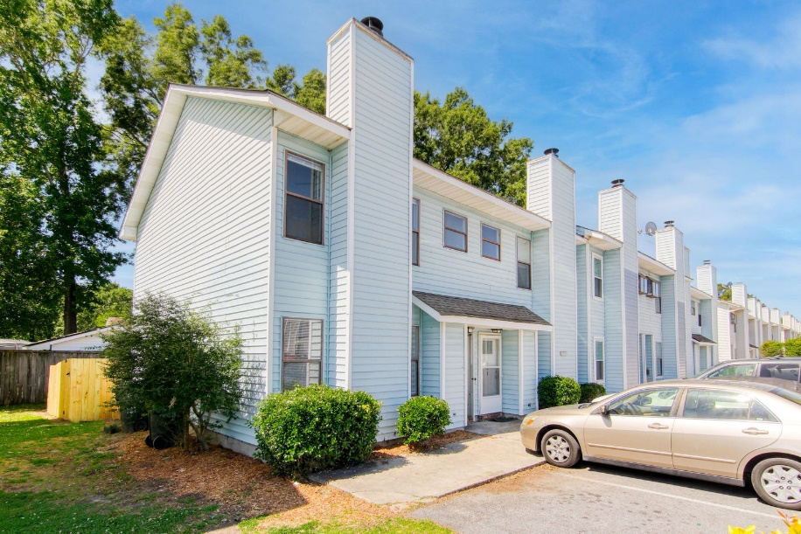
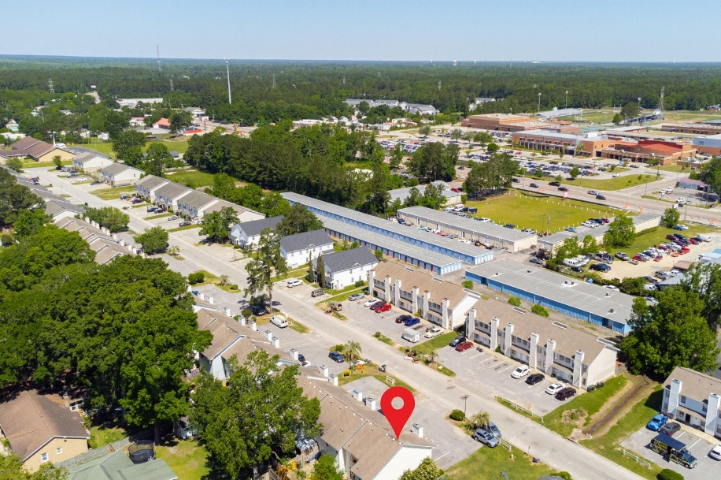
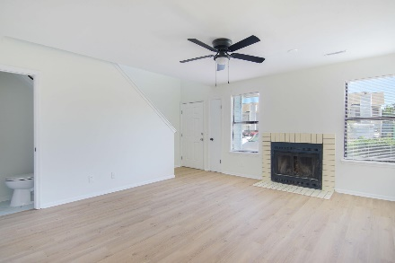
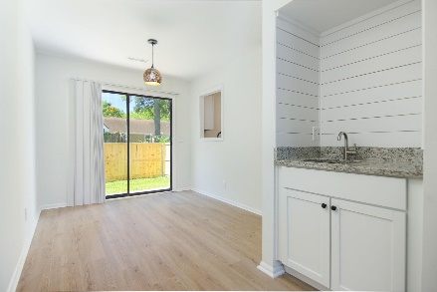
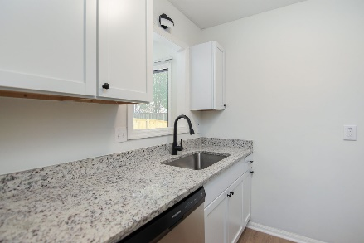
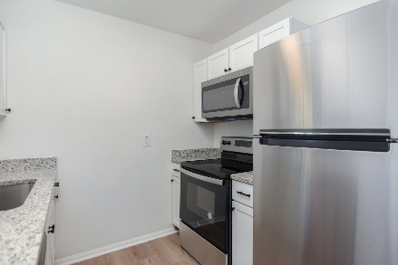
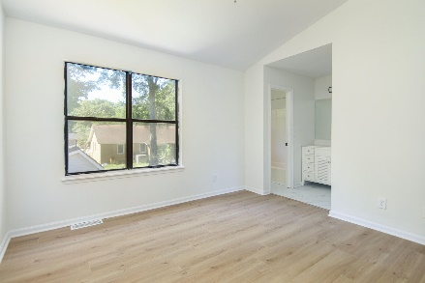
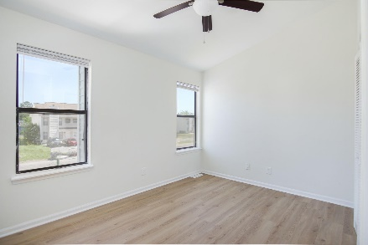
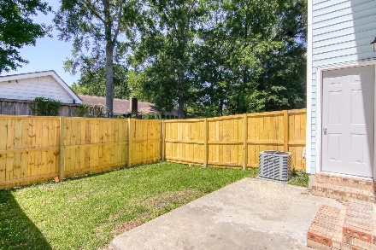
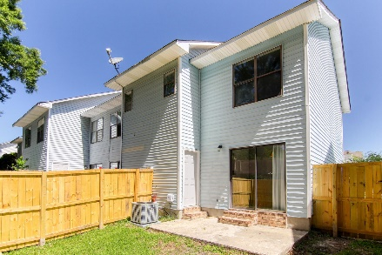



195 Pineshadow Drive Pineland Heights | Goose Creek MLS# 23009853 | $224,500
Renovated End Unit
WHY RENT WHEN YOU CAN OWN? Welcome to your completely renovated dream townhome in Pineland Heights! This ideal end unit home offers a perfect blend of comfort & convenience, with 2 bedrooms and an ample 2 1/2 baths, perfect for familiy or first time buyers. Natural lighting throughout home. Improvements include: New wood laminate luxury plank flooring throughout, new granite (fully equipped) kitchen and bathroom countertops, new hardware, brand new appliances, new wet-bar, all new cabinets, new HVAC, new water heater, new light fixtures and new wood privacy fencing for the backyard/patio area for relaxing. All of these new details create a very low maintenance home that you can enjoy for years to come. Come on by & check this home for yourself.
Susan Stanley
832-323-5573
susancstanley@gmail.com
Brand Name Real Estate
4 Carriage Lane Suite 106
Charleston, SC 29407

