Slide 1
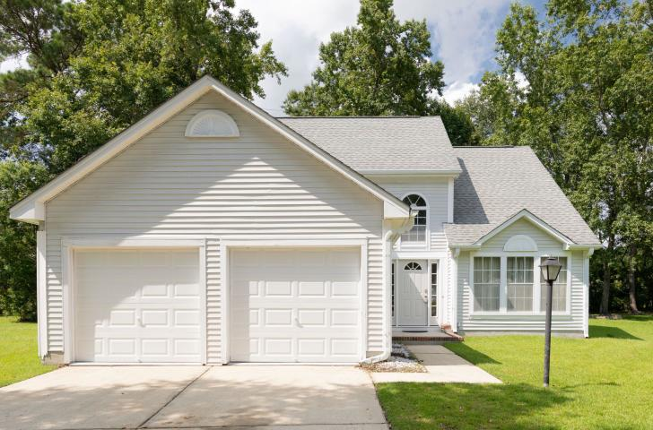
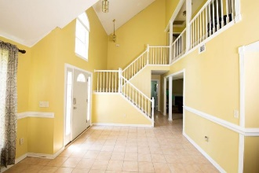
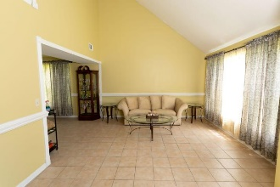
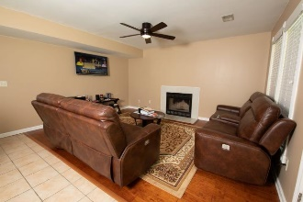
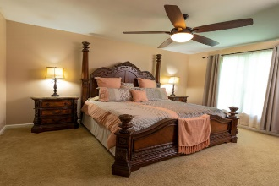
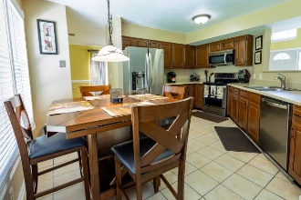
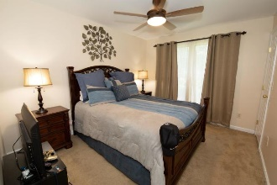
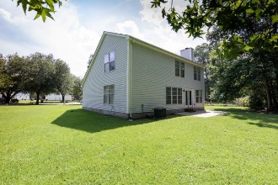
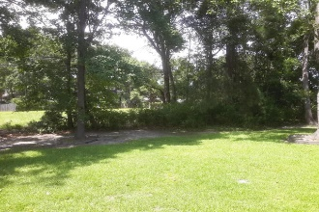
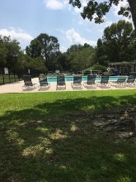
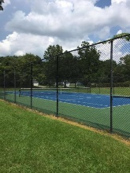


1961 Pebble Creek Court Canterbury Woods · Charleston · MLS# 19022046 · $279,000
Open House Saturday
12:00 until 4:00
Open House this Saturday from Noon until 4
Open House Saturday 8/24/19
12:00 until 4:00
Wonderful home in West Ashley's lovely Canterbury Woods subdivision. The home features 3 bedrooms 2.5 baths, 1996 sqft of living space on a 0.53 acre lot. The countertops, appliances, and cabinets have all been updated. The HVAC is new 2019 . This neighborhood with its gorgeous greenery, mature trees and neighborhood amenities allow for a relaxed active lifestyle for all of your family members. There is a very nice clubhouse, tennis courts, wonderful pool, childrens playground, and a basketball court. Schedule your showing today, this is "the right home in the right place for a perfect new beginning."
James Hopkins
(843) 708-5930
James.Hopkins@AgentOwnedRealty.com
AgentOwned Premiere Group
1800 Trolley Rd
Summerville, SC 29485

