Slide 1
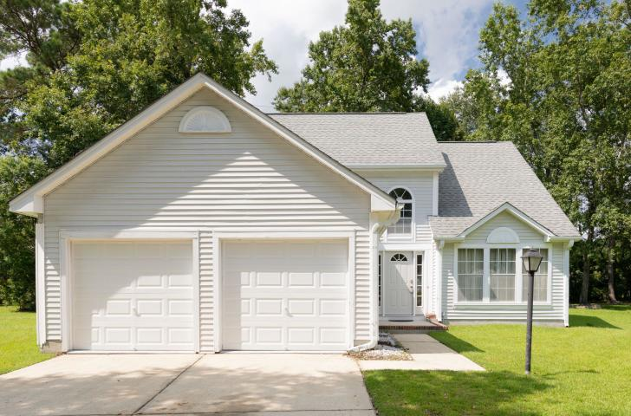
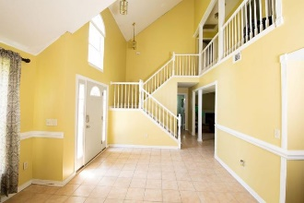
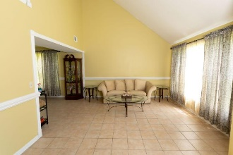
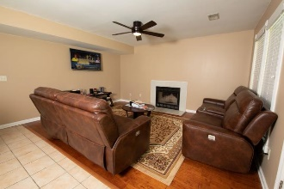
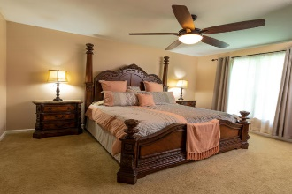
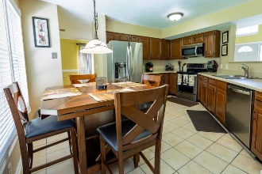
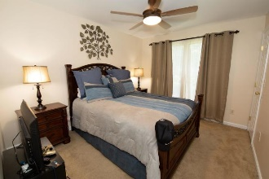
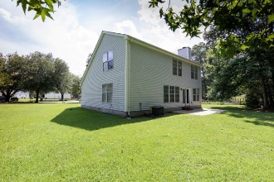
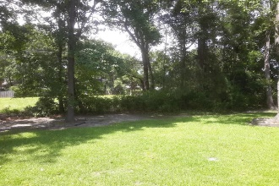
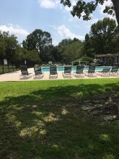
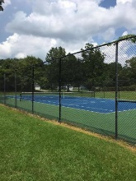


1961 Pebble Creek Court Canterbury Woods · Charleston · MLS# 19022046 · $279,000
The Right Home in the Right Place for a Perfect New Beginning
Beautiful Home And It's Move In Ready!
Great Neighborhood in West Ashley's lovely Canterbury Woods subdivision. The home features 3 bedrooms 2.5 baths, 1996 sqft of living space on a 0.53 acre lot. The kitchen has updated cabinets, countertops and stainless steel appliances.. The HVAC is new 2019 .Spacious back yard ready for barbecues and fun. This neighborhood with its gorgeous greenery, and neighborhood amenities allow for a relaxed active lifestyle for all of your family members. There is a very nice clubhouse, tennis courts, wonderful pool, childrens playground. Schedule Your Showing Today!
James Hopkins
(843) 708-5930
James.Hopkins@AgentOwnedRealty.com
AgentOwned Premiere Group
1800 Trolley Rd
Summerville, SC 29485

