Slide 1
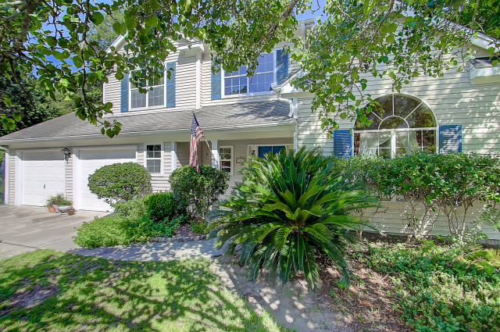
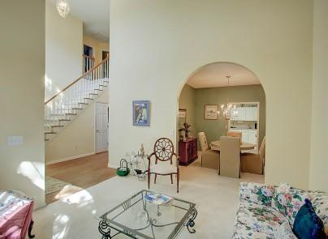
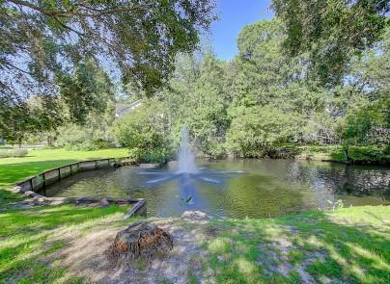
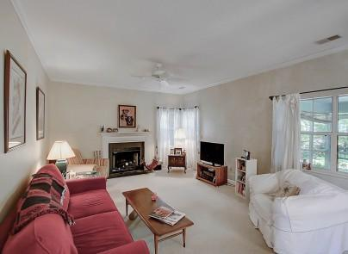
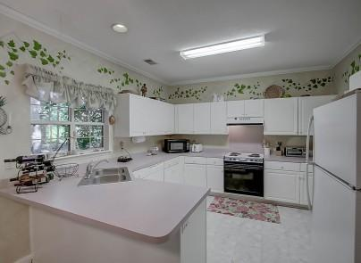
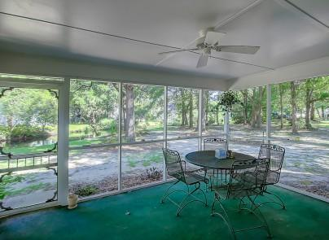


1963 Oak Tree Lane Sweetgrass Mount Pleasant MLS# 16020612 $419,000
Just Listed!
Just Listed!
Spacious, Great Lot and Close to Beach and Shopping
One of the most desirable areas of Mt. Pleasant close to the beach and the ability to walk to shopping. This Sweetgrass home is on a great lot with established trees and is situated beside one of the neighborhood ponds. You will enjoy the spaciousness of this home including separate dining room, living room and the fireplace in the family room as well as the screen porch. Be in the center of Mt. Pleasant and a quick trip to the beach. Make this home your forever home.
Darlene Smith Office - (843) 886-8110
Mobile - (843) 696-7824
darlenesmith@carolinaone.com
DarleneSmithTeam.com
Carolina One Real Estate
1503 Palm Blvd Ste
Isle of Palms, SC 29451

