Slide 1
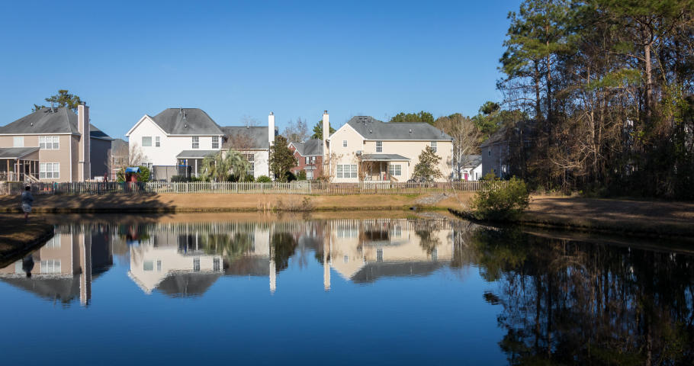
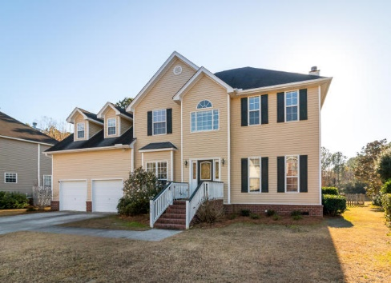
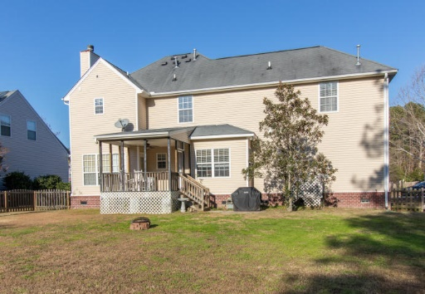
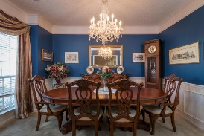
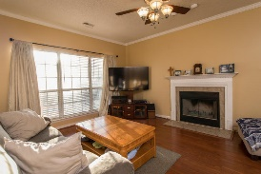
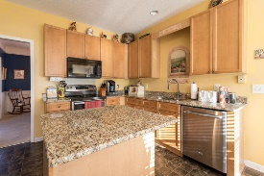
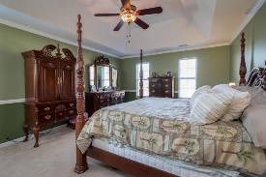
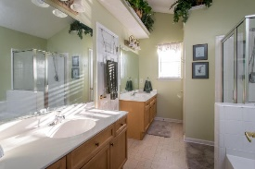
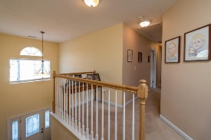
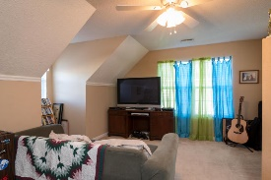

Beautiful 5 Bedroom Home With Excellent Pond View
Offering $1,000 Agent Bonus
1968 N Smokerise Way
Mount Pleasant · MLS# 16031065 · $414,999
You’ll love this gorgeous 2-story home overlooking a scenic pond located in Planters Pointe Community. This 5 br, 2.5 bath home with a 2-stall garage will give you 2545 sqft of generous space without losing that cozy atmosphere. The captivating view of the pond from your couch is the perfect setting for relaxing and entertaining in front of your wood fireplace. The 2-story foyer hosts an elegant formal dining room and office. The spacious eat in kitchen includes stainless steel appliances and granite countertops. Upstairs the divine master suite presents tray ceilings and an ensuite bath with dual vanities, soaking tub, separate glass shower, and walk-in closet. This tranquil property has a covered deck that allows you to enjoy your spacious landscaped back yard with pond view.
Henry Richardson
(843) 696-3155 | hrichardson@ergroupofsc.com
The Elite Realty Group of SC, LLC · 8310-A Rivers Ave · North Charleston, SC 29406

