Slide 1
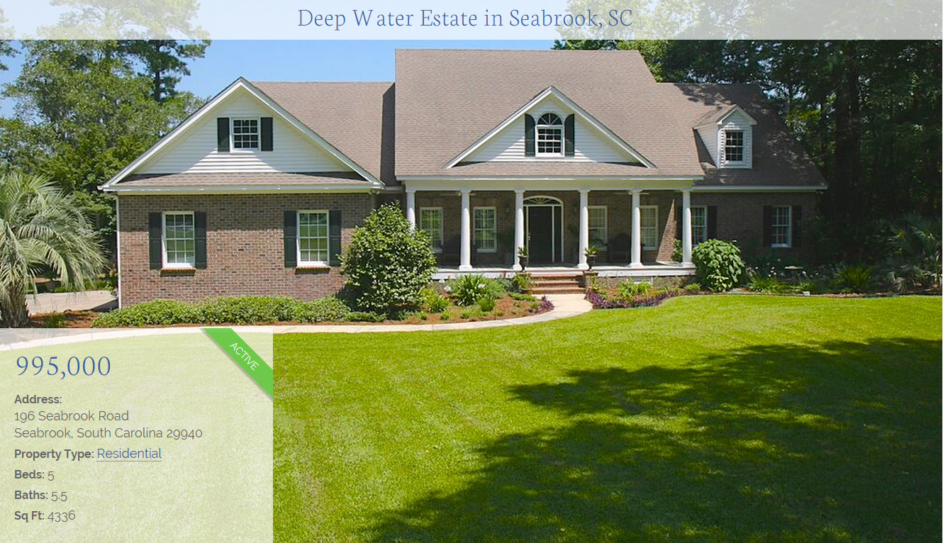
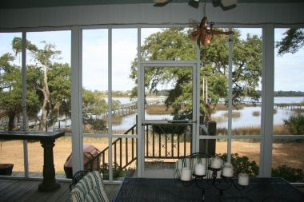
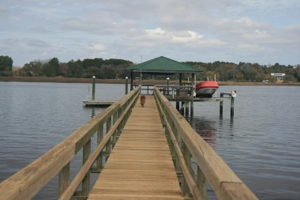
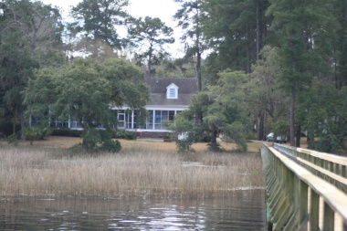

Classic brick colonial on two and one half acres on the deep waters of the Whale Branch River, halfway between Port Royal Sound and Saint Helena Sound.
Oak floors accentuate this flowing floor plan capable of holding large gatherings comfortably yet intimate with the smallest groups, or just a couple.
The main home offers 3 bedrooms on the main floor including the master suite. A jack and jill bathroom splits the two front bedrooms while the master suite, living room, dining room, and kitchen all offer open views of the river.
The kitchen has been renovated and updated with Thermador 6 burner cook top and double convection oven, and a Marvel icemaker. A convenient sitting area adjacent to the prep area means the cook is never cutoff.
The screened porch runs the length of the back of the property with doors from the kitchen, living room, and master suite.
The dock features a 14 x 16 covered pier head with electricity and water, a fish cleaning station, and a 13000 pound Davit Master boat lift.
While the main home features a two car garage, the guest home sits on top of a three car garage with a full bath for cleaning the yard dust off on those days in the garden while upstairs is the guest quarters with separate living, kitchen, and bedroom areas.
For more information and video, go to www.SeabrookWaterfront.com
Scott Bingham
843 321 9867 Office
843 252 2296 Mobile
Scott@beauforthometeam.com
Ballenger Realty
613 Carteret Street
Beaufort, SC 29902
www.BeaufortHomeTeam.com

