Slide 1
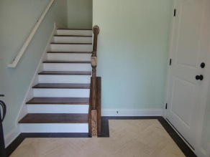
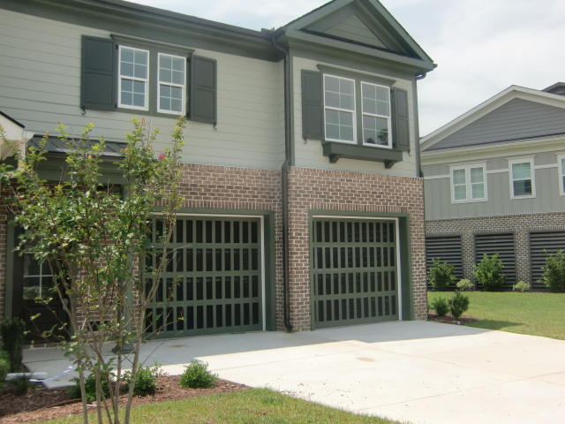
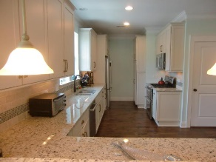
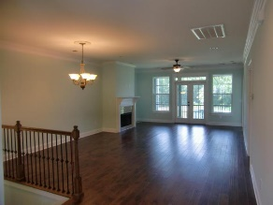
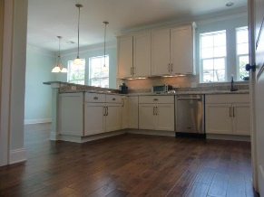
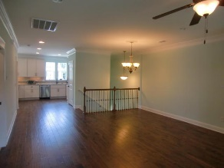
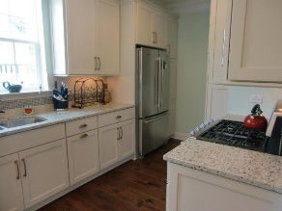
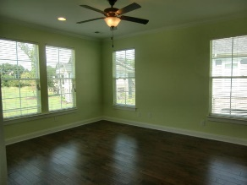
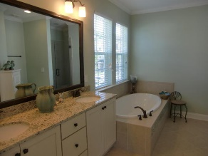
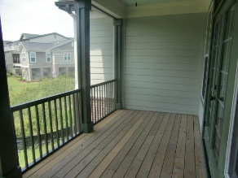
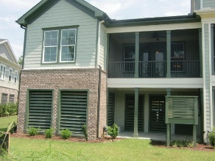
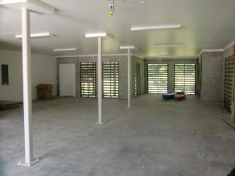

196 Slipper Shell Court Etiwan Pointe ~ Mount Pleasant ~ MLS# 15021843 ~ $420,000
Ready to move in NOW!! One Floor Living In Marshfront Community!!
Move-in Ready!
Located in the heart of Mount Pleasant this luxurious single floor living, corner townhome has all the upgrades you could desire. The kitchen was designed to give more overall space than the original plan called for and includes a breakfast bar, granite countertops, stainless steel appliances including a gas stove, soft close drawers, under cabinet lighting and a decorative backsplash. The expansive kitchen opens to a spacious breakfast room that can only be found in this kitchen design and is the perfect place for family gatherings. The entire home has hard wood floors(NO CARPET)! The master bathroom has a separate soaking tub and shower with glass tile accents. The home also features a screened in porch, back downstairs patio, fireplace, elevator shaft and a garage large enough to store your cars, kayaks and much more. Located only minutes to the beach, downtown Charleston and North Charleston, this location can't be beat! Enjoy the community clubhouse, swimming pool, fitness center, deep water dock and walking trails. This is a must see for anyone looking for a one floor living, completely upgraded, like new, maintenance free life style in the heart of it all!
Michelle Wood
Mobile - (843) 410-3691
michelle.wood@agentownedrealty.com
AgentOwned Preferred Group
824 Johnnie Dodds Blvd
Mt Pleasant, SC 29464

