Slide 1
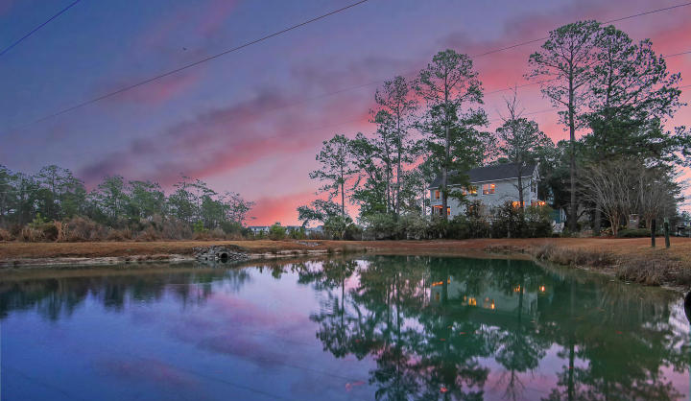

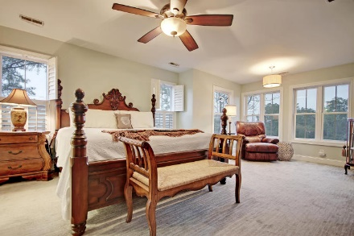
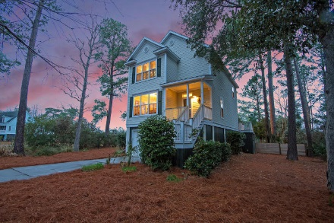
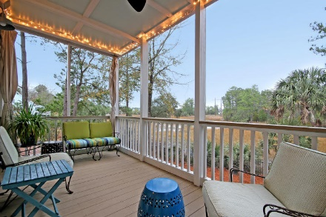
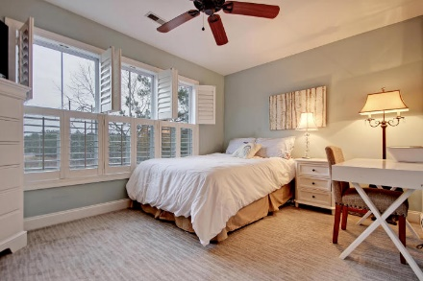
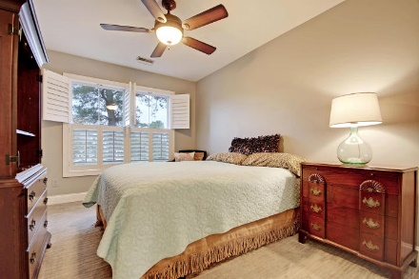
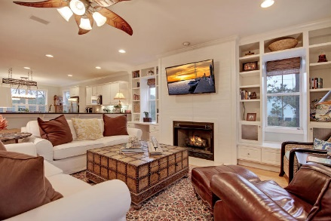
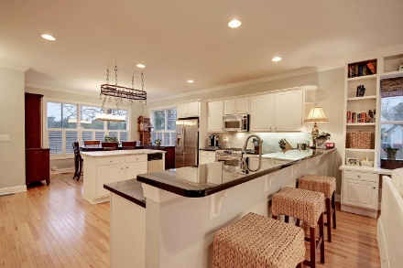
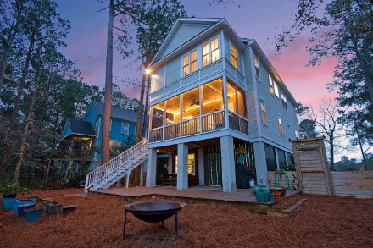
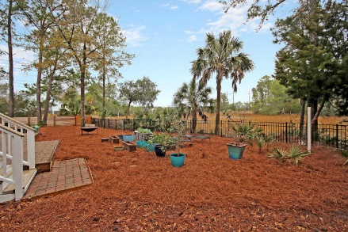
The Ultimate Fishing Getaway
Price Reduced $20,000!
Welcome home to this incredible, marshfront, custom home in the fantastic golf community of Rivertowne Country Club in Mount Pleasant. Here you’ll enjoy the tidal creek and outstanding water and marsh views from 3 sides, and you’ll love up to five feet of water at high tide. Inside you’ll be impressed with water views on both levels, high ceilings, hardwood floors, recessed lighting, and an open concept floor plan. The main living space features a lovely fireplace with built-in shelves on either side, and even includes a built-in desk on one side and a window seat on the other. There is also a wet bar so you can make a quick drink on your way out to relax on the porch. The large kitchen features granite countertops with a tile backsplash, stainless steel appliances, a large island, & an eat-in kitchen. Upstairs you'll find the spacious owner's retreat with a sitting area to enjoy the amazing marsh views, a huge walk-in closet & an en-suite bath with dual vanity, jetted tub & tile, walk-in shower. The upstairs also includes two additional bedrooms and a full bathroom. The garage is the perfect spot to store your boat or other water toys. The bottom level also includes a finished flex space (currently used as an office). Amenities include a community dock, pool, playground, walking trails, tennis courts, & the Arnold Palmer Signature golf course (membership available). This remarkable property won't be around for long. Book your showing today!
1971 N Creek Drive
Rivertowne Country Club ~ Mount Pleasant ~ MLS# 18004066 ~ $489,000
Nate Gainey nate@mattoneillteam.com 843-513-2038

