Slide 1
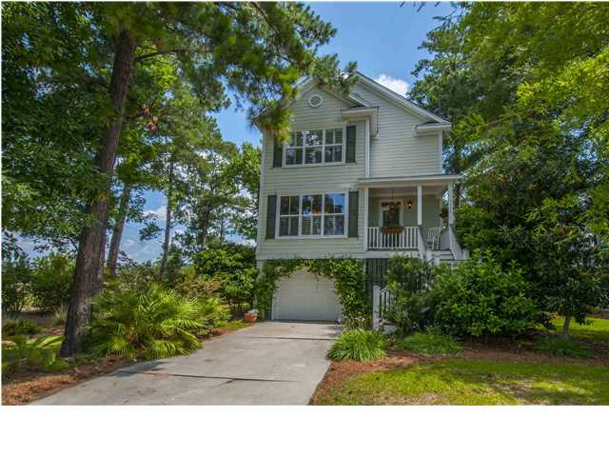
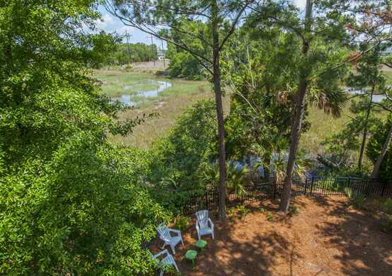
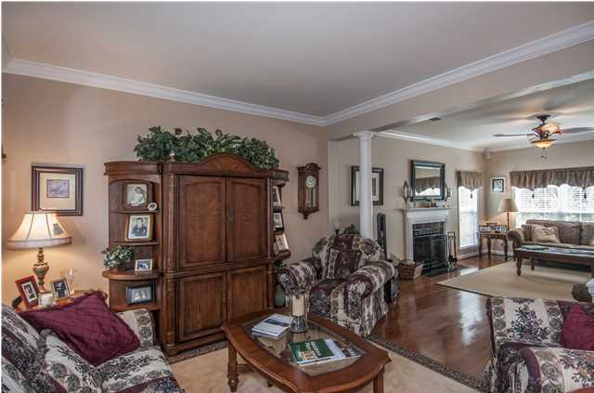
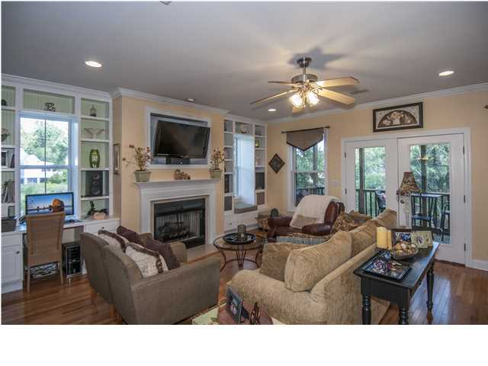
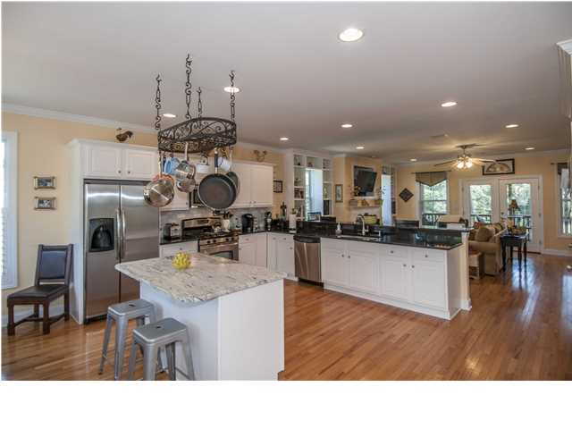
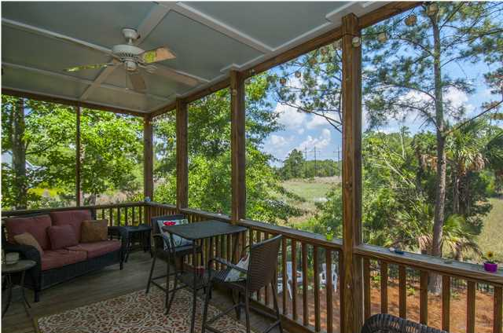
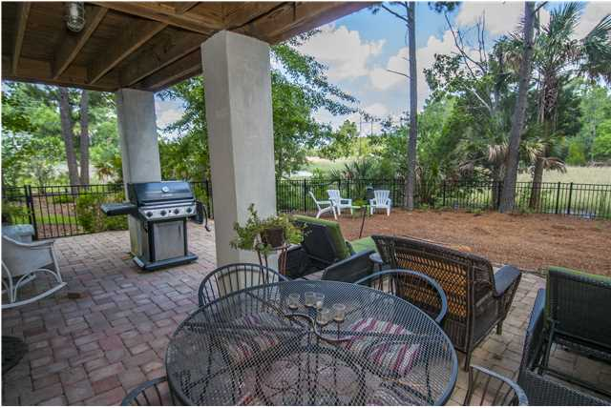

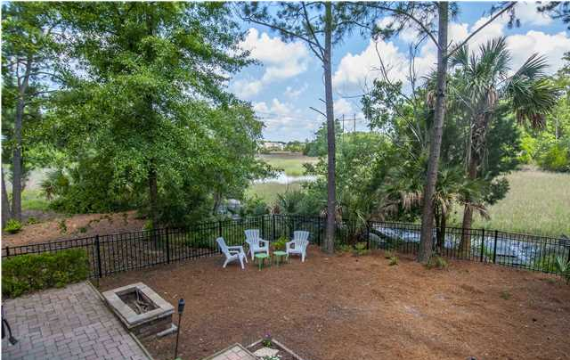

1971 North Creek Dr
RiverTowne CC ~ Mt Pleasant
MLS# 1416406 ~ $479,900
Tidal Creek!
Low Country Living at its Finest! Spectacular custom home on tidal creek and marsh front with approximately 5 ft of water at high tide. The views from your family room and master retreat are absolutely gorgeous! The home has a very open floor plan with hardwood floors throughout the main level and in the upstairs hallway. Gorgeous updated kitchen boasts stainless appliances, gas range & beautiful granite countertops. Separate dining area that is open to the kitchen - great for entertaining. The great room has a gas fireplace, built-in desk, surround sound and a wet bar. Nice lower lever hideaway great for a private office, a quiet playroom or a teen retreat! The oversized master suite has an open sitting room overlooking the beautiful tidal creek with a gorgeous bathroom featuring dual sinks and large shower. And the master closet is just amazing! This home sits on an a beautiful private lot with tidal creek & marsh views behind and a beautiful pond next-door. This subsection has a dock just for The Pointe homeowners. Enjoy tying up your boat or just fish on the Wando River! RiverTowne Country Club is a gorgeous golf course community with swim & tennis! Come see this Low Country Retreat!
Catherine Parker
Realtor
843-814-0551 M
843-202-3678 F
cparker@carolinaone.com
catherineparkersellscharleston.com

