Slide 1
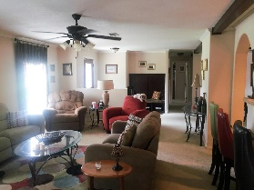
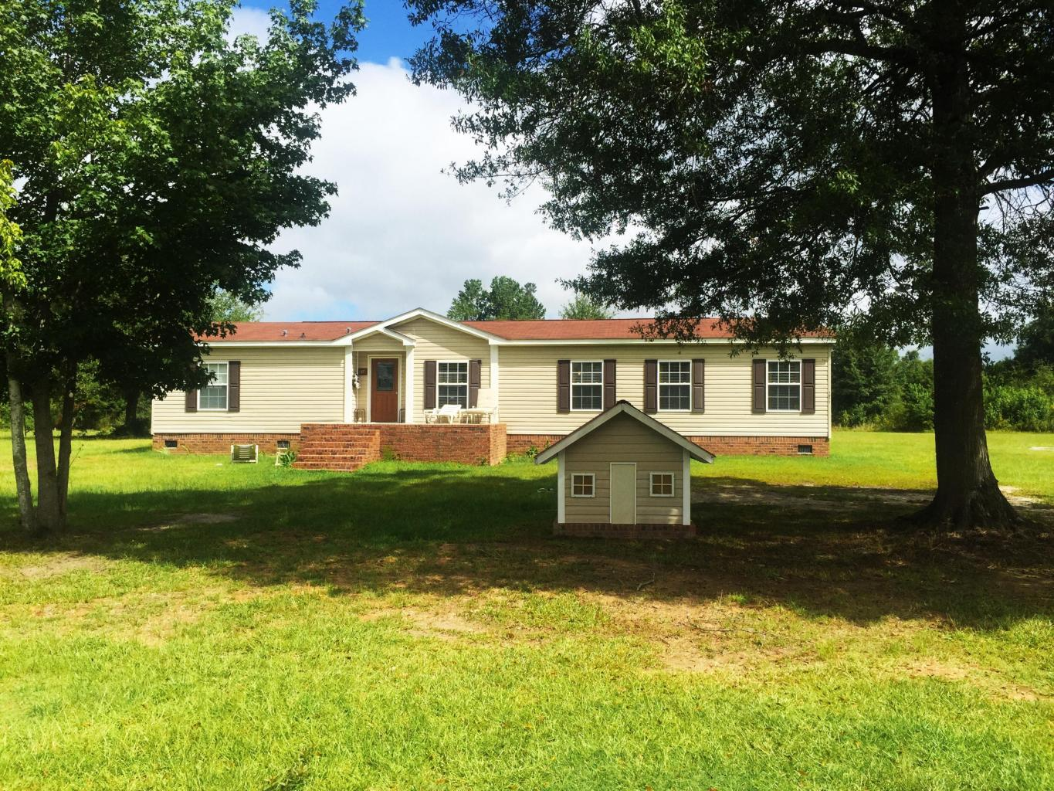
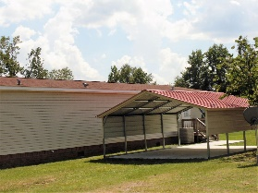
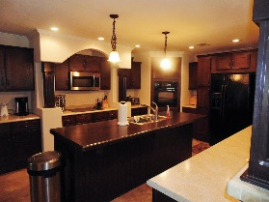
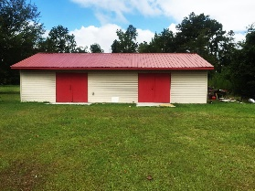
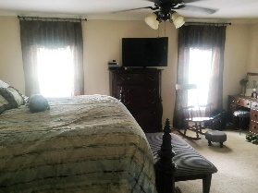
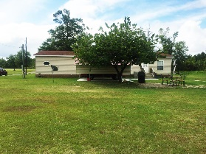
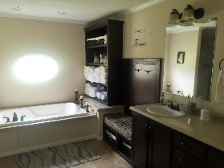
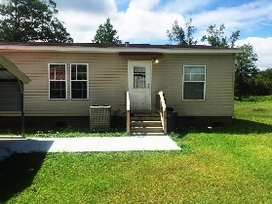
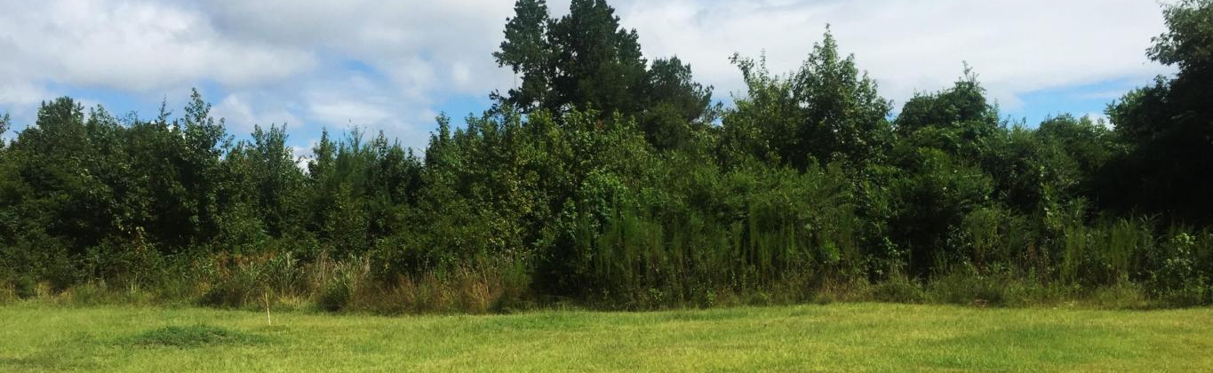


1971 Unity Road Holly Hill, SC 29059 $149,900 ~ MLS# 15025426
6 Acres of Quiet Country Living
Move-in Ready!
Spacious and immaculate manufactured home perfectly situated on cleared 6 acre lot with pond. This home features a large open floor plan with wood, tile and carpet floors, separate dining room with wood beam ceilings and a chef friendly kitchen with large center island open to great room. The master bedroom is a true retreat with large walk-in closet and spa like bathroom inclusive of oversized garden tub with detached shower. Exterior features include a carport with slab, oversized two car garage/workshop, large pond, tons of privacy and private security system with driveway sensor for added safety.
Adam Rafferty
M (843) 424-0610 :: O (843) 884-7300 adam@agentownedrealty.com
AgentOwned Preferred Group | 824 Johnnie Dodds Blvd | Mt Pleasant, SC 29464 | www.agentowned.com

