Slide 1
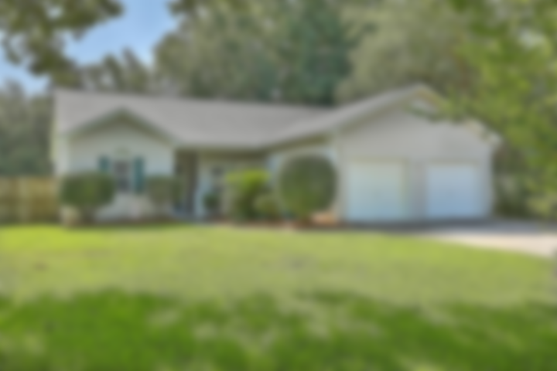
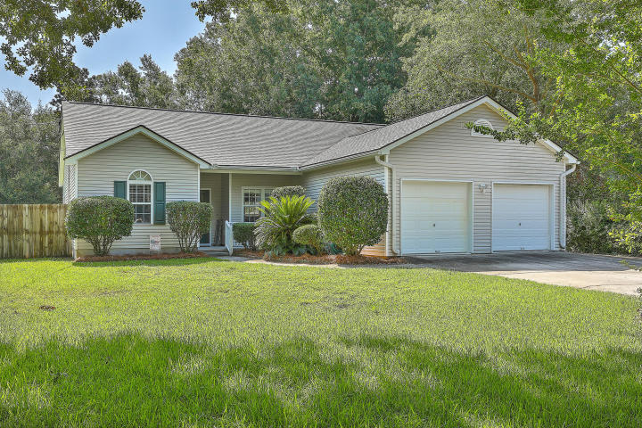
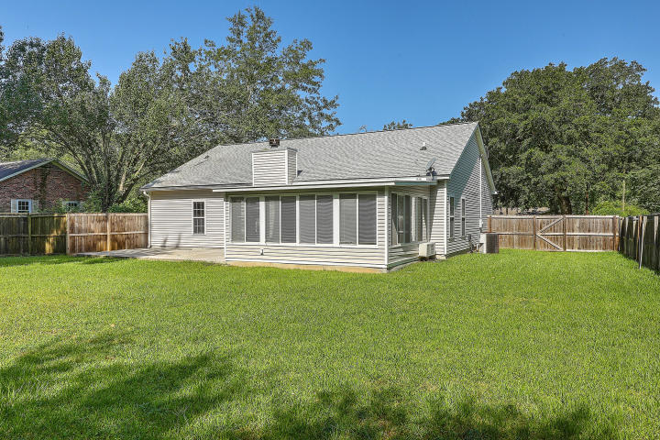
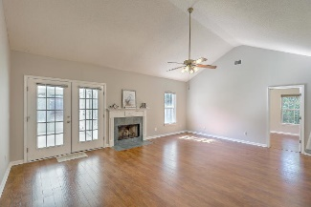
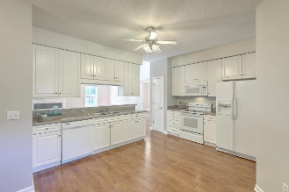
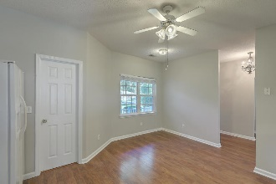
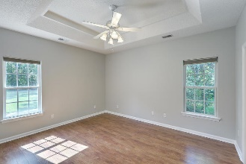
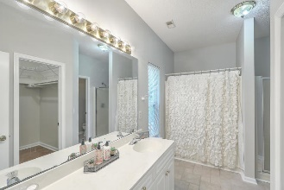
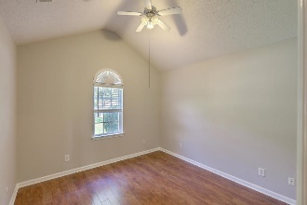
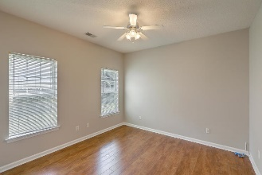
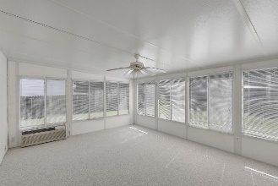
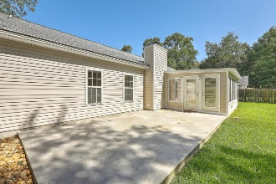
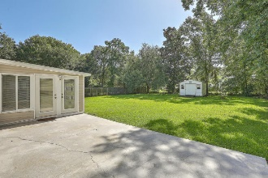

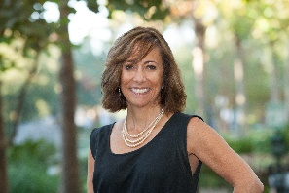
JUST LISTED!
Move-in Ready Home on Huge Lot and NO HOA!
1975 Fruitwood Avenue
Magnolia Ranch | Charleston, SC 29414 | MLS# 20021774 | $297,975
Welcome home to this lovely 1-story, well maintained, freshly painted home. As you enter the foyer, you will be greeted with high quality laminate flooring throughout the whole home. Your spacious eat-in kitchen, which is off to the right and looks out to the Great Room from the breakfast bar, has plentiful counter and cabinet space. The custom white cabinets include pull out shelves and the breakfast area has a bay window that brings in the morning sun. Off the kitchen is the nicely sized Laundry Room and entrance to the 2-car garage. On those cool winter nights, relax by the fireplace in the spacious Great Room which has a vaulted ceiling, offering lots of natural light and leads out to a huge Sunroom via French Doors. Relax and enjoy a glass of wine, after a long day, in the Sunroom while dinner is cooking on the grill on your very large patio in your fully fenced backyard. To the right of the Great Room is the Owners' Suite, complete with double tray ceiling, large walk-in closet with custom shelving, dual vanities, separate shower and tub. Tucked off to the left of the house, you will find 2 additional, spacious bedrooms, one of which has a vaulted ceiling, and guest bath which offers lots of privacy, whether for your children or visiting guests.
Other features include: A well-landscaped yard with beautiful live Oak trees**Lawn irrigation system**Extra driveway parking pad offering plentiful parking when having guests or to store that boat**Garage set up for workshop**A great storage shed in the backyard, perfect to store all of your gardening tools**NO HOA**Walking distance to West Ashley Park**Easy access to 526, Boeing, Joint Base Charleston, MUSC, downtown Charleston, shopping restaurants and more!
Video Tour: http://vimeo.com/444749346
Desiree Maurer
Office - (843) 416-2000
Mobile - (843) 327-9010
desiree.maurer1@gmail.com
www.yourcharlestonhousesearch.com
Keller Williams Realty
496 Bramson Ct Ste 200
Mt. Pleasant, SC 29464

