Slide 1
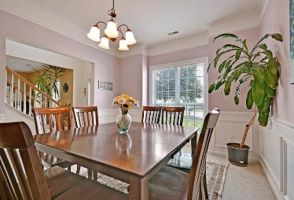
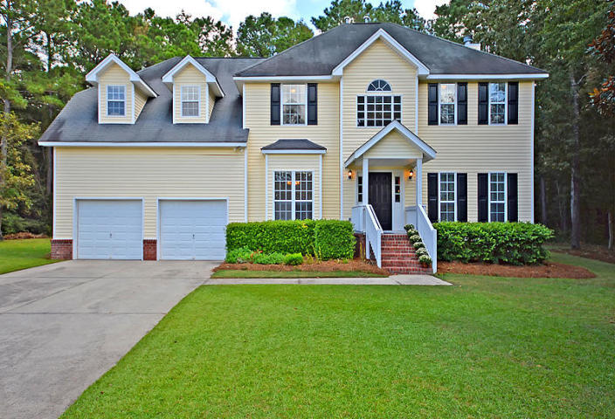
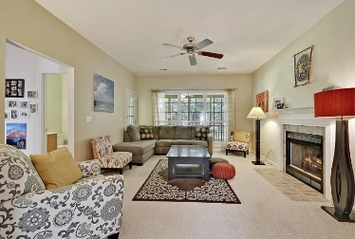
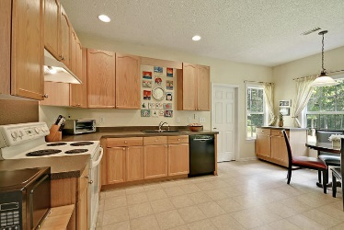
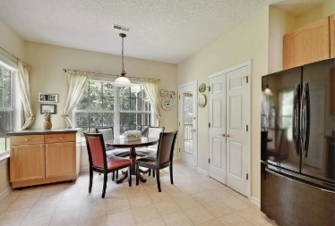
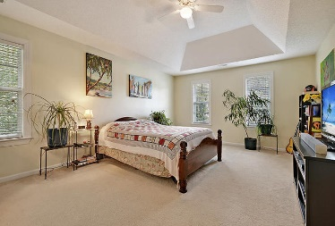
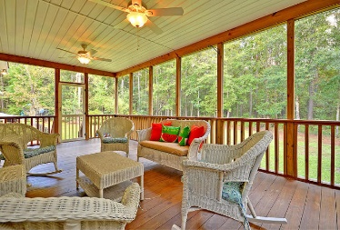
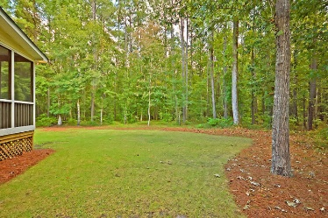
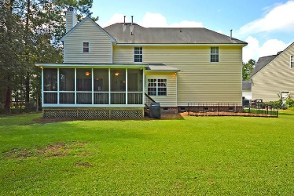

1979 N Smokerise Way Planters Pointe · Mount Pleasant MLS# 18026536 · $385,000
Gorgeous Listing
Just Reduced!
BEAUTIFUL 4-5 bedroom 2.5 bath home on FANTASTIC WOODED PRIVATE LOT! The street appeal of the home is wonderful as you drive up and are greeted with a bricked front porch covered entry. Inside is a GRAND TWO STORY foyer and a bright and airy dining room to the left and a flex room to the right that could easily be an office or separate living area. Continuing in is a big kitchen with pantry, large window, and breakfast nook area. From the kitchen is the family room with a fireplace, wall of windows, and French doors that open to the flex room. The MARVELOUS HUGE screened-in porch is accessible from the kitchen or family room and has GORGEOUS VIEWS of the sprawling lawn and private wooded area. The screened porch is perfect for a quiet cup of coffee in the mornings listening to the birds sing or relaxing after a long day of work. The first floor also has a separate laundry room and guest bath. The oversized master bedroom suite is upstairs and has an ensuite master bath with dual vanities, relaxing soaking tub, separate shower, and walk-in closet. Three additional sizable bedrooms are upstairs, each with it's own walk-in closet, and share a nice full bath. Finally, a there is a FROG that could easily be an office, 5th bedroom or media/game room. Planters Pointe in Mount Pleasant is a wonderfully landscaped community with a play park, tennis courts, walking exercise trails, and Olympic size community pool! The neighborhood is close to local shopping and grocery stores and is a short drive to downtown Charleston with 5-star restaurants, world class shopping and iconic history as well as a short drive to the beaches, the airport, Boeing and Daniel Island. Come take a look because you will not find another home that offers as much as this one.
Stan Huff
843-670-2835 stan.huff@agentowned.com
Jill Marcacci
843-297-5590 jill@agentowned.com
www.agentownedrealty.com
AgentOwned Realty Co. Preferred Group, Inc. | 824 Johnnie Dodds Blvd | Mt Pleasant, SC 29464

