Slide 1
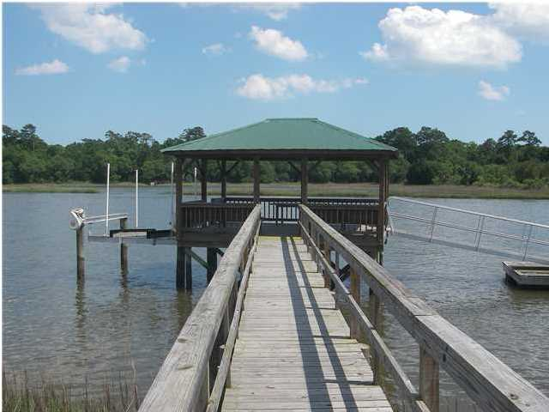
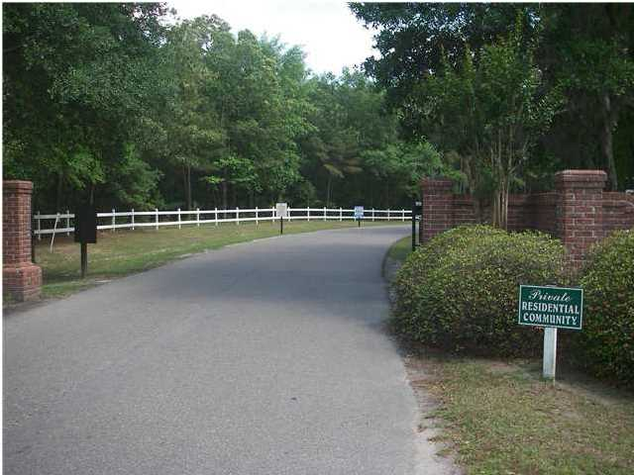
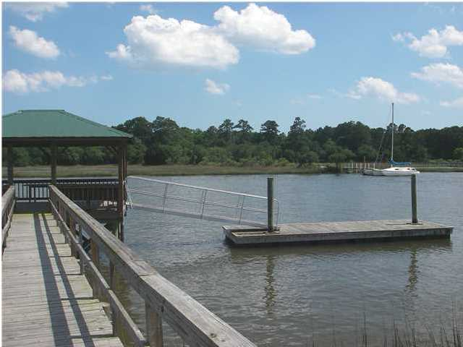
1984 Long Creek Rd
Longcreek Plantation ~ Wadmalaw Island ~ MLS# 1415559 ~ $740,000
Close in Deep Water Lot
$2,000 Realtor Bonus!
Gated community close in. Wooded 3.64 acres high with over 240 ft of deep water on the Bohicket Creek. Newer dock and electric 13,000 lb. lift with a large covered pier head, large floater and handrails on both sides of walkway. Possible owner financing.
Doug Wells
Mobile - (843) 452-5553
dwells.cds@gmail.com
Harbourtowne Real Estate | 672 Marina Drive, Ste 110 | Daniel Island, SC 29492

