Slide 1
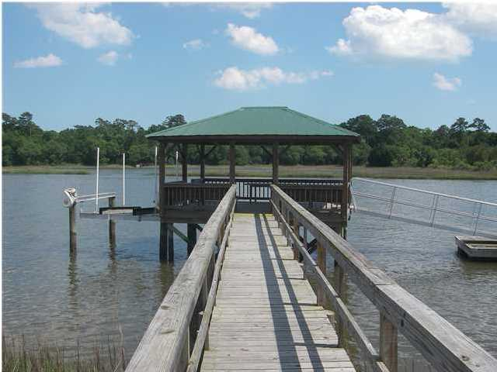
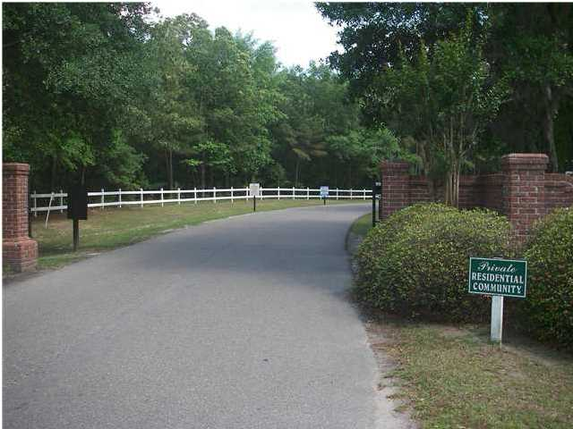
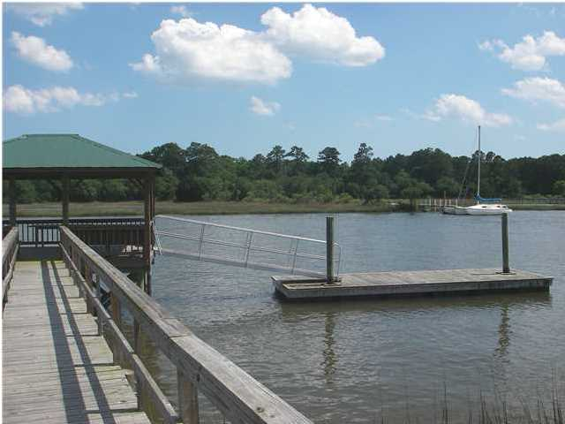
1984 Long Creek Rd
Longcreek Plantation ~ Wadmalaw Island ~ MLS# 15003026 ~ $740,000
Close in Deep Water Lot
$5,000 toward buyer's closing cost.
$5000 agent bonus w/ BIC approval.
Gated Community close in. Beautiful Wooded 3.64 high acres with over 240 ft. frontage on DEEP WATER on the Bohicket Creek with great views. Newer dock and electric 13,000 lb. lift with a large covered pier head, large floater with double anchor poles and handrails on both sides of walkway. One of the closest deep water lots on Wadmalaw! Over $160,000 in dock, floater, pier head, boat lift and clearing... Possible owner financing.
With an acceptable offer, owner to provide well and reverse osmosis filtration system not to exceed $13,000.
Doug Wells
Mobile - (843) 452-5553
dwells.cds@gmail.com
Harbourtowne Real Estate | 672 Marina Drive, Ste 110 | Daniel Island, SC 29492

