Slide 1
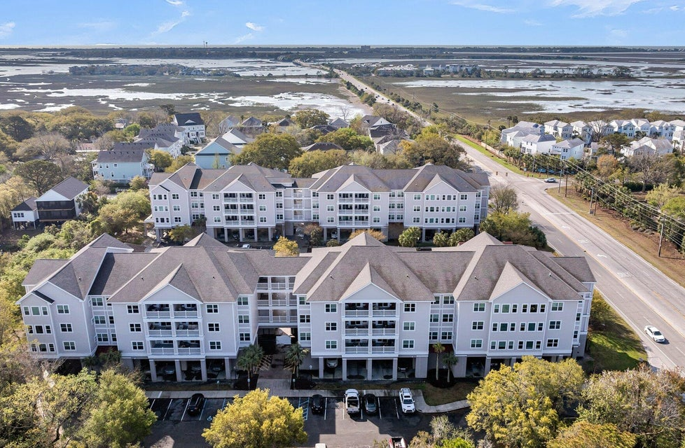
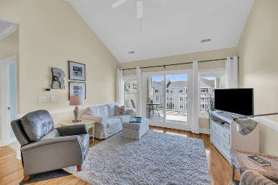
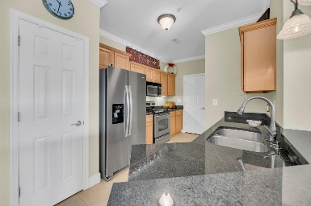
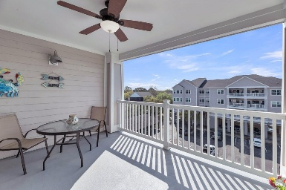
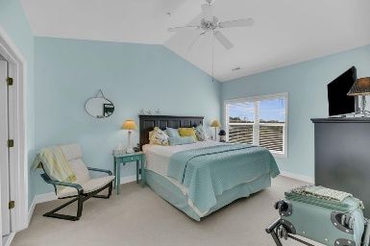
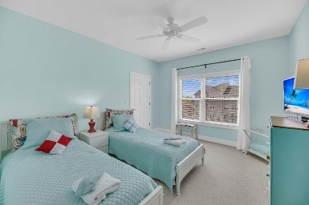


1984 Folly Road A306 Charleston, SC 29412 | $419,000
PELICAN POINTE - BROKER EVENT
Thursday, April 10th | 10:30am-1pm | Light Lunch Provided
2 Bedrooms | 2 Baths | 1133 sqft | Elevator to 3rd Floor
Steve Kaul 843-817-5547
skaul@carolinaone.com
http://www.charlestonhousehunt.com/
Carolina One Real Estate
195 W Coleman Blvd
Mt Pleasant, SC 29464-3495

