Slide 1
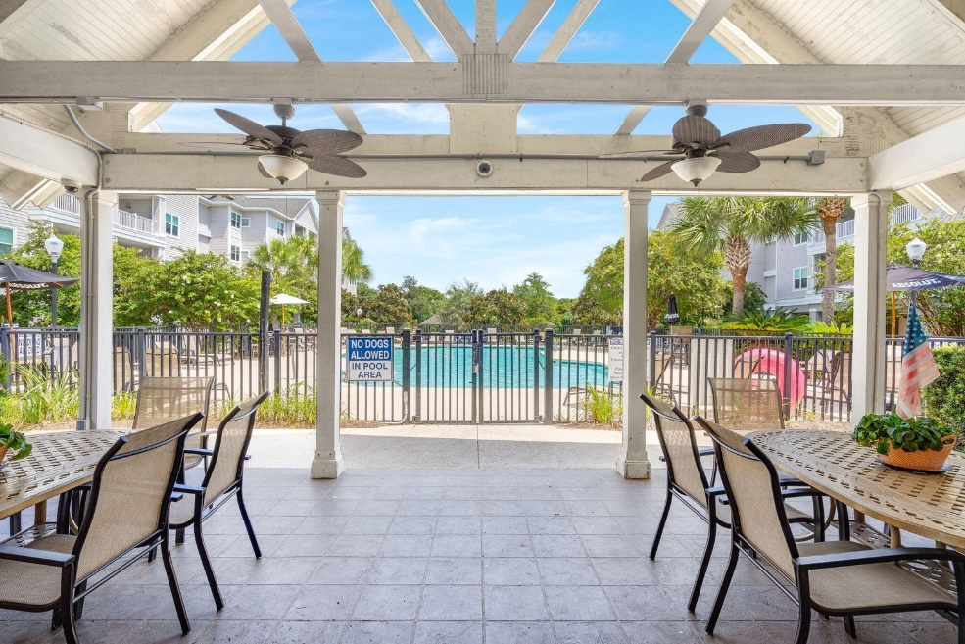
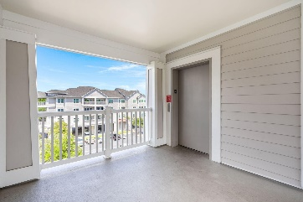
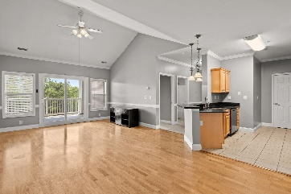
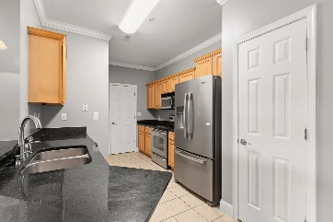
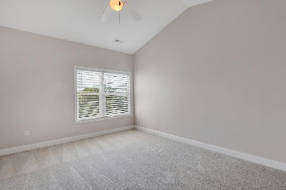
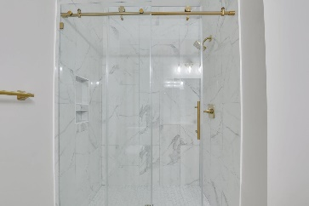
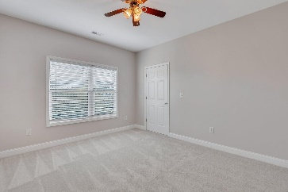
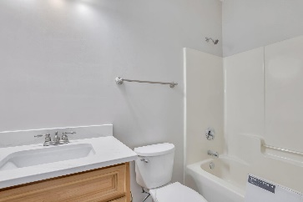
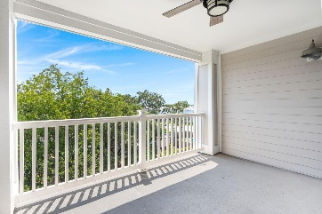
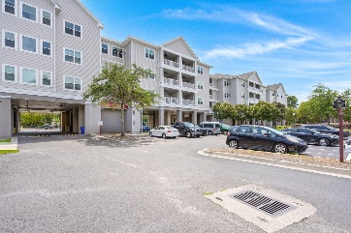
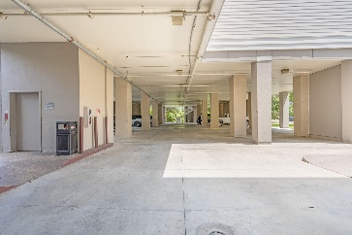



TOP FLOOR CONDO MINUTES FROM FOLLY BEACH
1984 Folly Road B310
Pelican Pointe Villas
Charleston, SC 29412
MLS# 24007617
$425,000
2 Bed | 2 Bath | 1,133 sf
NEW PAINT, NEW CARPET, RENOVATED BATHROOMS! TOP UNIT MEANS GREAT VIEWS, HIGH CEILINGS, AND NO ABOVE UNIT!**
Welcome to this exquisite 2-bedroom, 2-full bathroom top-floor condo nestled in the serene surroundings of Pelican Pointe Villas. Ideally positioned just minutes from the alluring Folly Beach, this unit promises a harmonious blend of coastal living with the luxuries of modern condominium amenities. Step into a luminous living space accentuated by high vaulted ceilings that give an expansive feel and invite an abundance of natural light. The open-plan design seamlessly integrates the living and dining areas, creating a perfect ambiance for intimate gatherings or quiet evenings. The two spacious bedrooms boast ample closet space and are designed to provide an oasis of tranquility.
The master suite, in particular, is a retreat, offering homeowners a private sanctuary to relax and rejuvenate. One of the most striking features of this condo is the generous balcony that extends off the living room. It's the perfect vantage point to enjoy panoramic sunrise views, morning coffees, or alfresco dinners under the stars. Living in Pelican Pointe Villas brings more than just a beautiful home; it brings a lifestyle. Dive into the refreshing waters of the community pool, socialize at the clubhouse, or embark on an adventure at nearby Folly Beach. Moreover, being on the top floor means you have the privilege of unparalleled peace with no overhead noise. Pelican Pointe includes drive-under parking and elevator access to maximize convenience. If you've been seeking a blend of coastal beauty and modern convenience, this condo is your dream come true. Schedule your viewing today and immerse yourself in a lifestyle that epitomizes relaxation, beach life, and luxury. All appliances included in the sale (fridge, dishwasher, range, washer, dryer)! HOA covers exterior maintenance, exterior flood and hazard insurance, termite bond/pest control, pool upkeep/maintenance, elevator, internet, and water and sewer.
Nick Mazzilli (843) 640-5575
nick@nickmcharleston.com nickmavencharleston.com
Maven Realty
2180 McMillan Ave
#71672
Charleston, SC 29405

Slide 2
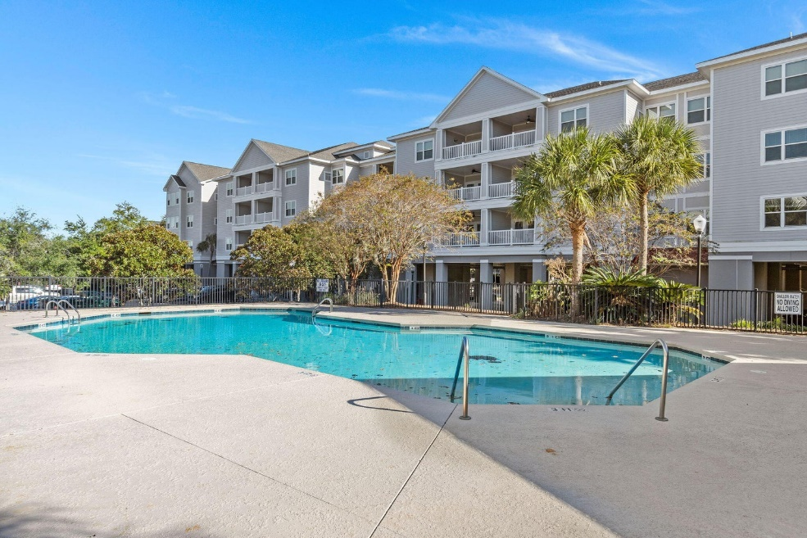
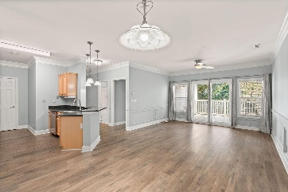
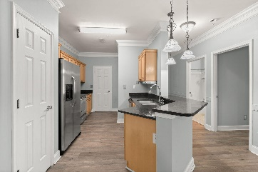
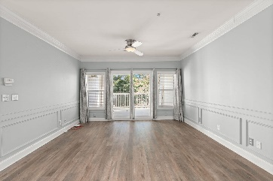
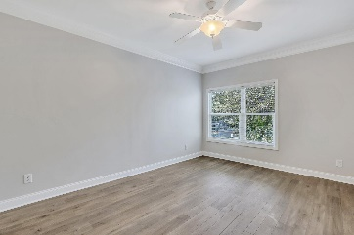
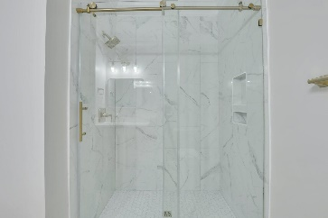
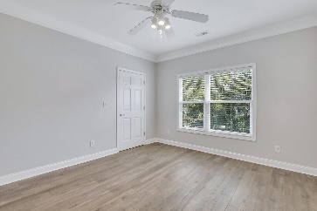
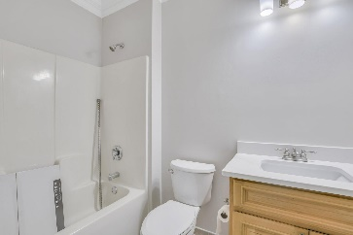
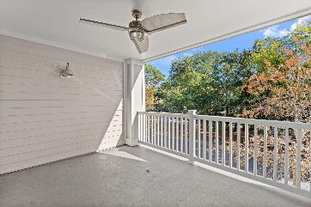
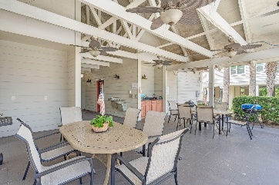
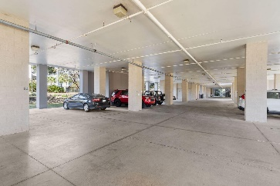
FIRST FLOOR CONDO MINUTES FROM FOLLY BEACH!
1984 Folly Road B111
Pelican Pointe Villas
Charleston, SC 29412
MLS# 24007623
$425,000
2 Bed | 2 Bath | 1,133 sf
NEW PAINT AND JUST RENOVATED BATHROOMS!**
Welcome to this exquisite 2-bedroom, 2-full bathroom first floor condo nestled in the serene surroundings of Pelican Pointe Villas. Ideally positioned just minutes from the alluring Folly Beach, this unit promises a harmonious blend of coastal living with the luxuries of modern condominium amenities. Step into a luminous living space with laminate vinyl plank flooring throughout the entire unit. The open-plan design seamlessly integrates the living and dining areas, creating a perfect ambiance for intimate gatherings or quiet evenings. The two spacious bedrooms boast ample closet space and are designed to provide an oasis of tranquility.
The master suite, in particular, is a retreat, offering homeowners a private sanctuary to relax and rejuvenate. One of the most striking features of this condo is the generous balcony that extends off the living room. It's the perfect vantage point to enjoy panoramic sunrise views, morning coffees, or alfresco dinners under the stars. Living in Pelican Pointe Villas brings more than just a beautiful home; it brings a lifestyle. Dive into the refreshing waters of the community pool, socialize at the clubhouse, or embark on an adventure at nearby Folly Beach. Pelican Pointe includes drive-under parking and elevator access to maximize convenience. If you've been seeking a blend of coastal beauty and modern convenience, this condo is your dream come true. Schedule your viewing today and immerse yourself in a lifestyle that epitomizes relaxation, beach life, and luxury. All appliances included in the sale (fridge, dishwasher, range, washer, dryer)! HOA covers exterior maintenance, exterior flood and hazard insurance, termite bond/pest control, pool upkeep/maintenance, elevator, internet, and water and sewer.
Nick Mazzilli (843) 640-5575
nick@nickmcharleston.com nickmavencharleston.com
Maven Realty
2180 McMillan Ave
#71672
Charleston, SC 29405

