Slide 1
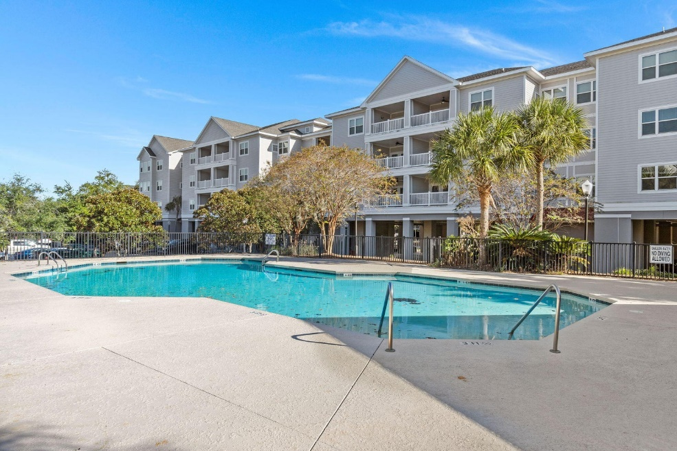
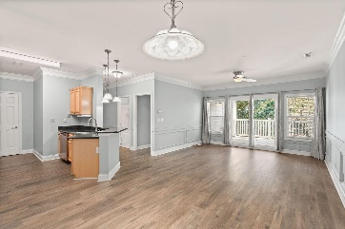
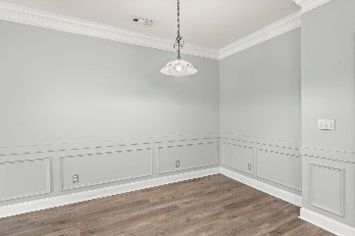
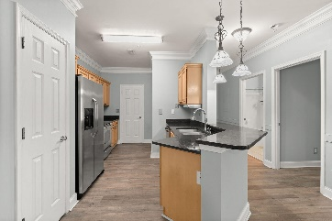
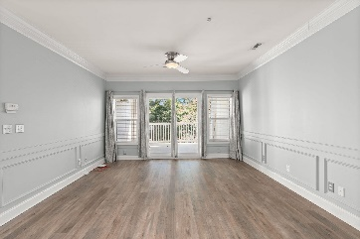
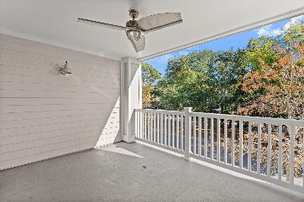
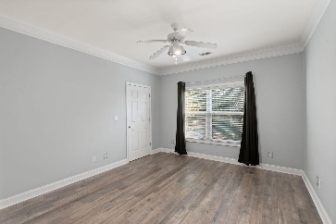
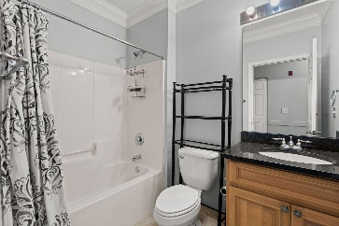
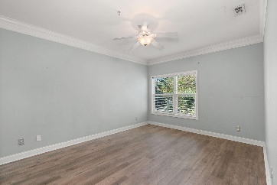
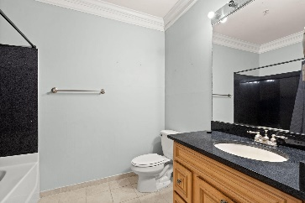
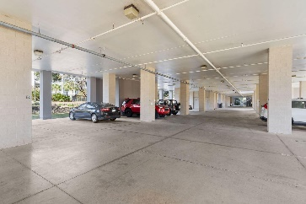



FIRST FLOOR CONDO MINUTES FROM FOLLY BEACH!
1984 Folly Road B111
Pelican Pointe Villas
Charleston, SC 29412
MLS# 23025356
$415,000
2 Bed | 2 Bath | 1,133 sf
Welcome to your dream coastal getaway, just minutes from the sandy shores of Folly Beach! Nestled on the 1st floor of a charming building, this condo offers the perfect blend of comfort, convenience, and relaxation. Step inside the condo, and you'll immediately notice the fresh paint that brightens up the space and creates a welcoming atmosphere. The wainscoting adds a touch of coastal charm, giving the living area a beachy vibe that's perfect for your coastal retreat. The best part? No need to worry about dealing with carpet - this unit boasts all wood floors, creating a clean and allergy-friendly living environment.
The low-maintenance wood floors are not only aesthetically pleasing but also easy to clean, ensuring that your time here is stress-free and enjoyable. Safety and privacy are paramount here, with a gated pool area that offers a peaceful oasis for residents and their guests. You'll love spending your leisure time here, whether you're cooling off with a swim or simply relaxing in the sunshine. The community amenities are truly something to behold. Picture yourself basking in the sun by the pristine pool, surrounded by lush landscaping and palm trees. There's a dedicated area with tables and chairs, ideal for enjoying a poolside snack or a cold drink. And for your convenience, there are restrooms right by the pool, saving you the trouble of going back to your unit. One of the standout features of these condos is that they have elevators to each floor, so it makes a long day at the beach a breeze getting back up to your unit! Don't miss your chance to own this fantastic unit that's just minutes from the beautiful Folly Beach and all the coastal amenities you could wish for. Get ready to make this your new home or your favorite vacation destination! THIS UNIT HAS A DESIGNATED PARKING SPOT UNDER THE BUILDING!
Nick Mazzilli
(843) 640-5575
nick@nickmcharleston.com
nickmavencharleston.com
Maven Realty
2180 McMillan Ave
#71672
Charleston, SC 29405

