Slide 1
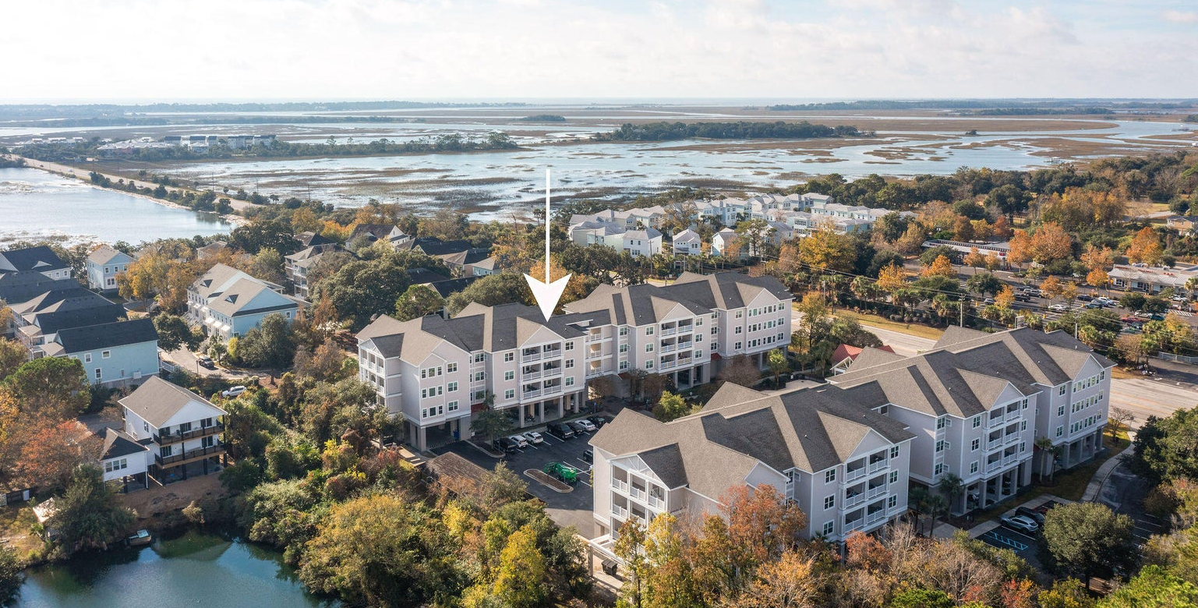
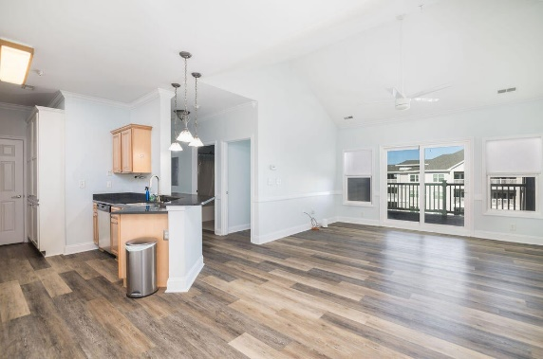
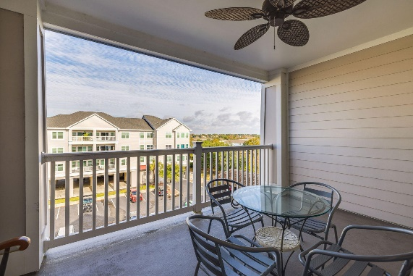
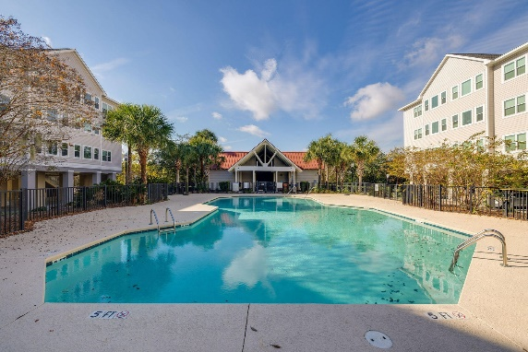

Folly Beach Top Floor Condo
1984 Folly Road B303
Pelican Pointe Villas | Charleston, SC 29412 | MLS# 24010699 | $399,000
Welcome to Pelican Pointe Villas, where coastal elegance merges with modern convenience. A top floor unit, this sanctuary is ideally situated just 2.5 miles from Folly Beach and 8 miles from Historic Downtown Charleston.
This two-bedroom, two-bathroom unit features vaulted ceilings, providing a spacious haven for your Lowcountry lifestyle. Your own private balcony offers tranquil views of Folly Creek and the iconic Ravenel Bridge. Recently upgraded with a new HVAC, luxury vinyl flooring, appliances, and fresh paint, this home is ready to settle into for your year-round vacation.
Take advantage of the community's amenities, including a pool and clubhouse, perfect for relaxation or hosting guests. Pelican Pointe Villas is your coastal sanctuary! Call us to schedule a tour today and embrace a lifestyle of comfort, tranquility, and ease.
Kelly Snyder
843-457-5951
kelly.snyder@agentownedrealty.com
Greg Gelber
843-494-2354
greg.gelber@agentownedrealty.com
AgentOwned Charleston Group | 902 Savannah Hwy | Charleston, SC 29407-7802

