Slide 1
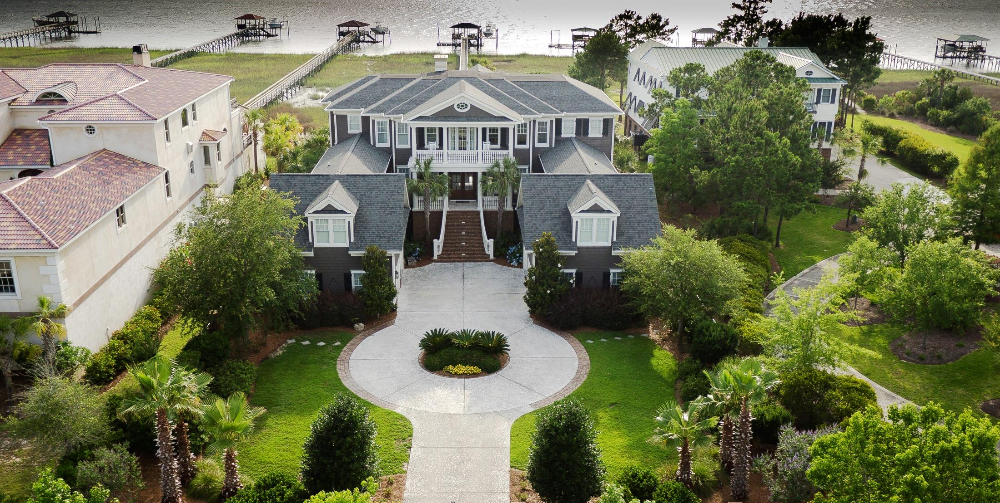
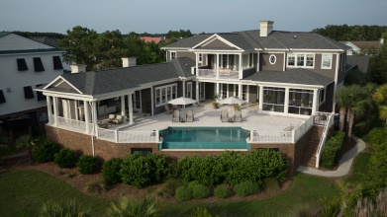

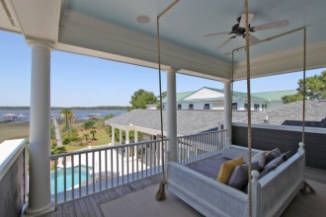


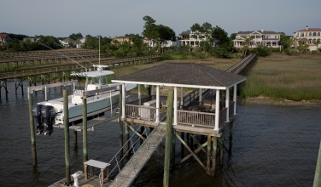
1986 Sandy Point Ln - RiverTowne on the Wando - MLS# 1412549 - $5,000,000
Luxury Lowcountry Living!
Matchless! Meticulous! Memorable! Welcome home to this luxurious, waterfront estate complete with private dock on deep water. You’ve earned the right to enjoy the best!
For more details, please contact
Kimberly S. Ritter, ABR, CRS
843.693.8802 | kritter@carolinaone.com
Carolina One Real Estate | 628 Long Point Rd | Mt Pleasant, SC 29464-3032

