Slide 1
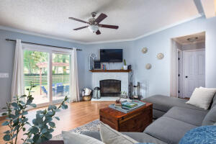
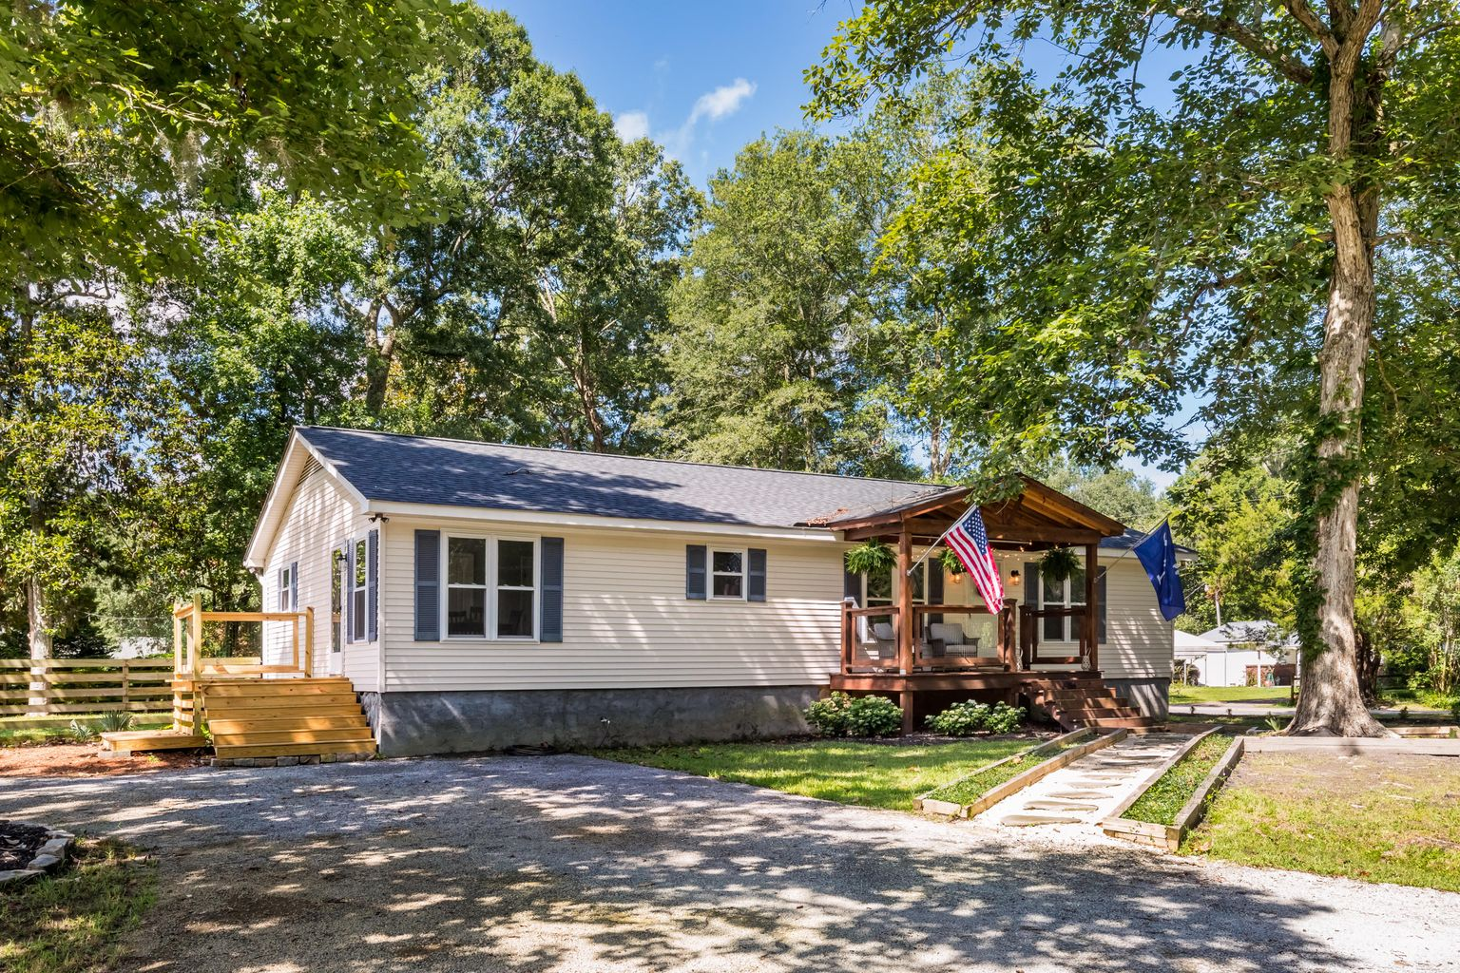
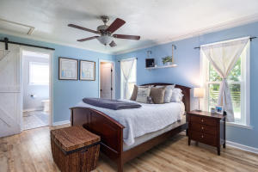
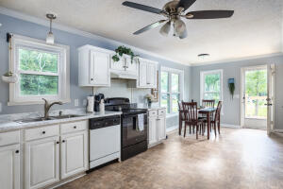
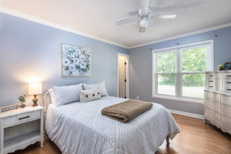
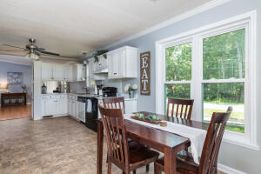
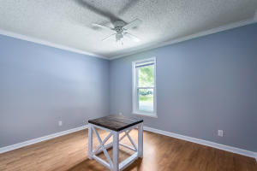
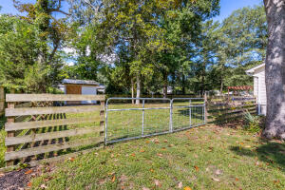
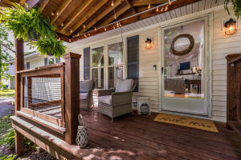
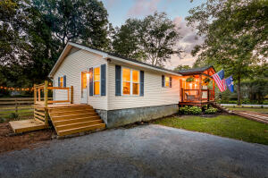
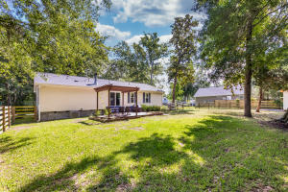


MUST SEE JOHNS ISLAND PROPERTY!
1986 Nitsa Street
Cedar Springs · Johns Island · MLS# 21016389 · $340,000
Welcome home to Nitsa Street. This charming home is a must see with a great floorplan and lot in a wonderful community. The home features a number of updates which include a new roof (summer 2020), new windows (spring 2020), new HVAC (summer 2020), new 8 x 12 shed (2020), a generous front porch (summer 2018) and back porch (summer 2019) and a fully fenced in back yard (fence added summer of 2018). The roof and windows both have transferable warranties.
The first thing that greats you as you walk up to the home is the beautiful and sizable front porch and mature landscaping. Upon entering the home, you are greeted by a spacious and open split floorplan. To your left you will find a spacious kitchen. There is a nice sized pantry and laundry closet off of the kitchen as well as door leading you into the side porch.
The master bedroom sits on the left side of the home and features a newly updated bathroom with beautiful updated tile work and that barn door you've been dreaming of. Walk back through the living room and past the cozy and relaxing woodburning fireplace to the right side of the home and you will find two nicely sized bedrooms and a full bathroom. Both bedrooms feature ample sized closets.
The back yard is truly an oasis with plenty of room to garden, entertain or just sit back and enjoy island life. Located in a peaceful, family friendly and highly sought-after community, this property does not have an HOA. You are just a quick golf cart ride away from several breweries and by car, you are only minutes from a number of amazing dining options and both Kiawah Island and Folly Beach.
Home is manufactured and has been permanently affixed to the property. The seller is currently working to have it detitled.
Keller Williams Realty
Charleston West Ashley
1180 Sam Rittenberg Ste 105
Charleston, SC 29407
Celeste Jones
Realtor
843-345-9387
welcomingyouhomecharleston@gmail.com

