Slide 1
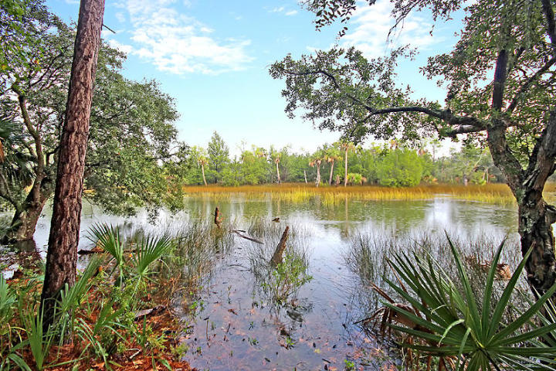
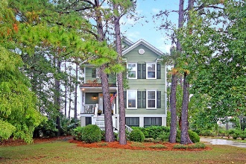
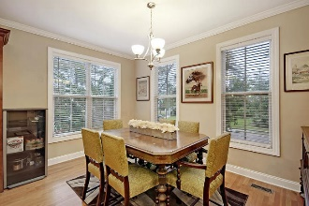
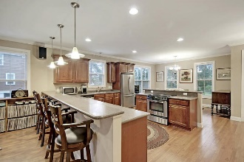
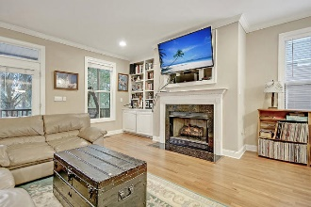
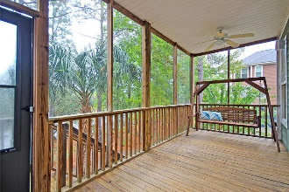
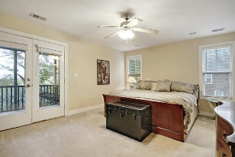
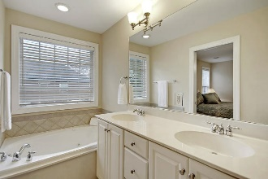
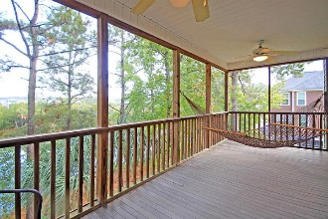
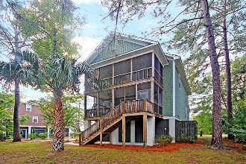
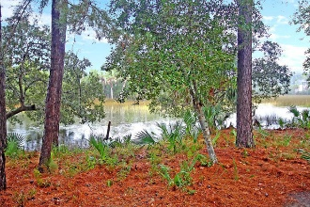

1991 N Creek Drive
Rivertowne Country Club · Mount Pleasant
MLS# 18029565 · $439,000
Launch Your Kayak from the Backyard!
Launch Kayak from Backyard!
Outdoor lover OASIS-kayak starting in your back yard! GORGEOUS tidal creek, marsh front, 3 bedroom, 2.5 bath, elevated, open floor-plan home! Beautiful wood floors throughout the first floor greet you when entering and the entire first floor is OPEN! To the right is the dining area, followed by the kitchen with stainless steel appliances and kitchen island with breakfast bar seating. The family room has a fireplace, large wet bar and is open to the screened-in porch which has TREMENDOUS VIEWS of the tidal creek and marsh. Wood tread stairs lead upstairs. The oversized master suite has access to a PRIVATE DECK that is perfect for an early morning cup of coffee or relaxing on the hammock after a long day of work, walk-in closet, ensuite bath with relaxing jetted tub, and separate shower.
Two additional large bedrooms are upstairs that share a full bath. There is parking for two vehicles and an ABUNDANCE OF STORAGE! Rivertowne Country Club in Mount Pleasant is a wonderfully landscaped community with a play park, tennis courts, community pool, club house and golf course memberships available! The neighborhood is close to local shopping and grocery stores and is a short drive to downtown Charleston with 5-star restaurants, world class shopping and iconic history as well as a short drive to the beaches, the airport, Boeing and Daniel Island.
Stan Huff
843-670-2835
stan.huff@agentowned.com
Jill Marcacci
843-297-5590
jill@agentowned.com
www.agentownedrealty.com
AgentOwned Realty Co. Preferred Group, Inc. | 824 Johnnie Dodds Blvd | Mt Pleasant, SC 29464

