Slide 1
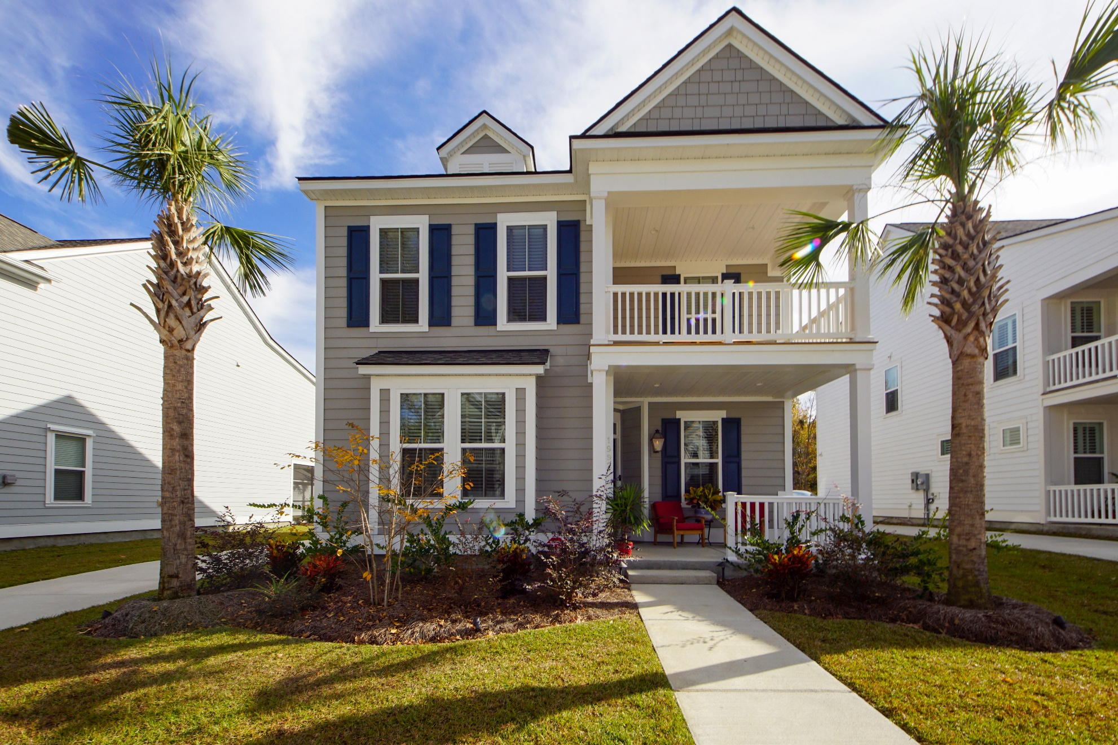
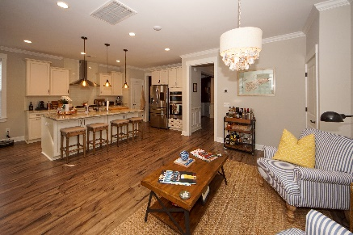
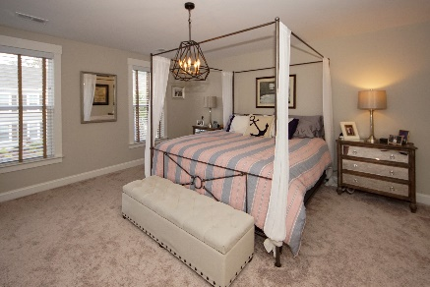
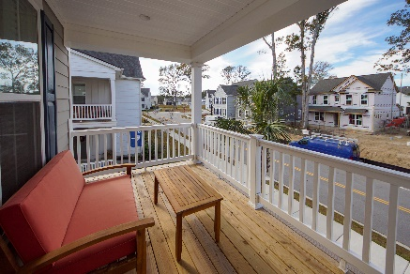


1992 Shadetree Boulevard Oakfield :: Johns Island, SC 29455 MLS# 20002556 :: $412,500 4 Bed / 2½ Bath
Why Wait For New Construction!
Just Listed!
Built in 2019 The Magnolia floor plan is available now and this home is loaded with up grades!
Double porch, top level kitchen cabinets with granite counters, gas cook top, custom lighting, luxury flooring and more!
Seller installed a 6ft privacy fence and this home is professionally landscaped with gorgeous palms and lowcountry planting.
Sellers are able to close quick so the new owner can enjoy their summer on Johns Island!
Connie White, Broker
843-532-3356
connie@chrepros.com · conniewhiterealestate.com
Charleston Homes · 597 Old Mt. Holly Road · Suite 301 · Goose Creek, SC 29445

