Slide 1
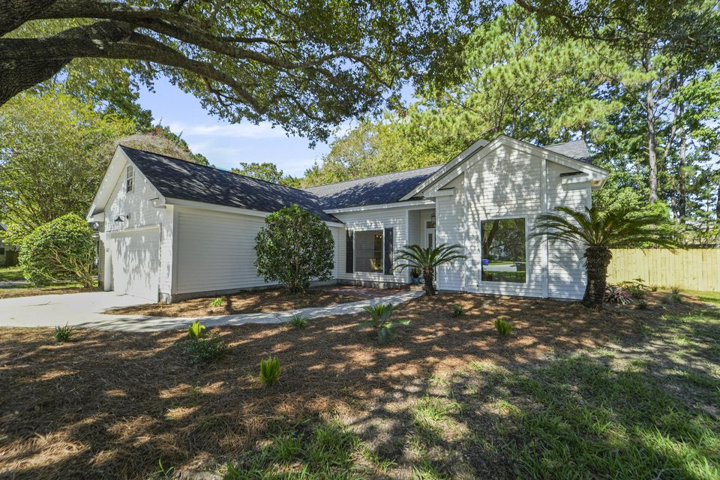
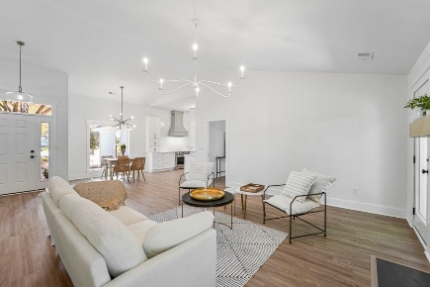
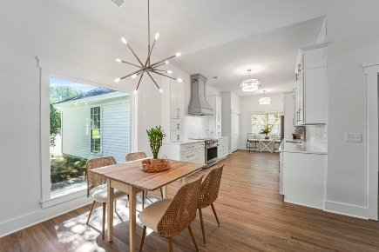
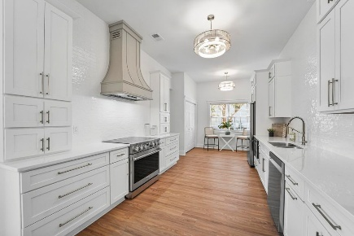
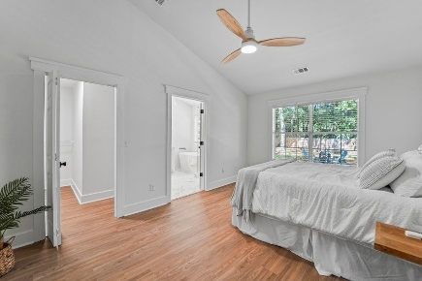
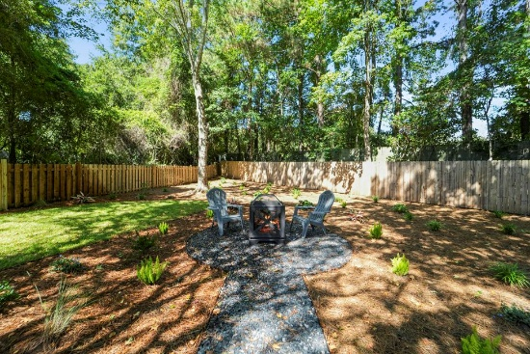






1993 Gray Battery Court
$779,900
Sweetgrass · Mount Pleasant, SC 29464 · MLS# 25024297
HEART OF MOUNT PLEASANT – ONE-LEVEL RENOVATED 3B/2BA RANCH
PRICED TO SELL, WON'T LAST LONG!!
PROPERTY FEATURES:
3 Bedrooms
2 Bathrooms
1,541 Sq Ft
Welcome home to this immaculate, top shelf renovation located conveniently in the heart of Mt. Pleasant, and only 7-10 minutes to the sandy beaches of the Isle of Palms/Sullivans. No expense was spared from adding a new roof/hot water heater/HVAC/opened up floor plan & remodeled kitchen completely/new LVP throughout/scraped ceilings & fresh paint, wood burning FP, 2 car garage, end of a cul-de-sac with tons of privacy (new privacy fence with gate to enclose the yard for pets/kids/parties/privacy, etc. Also, a new landscaping plan & tree work was done throughout the property to shows off its' stunning (yet low maintenance) curb appeal. Excellent open floor plan with vaulted/high ceilings in the Living Room/Kitchen/Master, and light pouring in the new picture windows and gleaming floors.
HAYNES JOHNSON
843-864-8159
haynes.charlestonproperties@gmail.com haynes.findhomesforsaleincharleston.com

