Slide 1
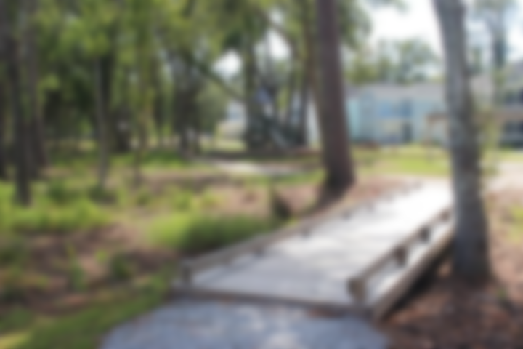
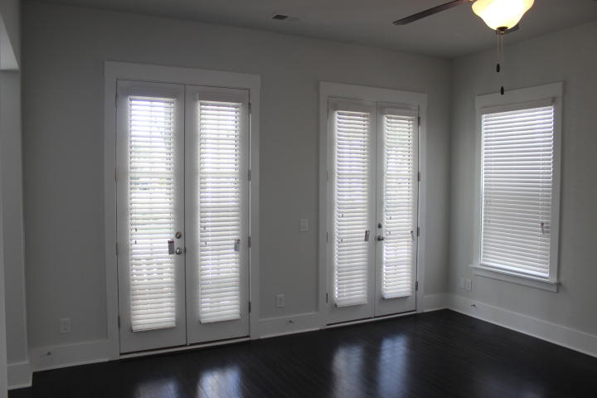
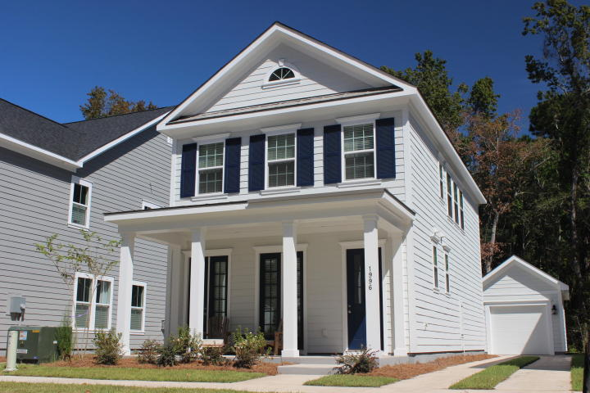
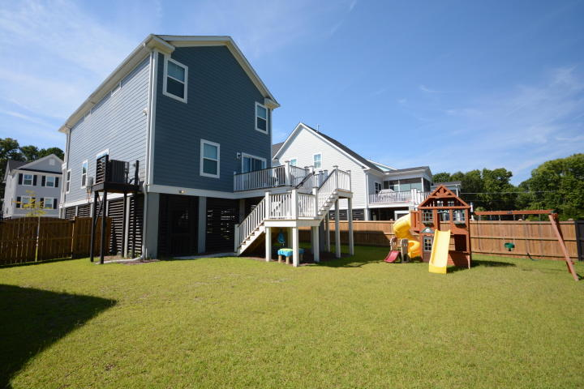
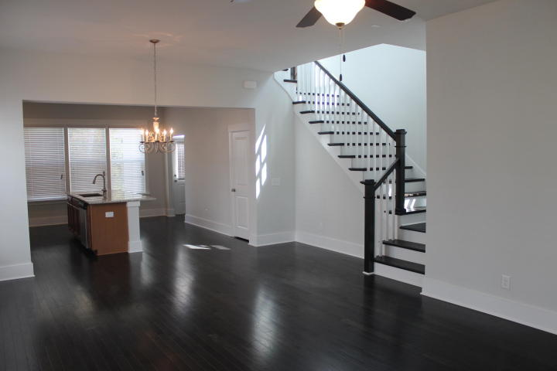
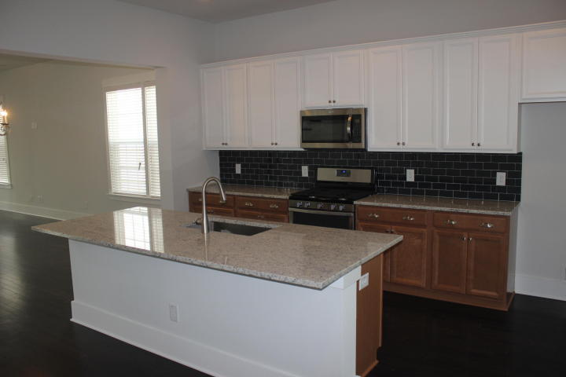
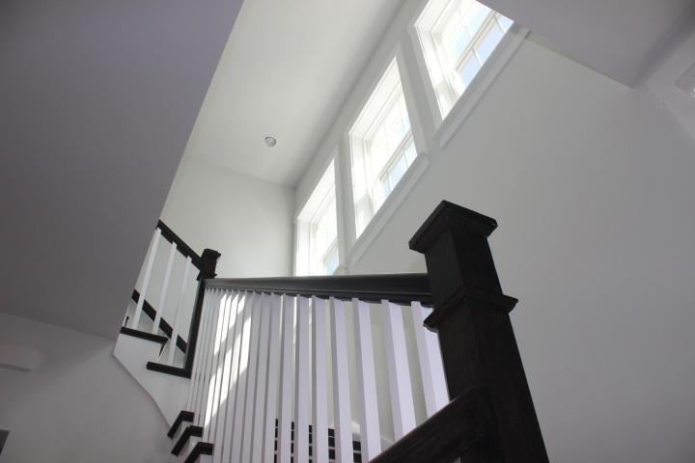
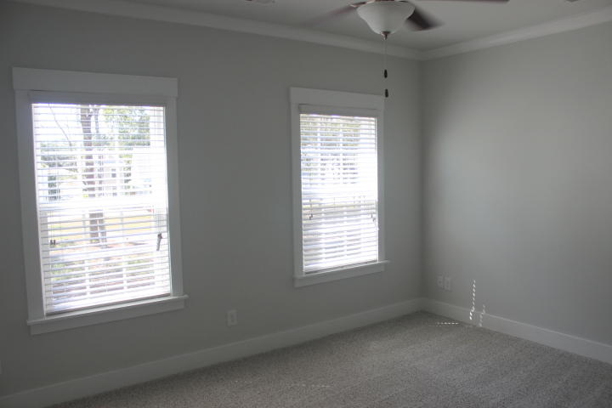
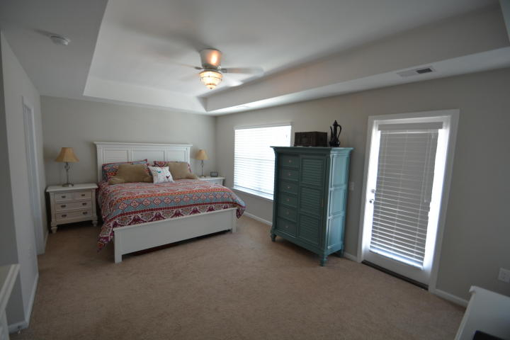
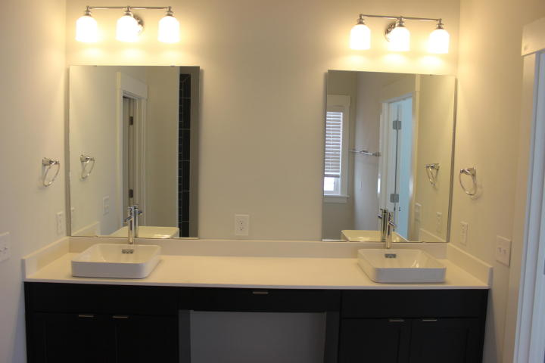
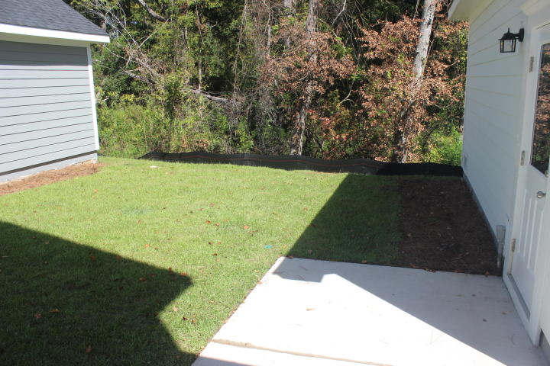
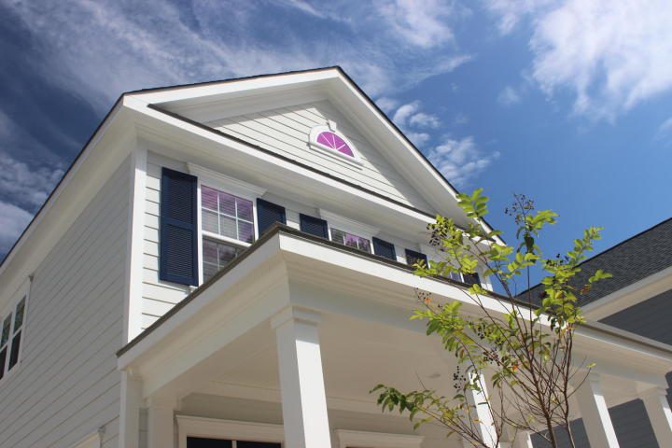
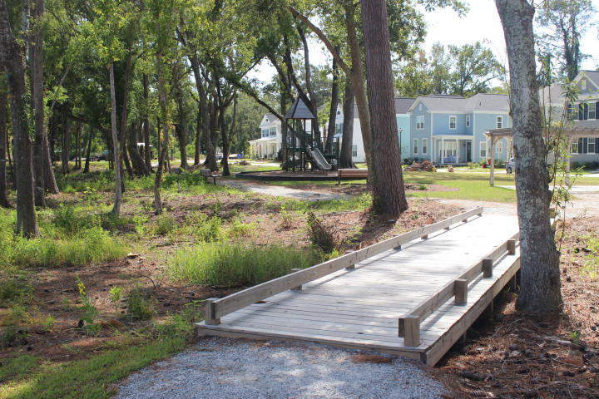
Fleming Park Open House
Thursday 3/15 11-3
1996 Fleming Woods Road
Charleston, SC 29412 ~ MLS# 18002053 ~ $433,500
My friends, if you want to enjoy the benefits of the coveted quiet and stately Fleming Park, this is the home for you! Saunter effortlessly to the unrivaled backyard and focus on the wooded serenity far away from noisy neighbors, while birds serenade you to total relaxation. Unlike others in the subdivision, this majestic 2-story "Sanderling" style with detached 1-car garage backs up to deep woods, offering unmatched privacy. Finished in Sept 2017, it offers the most modern conveniences, such as tankless hot water, energy efficient HVAC, gas range & granite countertops. The owner has selected numerous upgrades and premium features. Fleming Park boasts a beautiful park with play area and walking trails; you may even see egrets leisurely sashaying through the stream which meanders through.
Eric Windt
(843) 331-9072
ericcharlestonrealtor@gmail.com
Brand Name Real Estate
4 Carriage Lane Suite 106
Charleston, SC 29407
Michael Albenesius
(843) 343-5870
m.albenesius@gmail.com

