Slide 1
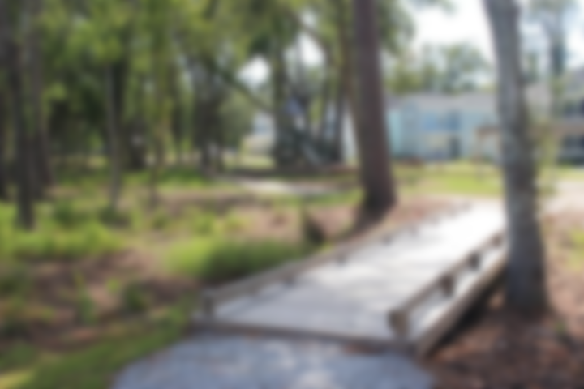
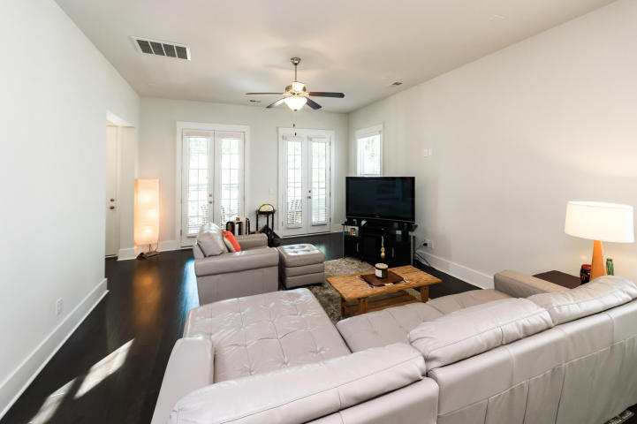
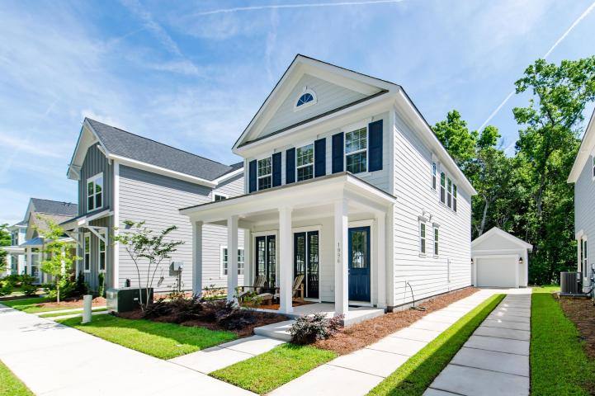
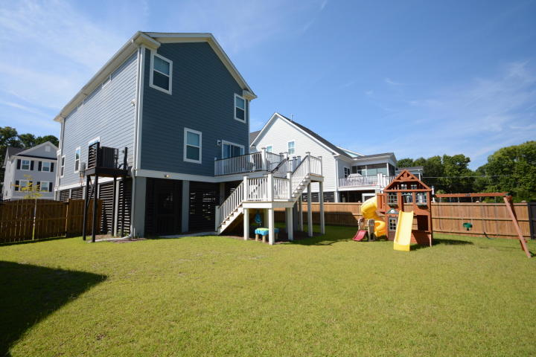
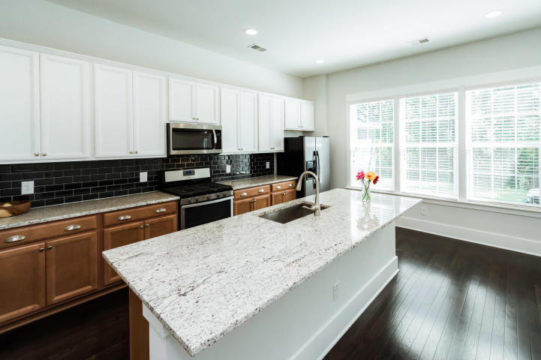
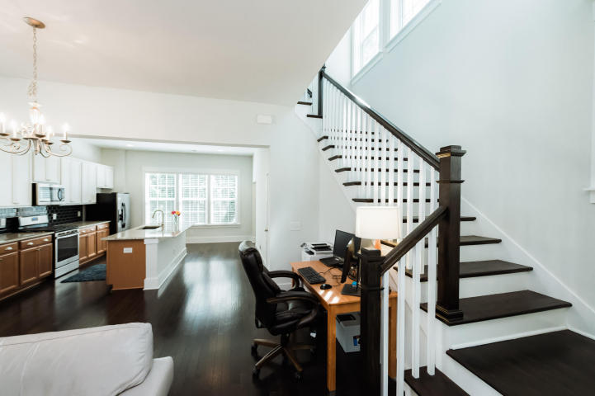
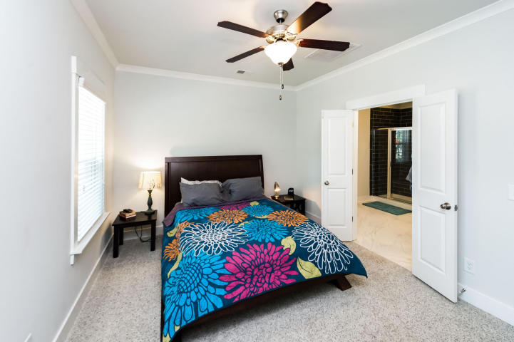
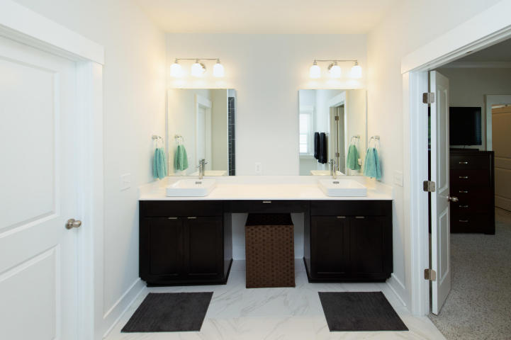
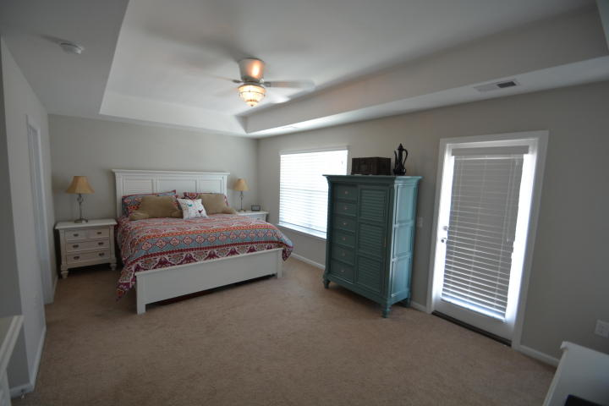
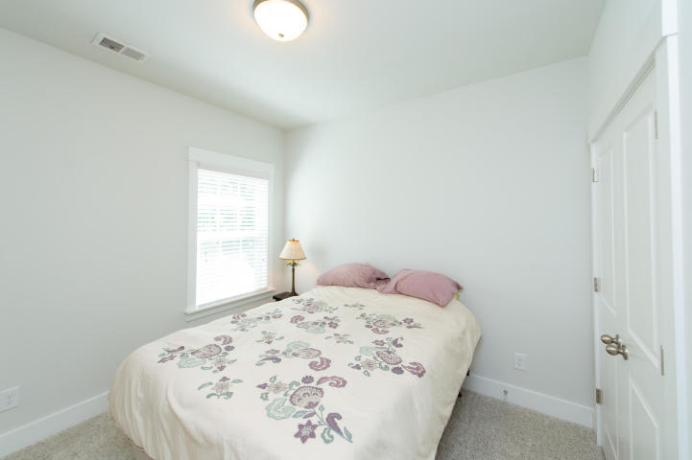
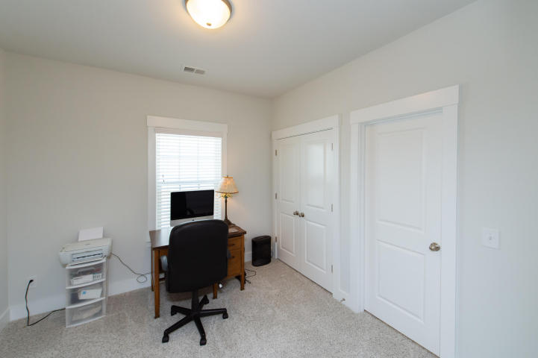
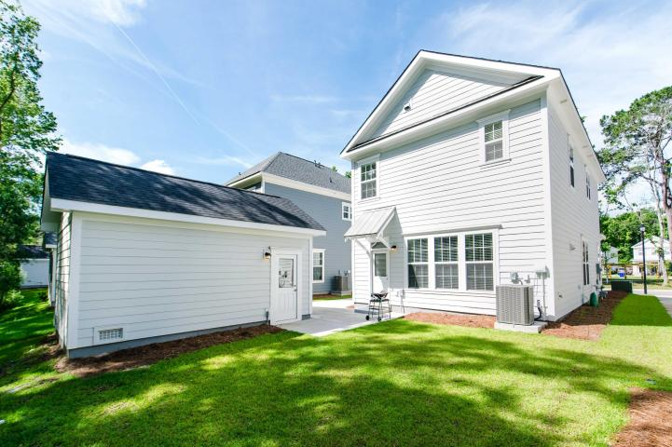
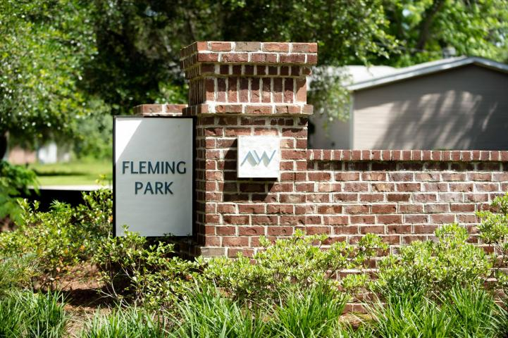
Fleming Park Open House Saturday 6/23 11am-2pm
1996 Fleming Woods Road
Charleston, SC 29412 ~ MLS# 18015552 ~ $425,000
You'll know you've "made it" when you move into this beautiful "Sanderling" style home in the coveted Fleming Park by Ashton Woods. It was completed in Sept 2017 and still boasts that "new construction" feel in every way. Unlike many others in the community, it offers a detached one-car garage with electric door, and backs up to deep, pristine woods - offering the maximum of backyard privacy and outdoor living possibilities. Owner selected many highly desirable upgrades, such as granite countertops, premium tile, tankless hot water and gourmet gas range. Lower level has an open floor plan with high ceilings and generously-sized windows. Would you like to relax on your front porch, or maybe take a stroll on the walking trails in the center of the community? The possibilities are endl
Eric Windt
(843) 331-9072
ericcharlestonrealtor@gmail.com
Brand Name Real Estate
4 Carriage Lane Suite 106
Charleston, SC 29407
Michael Albenesius
(843) 343-5870
m.albenesius@gmail.com

