Slide 1
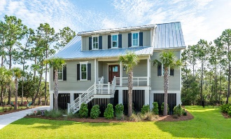
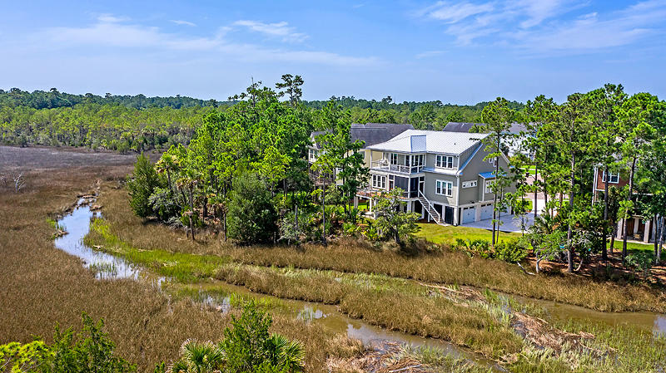
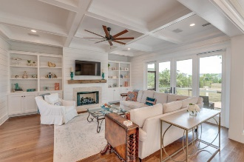
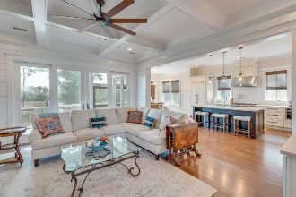
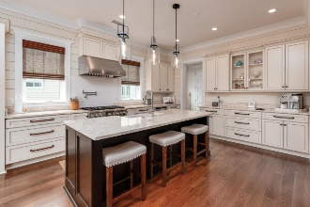
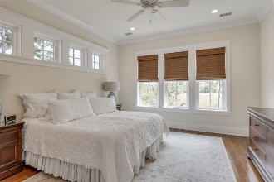
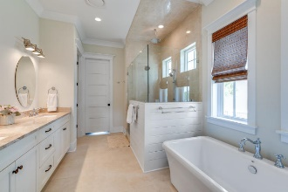
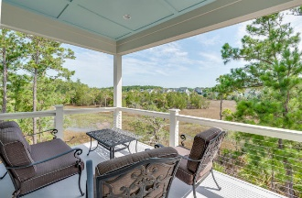
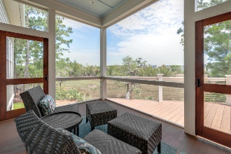
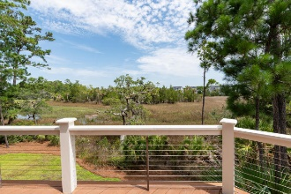
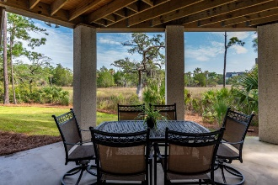


End Unit Townhome on Golf Course w/ Screened Porch
Starbucks card to first 10 agents
1999 N Creek Drive
Rivertowne CC~ Mt Pleasant ~ MLS# 19021277 ~ $849,900
Custom Built By A Prism Award Winning Local Builder
3,648 Sqft 4 Bdrm 3.5 Bath W/ Home Office
Marsh Front W/ Water Views
Unobstructed Natural Views From All Living Areas
10-foot Ceilings Outlined In Solid Crown Molding
Floor To Ceiling Shiplap Walls
8 Ft Solid Doors ~ Coffered Ceilings
Gourmet Kitchen Featuring All Stainless Steel Thermador Appliances
DXV Porcelain Farmhouse Sink And Faucet
Soft Close Drawers And Cabinets
Quartz Center
Oversized Built-in Refrigerator
Thermador Wine Fridge
Full Metal Roof With Foam Insulation
Site Finished 5 Inch White Oak Hardwood Flooring
Three Stop Elevator
First And Second Story Back Porches With Expansive Marsh And Water Views
Chandelier Lift In The Foyer
Tankless Hot Water Heater
Fresh Landscaping
Elevated Construction With 3 Garage Doors With Abundant Parking For Your Cars, Jet Skies, And Boat.
At $233 A Square Foot You Won't Find Better Upgrades, Craftsmanship Or Quality In Any Home. Come See It!
Private Community Boat Dock
Jerod Coulter, ABR, REALTOR
(843) 513-3741
jerod@realtor.com | www.HomesOfMountPleasant.com
The Boulevard Company, LLC | 35 Broad Street | Charleston, SC 29401

