Slide 1
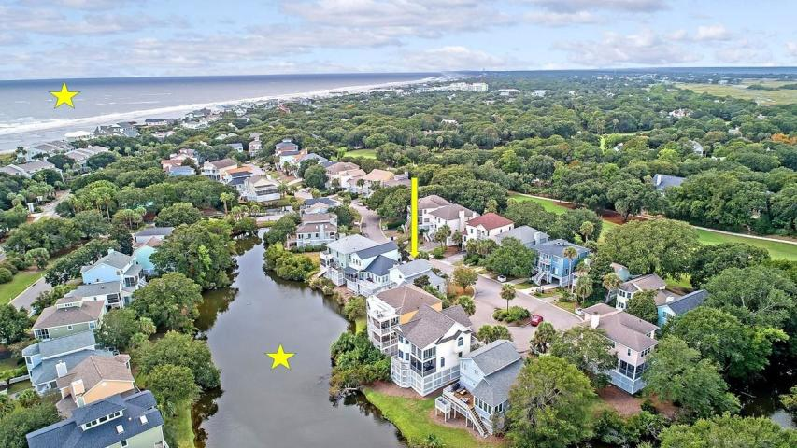
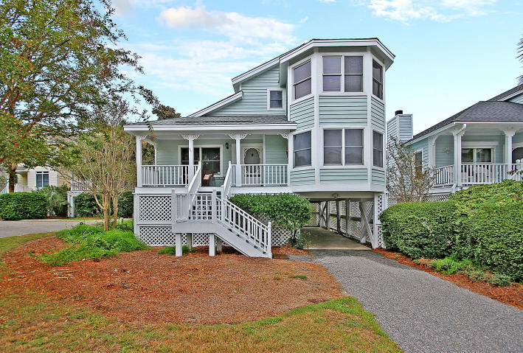
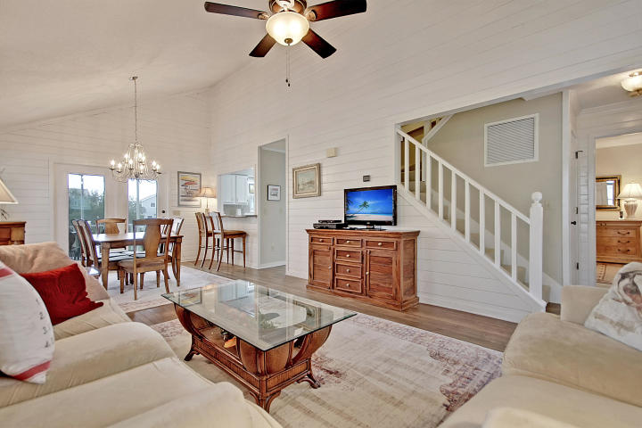
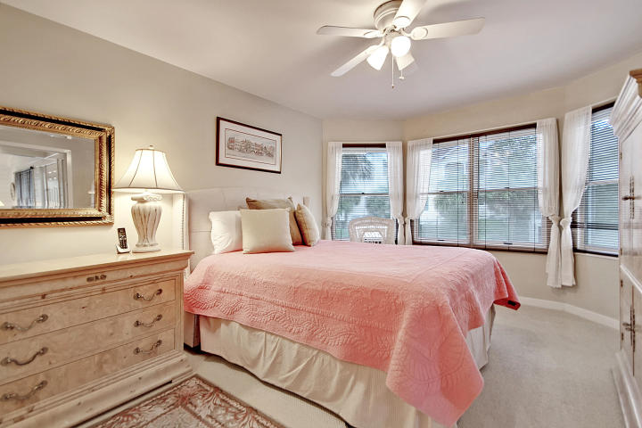
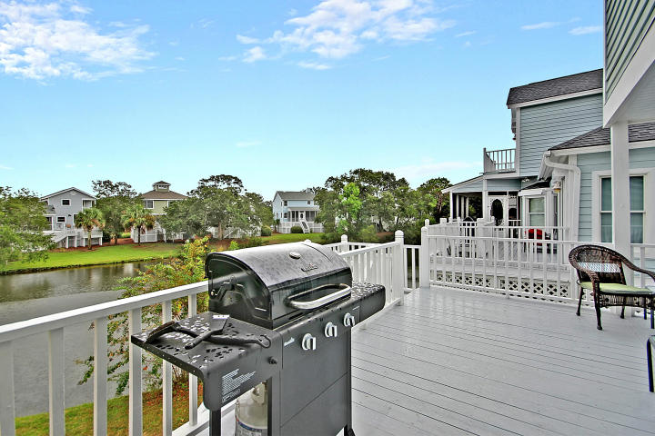
Wild Dunes Retreat
Price Reduced!
19 Pelican Reach
Isle of Palms, SC 29451 ~ MLS# 18027595 ~ $715,000
If you're vacationing or looking to trade in your business shoes for a pair of flip flops and your commuter car for a golf cart, this is the place for you! What makes this setup perfect for any occasion is that all three bedrooms have en-suite full baths so you and your family or guests will all have privacy and their own comfortable space. A screened-in porch and wrap around deck overlooks the peaceful pond and water fountain so you can always enjoy the outdoors and scenery. From a photo not too high up you can easily see how close you are to the gorgeous Isle Of palms Bech and the Wild Dunes golf course, you are surrounded by tropical beauty! The main living area boasts hardwood floors, a vaulted ceiling and open floor plan from the living/dining area to the kitchen. Don't miss out!
Tyler Hawkins tyler@mattoneillteam.com (843) 908-2734

