Slide 1
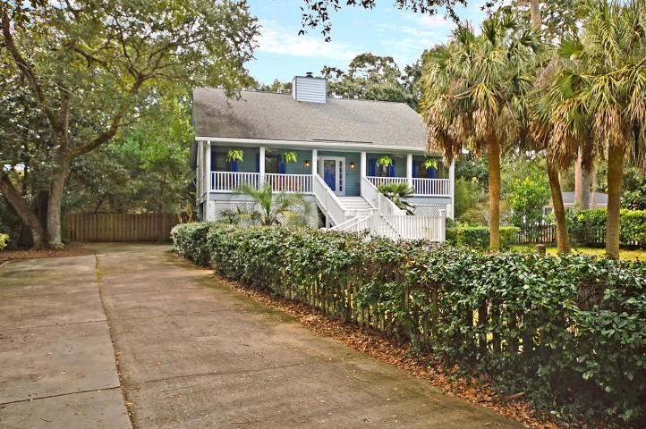
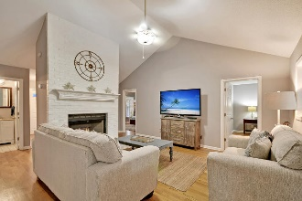
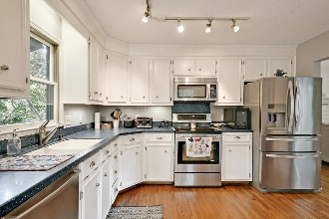
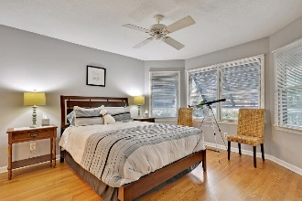
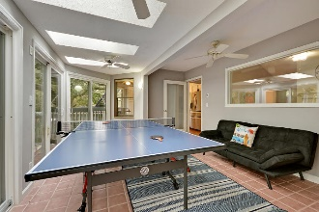
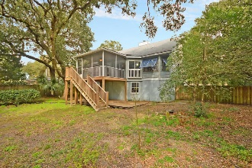


MOTIVATED SELLER!
$15,000 Agent Bonus
with ratified contract by 4/15/18
19 24th Avenue
Isle of Palms, SC 29451
MLS# 19004761
$775,000
$12,100 Under
Recent Appraised Value
PRICED BELOW RECENT APPRAISAL! Spacious elevated cottage, close to the beach and on a large lot! Beach access located just at the end of the street! Entering the cottage from the full front porch, you will be greeted in the foyer that leads to the comfortable living room with a fire place! Just off the living room is the light filled kitchen! The home boast a split floor plan with the master bedroom located on the right side of the home and the two guest bedrooms on the left, connected with a jack-and-jill bath! On the back of the home is a sun room with sky lights and large screened porch that overlooks the back yard! Entertainment possibilities are endless in the fenced-in back yard! Under the home features a car port, outdoor shower, elevator access, storage space, and workshop!
Age, sqft, taxes, acreage, HOA dues, flood zone and schools are approximate, buyer to verify any and all information deemed necessary.
Mason Thurber
(843) 709-5109– C (843) 576-2701 – O
mason@theeverettgroup.net
RE/MAX Pro Realty, 9209 University Blvd, Charleston, SC 29406

