Slide 1
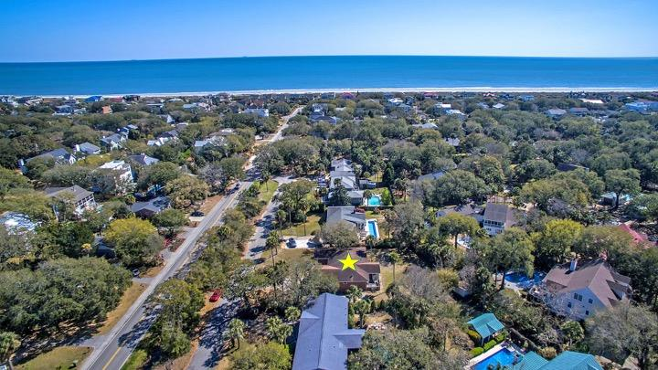

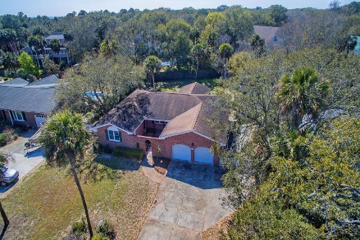
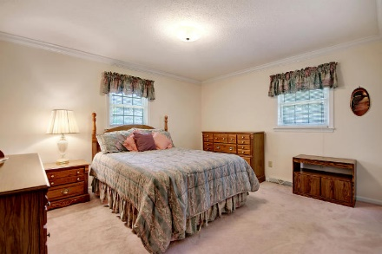
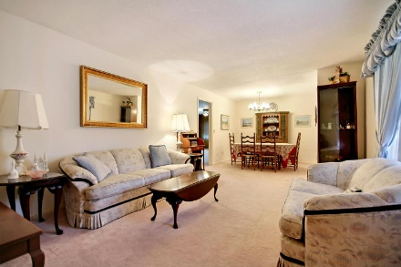
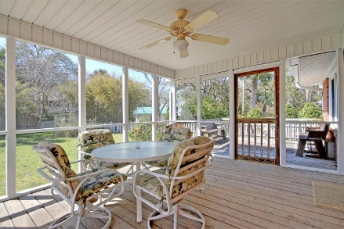
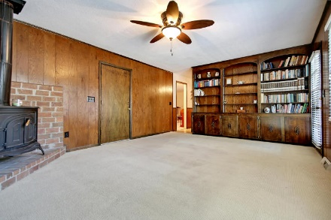
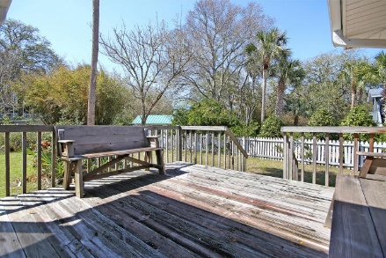
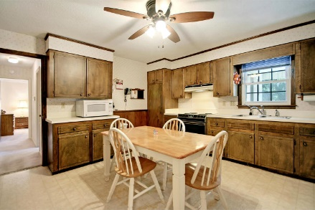
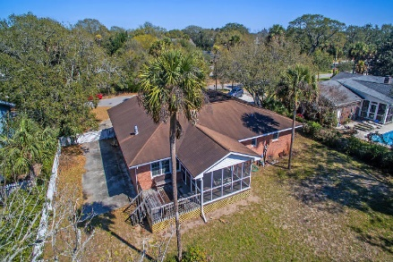
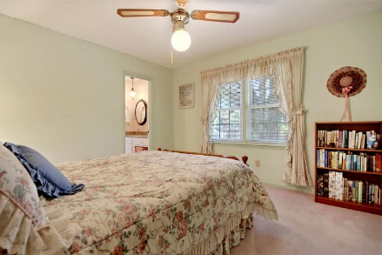
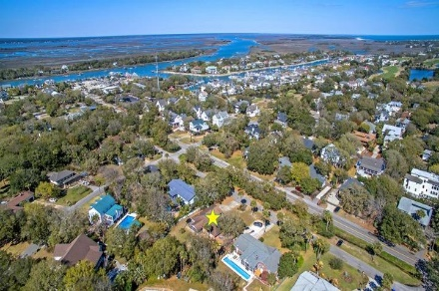

Parkshore Marshfront
Price Reduced
19 41st Avenue
Isle of Palms, SC 29451 ~ MLS# 18007268 ~ $749,900
What’s better than living at the beach??
Nothing!
That’s what makes this one story home on Isle of Palms so amazing.
From this location, you can walk two blocks east & be on the white sand beach enjoying the surf and sand OR you can walk two blocks west to rent a wave runner or grab a bite to eat at the Morgan Creek Grill while enjoying the beautiful water views.
With a golf cart you can make your way to Harris Teeter, shopping, dining & just leave your car at home.
This brick home has a stylish, arched, gated entry, a front porch, a screened porch & deck overlooking the large, fenced-in backyard.
Inside you'll find an eat-in kitchen, comfortable living/dining room & family room with a cozy stove fireplace.
If the beach lifestyle has been calling your name, now's your chance to say yes.
Sam Stith Sam@MattOneillTeam.com (843) 452-5271

