Slide 1
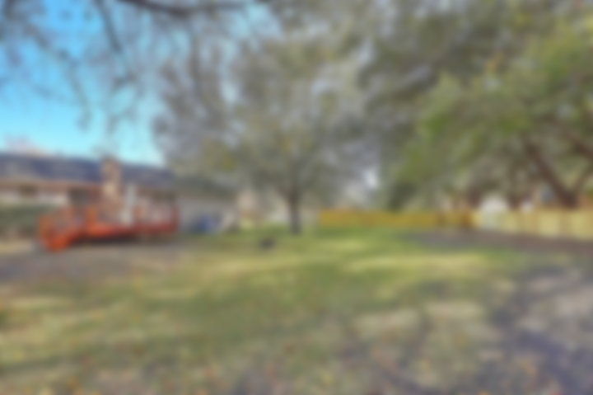
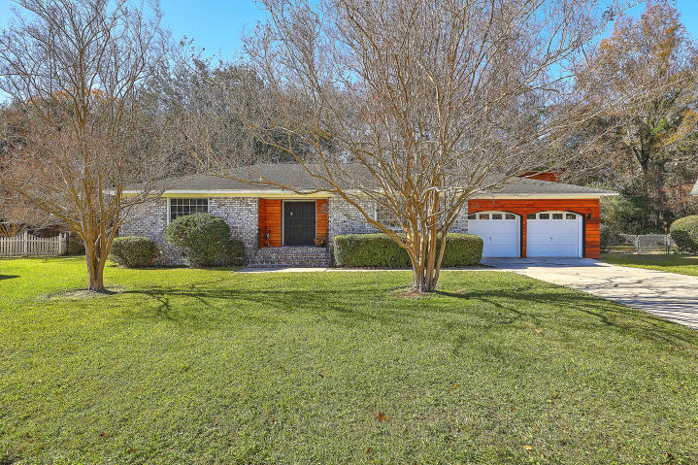
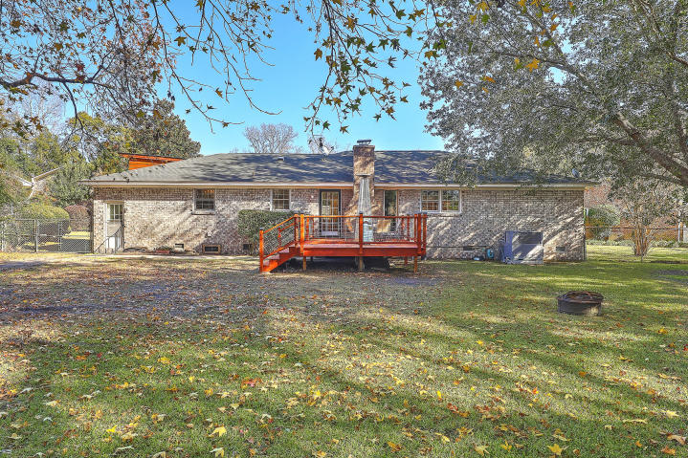
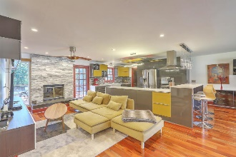
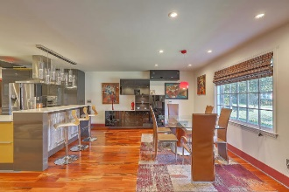
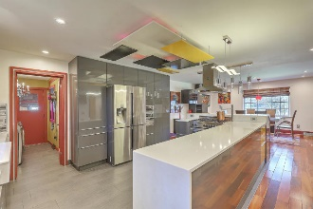
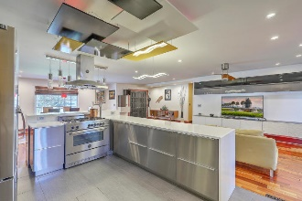
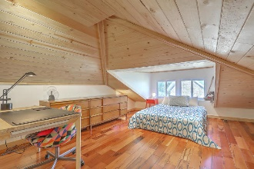
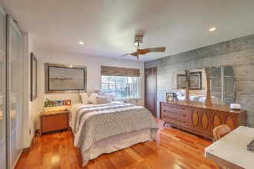
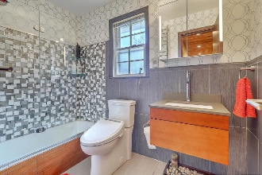
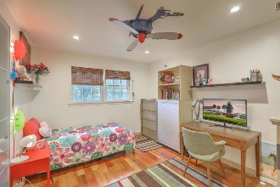
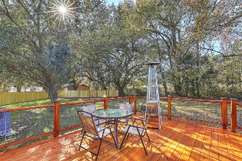
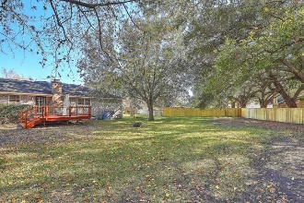

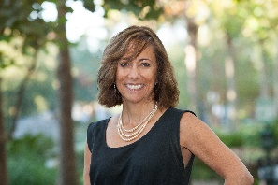
West Ashley Renovated Mid-Century Modern Open House Saturday and Sunday
19 Ashland Drive
Wespanee Place | Charleston, SC 29407 | MLS# 20000033 | $489,975
Situated just minutes to downtown Charleston and I26, this stunning & exquisitely remodeled mid-century modern home offers an open floor plan & spacious yard for seamless indoor/outdoor enjoyment. From the expansive living/dining area with ultra modern dream kitchen to the BRAND NEW deck, you & your family will fall in love with the most detailed, unique features of this showstopper. The light-filled chef's kitchen has generous counters & unique storage space, large island & top-of-the-line professional stainless steel appliances incl 36'' Pro Series S/S Bertazzoni gas Range w/Convection Oven, Smeg warming oven and pot filler. The romantic master retreat includes spacious closet storage and zen-like master bath which even has heated towel bars & Bluetooth speaker system! The awesome loft (NOT included in the square footage but has heat vents) is perfect for an office/teen 'cave'/creative space or 4th bedroom. Other highlighted features such as elegant Brazilian Tigerwood hardwood floors throughout, recessed lighting, built-in modern designed cabinets, along with the two additional, nicely sized bedrooms and European style guest bath round off this truly unique and striking home. Please ask your agent for the detailed upgrades list!
Between your huge backyard at the end of a quiet cul de sac (with NO HOA and no flood zone!) which offers a peaceful, country-like setting and all of the state-of-the-art features that you would normally see in high end, new construction homes, you will never want to leave this true architectural mid-century-modern architecture experience! Popular restaurants, shops, parks and biking trails are just within a 2.5 mile radius too! Don't miss this opportunity for unparalleled living and entertaining space whilst preserving the peacefulness and privacy of individual sleeping quarters! Appraisal just done and in hand too!
Desiree Maurer Office - (843) 416-2000
Mobile - (843) 327-9010 desiree.maurer1@gmail.com
www.yourcharlestonhousesearch.com
Keller Williams Realty 496 Bramson Ct Ste 200 Mt. Pleasant, SC 29464

