Slide 1
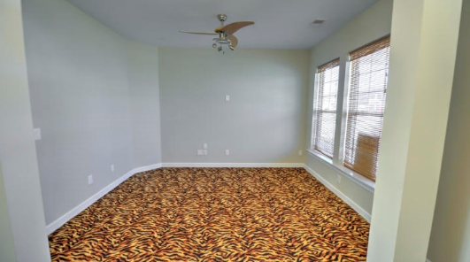
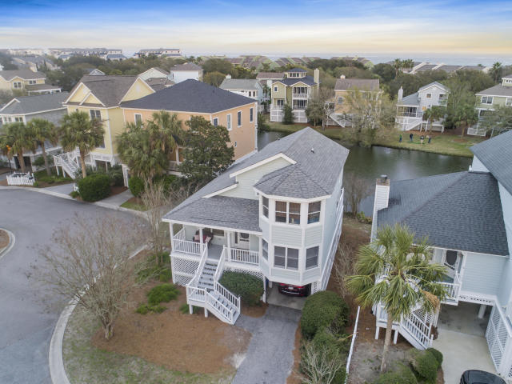
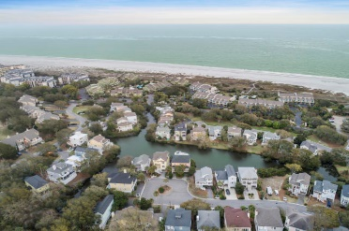
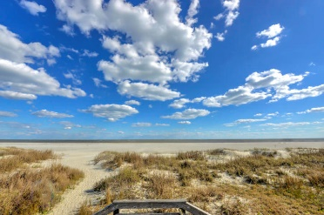
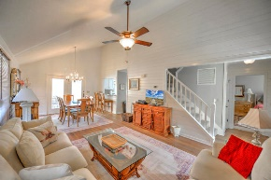
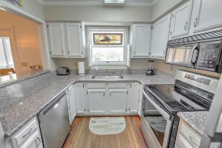
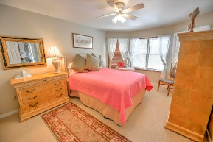
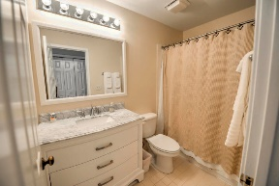
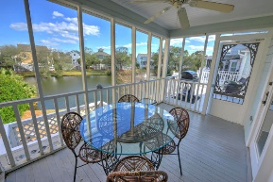


Motivated Sellers!!
Gorgeous Wild Dunes Vacation Home (Steps from Beach!)
19 Pelican Reach
Wild Dunes
Isle of Palms, SC 29451
MLS# 20005878 ~ $699,900
Gorgeous 3 bedroom and 3.5 bathroom beach cottage that sits on a pond! If you're looking for a vacation home, a rental home with great rental history, or looking to make this your primary residence, you cannot make the wrong decision with 19 Pelican Reach. This home has new bathrooms, new water heater and the outside was painted only 18 months ago. The first floor of this home includes an open living area with original hardwood floors and vaulted ceilings, updated kitchen, full bathroom plus powder room, and master bedroom with ensuite. The kitchen was completely remodeled with new countertops, cabinets and new appliances that come with the sale. Upstairs includes the 2 additional bedrooms each with their own ensuites so it makes freshening up easy - regardless of how many guests you have over. One of the best parts of this home is the wrap-around deck in the back and screened-in porch that overlooks the pond. The perks don't end here! This beach cottage is in the Pelican Bay subsection of Wild Dunes meaning that homeowners can enjoy their own private neighborhood pool, just a short walk away. The Wild Dunes Property Owners Beach House is located within a short walking distance (directly across from Pelican Bay) and offers beach access, a covered picnic pavilion, event/gathering space, showers and bathrooms plus ample parking for cars and golf carts. Slide on your flip flops on, put your bathing suit on, and call this wonderful cottage yours!
Virtual Tour: https://my.matterport.com/show/?m=bCNQDdVJPsp
Nick Mazzilli
(843) 640-5575
nick@nickmcharleston.com
www.nickmcharleston.com
Reside Real Estate LLC
155 Wingo Way Unit 421
Mt. Pleasant, SC 29464

