Slide 1
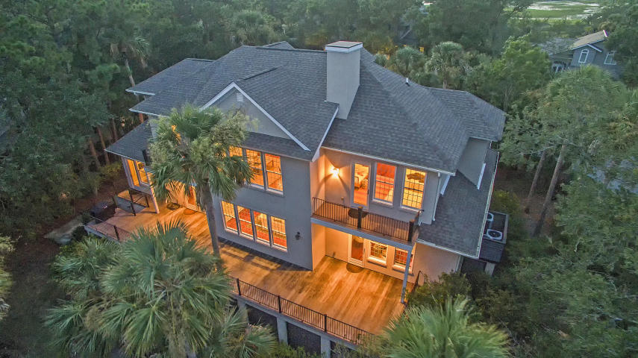


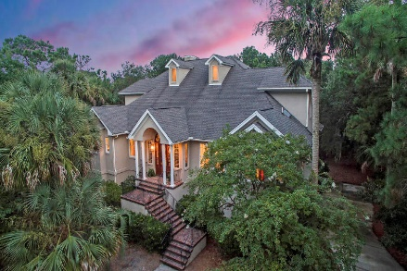
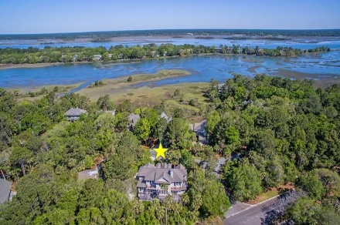
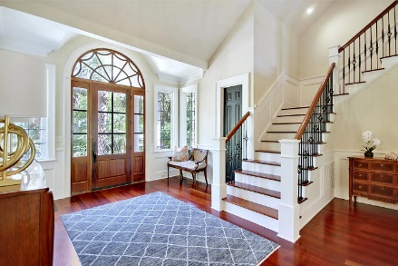
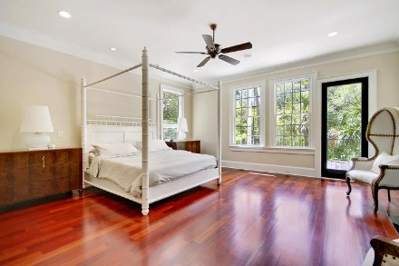
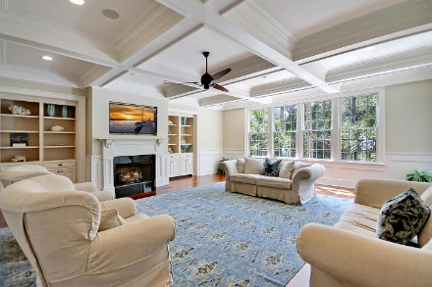
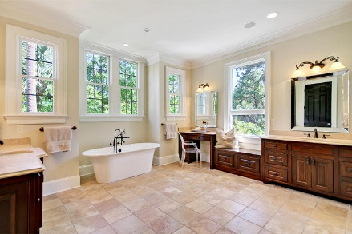
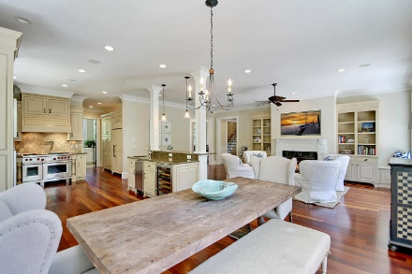
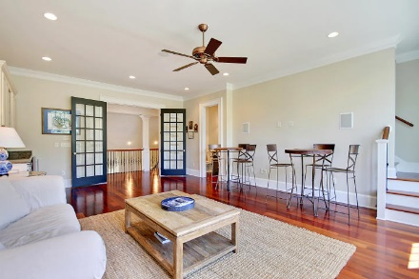
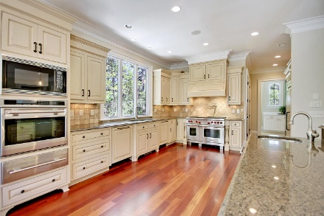
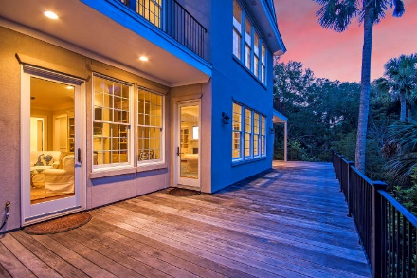
Parkshore Marshfront
Huge Price Reduction!
1 Airy Hall
Kiawah Island, SC 29455 ~ MLS# 18012086 ~ $1,695,000
Between the Kiawah River, the rolling greens of the golf course and the Atlantic Ocean, this stunning, custom home on Kiawah Island will leave you speechless. Tropical landscaping surrounds this three story home (four including the garage level) that features a two story foyer, high ceilings, cherry wood floors, wrought iron staircase, an elevator from the garage to the kitchen, laundry on three levels, coffered ceiling in the great room, three fireplaces and an expansive back deck. After a day full of playing 18 holes, lounging at the pool or riding your bikes on the beach, you can clean up in the gigantic walk-in, rainfall shower, curl up next to any one of the fireplaces, have a drink at the wet bar in the family room or visit with friends on the peaceful deck! No expense spared!
Additional features include:
Intercom system through home
Sub-Zero fridge
2 Bosch dishwashers in kitchen
Wolf Gas Range and oven
Wolf microwave built-in
Wolf Oven and heating drawer
Sub-Zero wine fridge
Book your viewing today!
Christopher Smith christopher@mattoneillteam.com 843-267-0735

