Slide 1
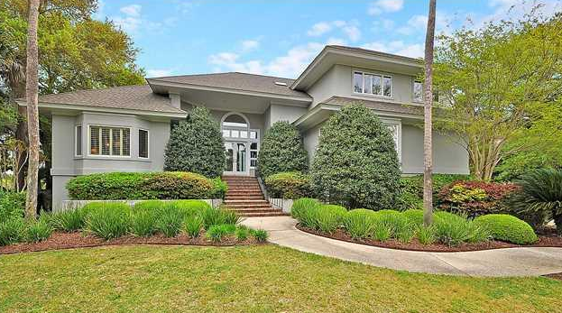
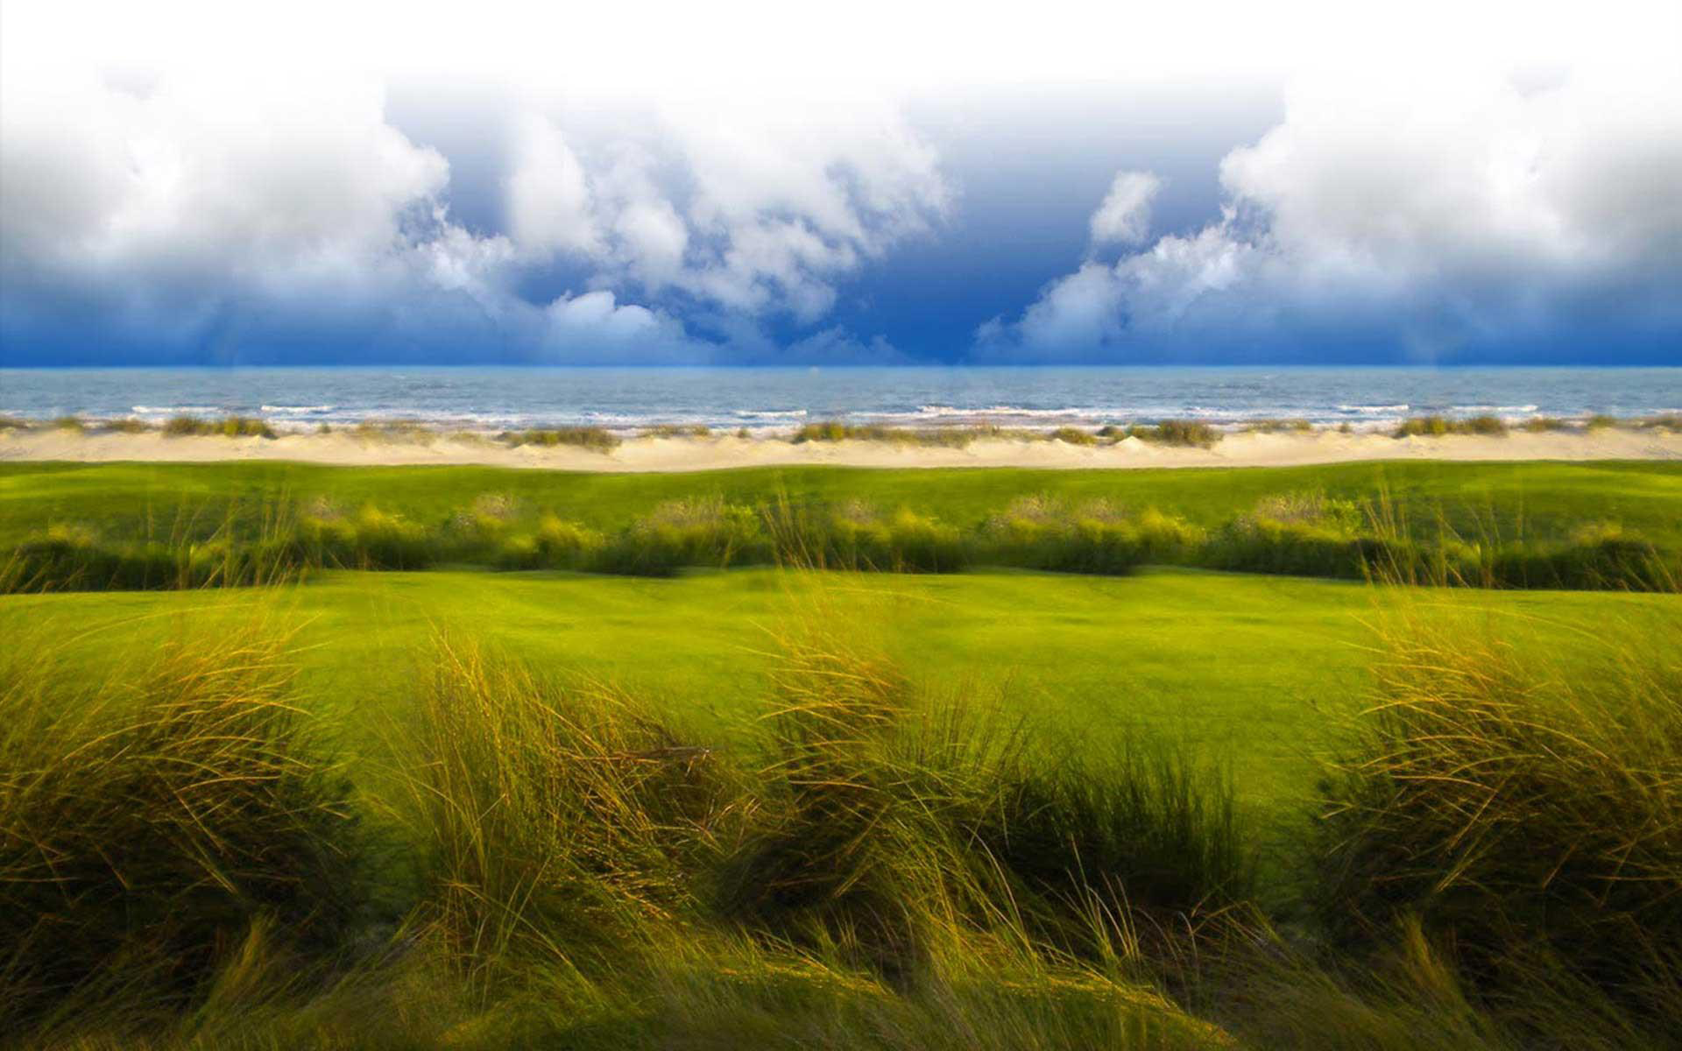
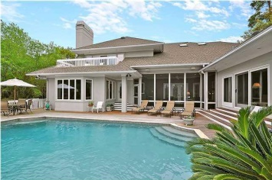
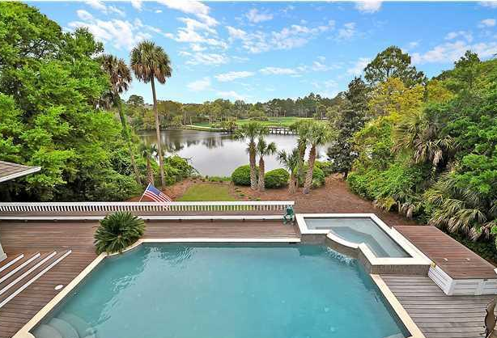
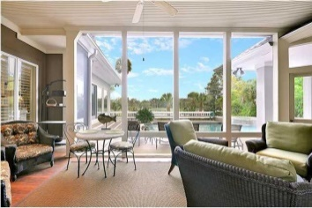
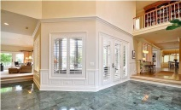
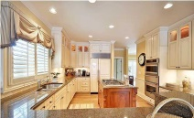
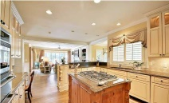
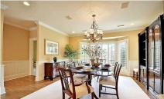
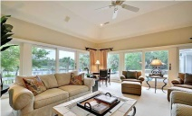
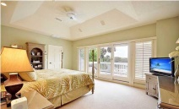
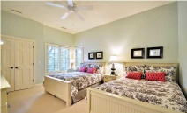
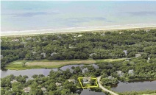
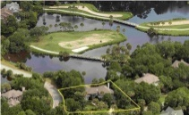


1 Avocet Lane
Kiawah Island, SC
MLS# 1417870 ~ $2,795,000
One of Kiawah's finest Premier homes located in the exclusive Vanderhorst Plantation!
4 Bedroom/4.5 Bath Oasis
Newly rebuilt heated pool with Brazilian IPE decking
8 person hot-tub overlooking pristine Pintail lagoon & Osprey Point Golf Course
Large second floor master suite with a gorgeous bathroom including jacuzzi and private deck overlooking the pool and lagoon
A full 8' wet bar/entertainment center with wine and beverage coolers is conveniently located between the main living room and kitchen
First level has two guest suites with private baths
Kiawah Island Club Membership available
Currently on established rental program
Listed Exclusively by
Christina Bucci
843-830-0888 Cell
christina@sweetgrassps.com
RE/MAX Elite | Sweetgrass Properties, 91A Broad St, Charleston, SC 29401

