Slide 1
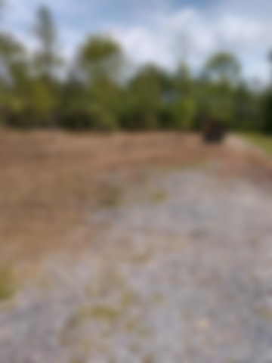
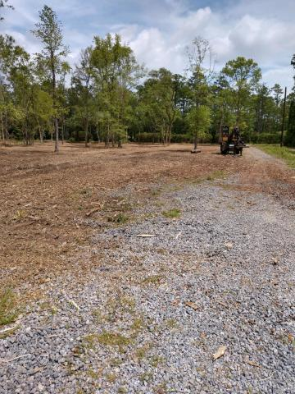
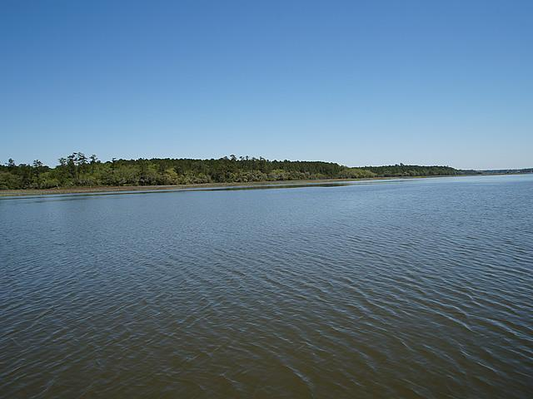
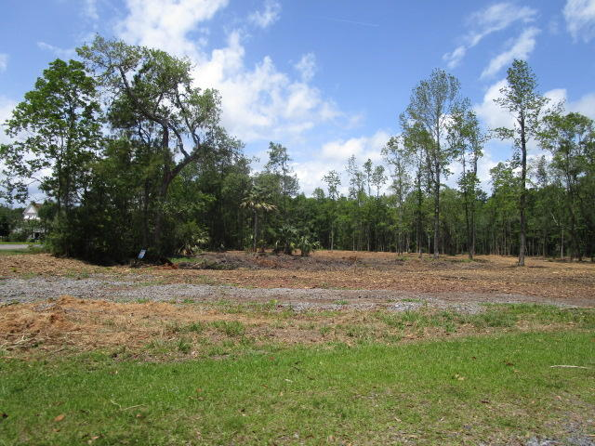
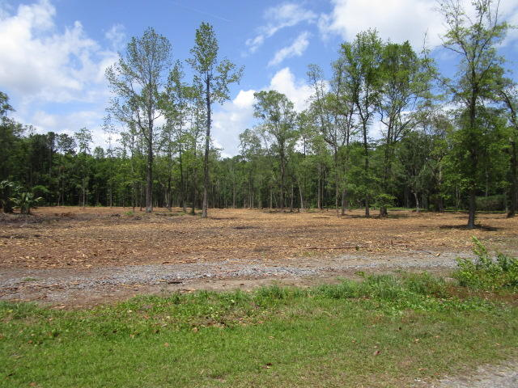
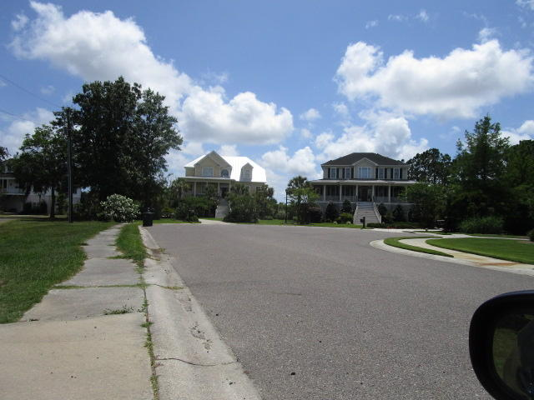
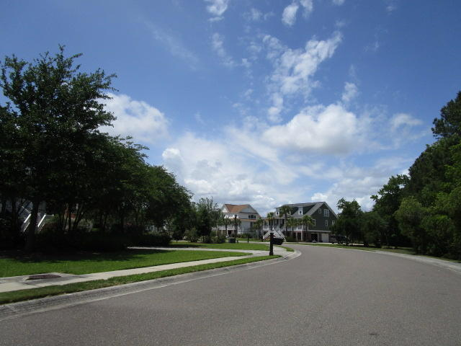
Vacant Lot ~ Owner is Anxious!
1B Newport Court
Beresford Creek Landing | Charleston, SC 29492
MLS# 19013300 | $175,000
There is a $7500 assessment if the Buyer would like to join the Beresford Creek Landing HOA, which is optional, not mandatory.
Charles Salmonsen
M (843) 224-0300 | O (843) 388-6613 | charles@salmonsen.com
Salmonsen Realty | 864 Lowcountry Blvd Ste B | Mt Pleasant, SC 29464

