Slide 1

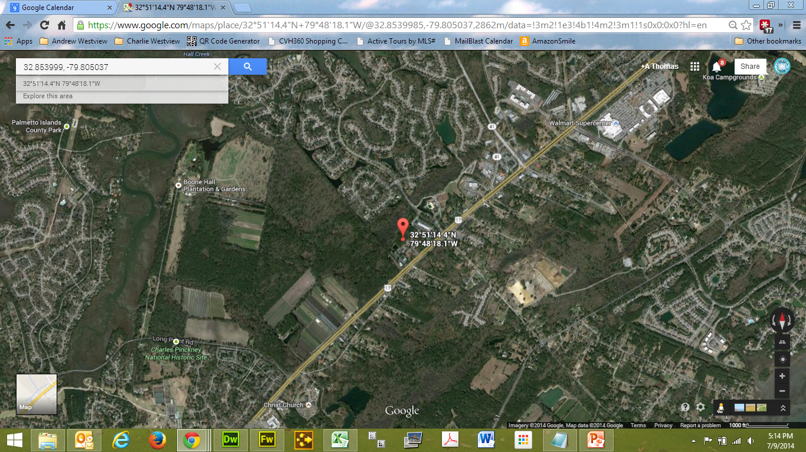
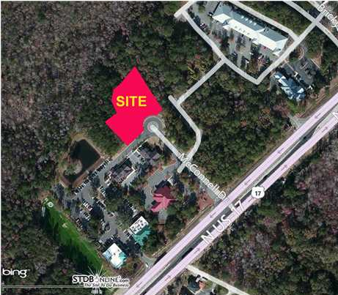


PRIME COMMERCIAL LOCATION CONNECTED TO BRICKYARD PLANTATION
Office Professional District (OP) Build to Suit Commercial Buildings For Sale in Mount Pleasant. 1.94 Acres just off Highway 17 North which is easy to access from the north or south. Connected to Brickyard Subdivision via The Shoppes at Brickyard. Located in the Brickyard Professional Center where Medical/Dental Services are nearby. In between East Cooper and Roper Hospitals. Current owner is a developer that is also marketing this property location as a build to suit lease, lease-purchase or sale ranging from 1,000 to 25,000 square feet. Lease rate is 17 NNN. This is a turn-key process for a buyer which includes architectural services, structural, mechanical and electrical engineering, interior building design and upfit, landscaping and installation. Also for sale at $190 per square foot.
Address: 1 BRICKSIDE LN
Area: CHS-Mt.Pleasant North of IOP Connector
Building Square Feet: 1000
Category: details
City: MOUNT PLEASANT
County: Charleston
Listing ID: 1224937
Listing Price: $17
Max Contiguous SqFt: 25000
Minimum Div. SqFt: 1000
Office Class: A
Property Name: BRICKYARD PROFESSIONAL CENTER

