Slide 1
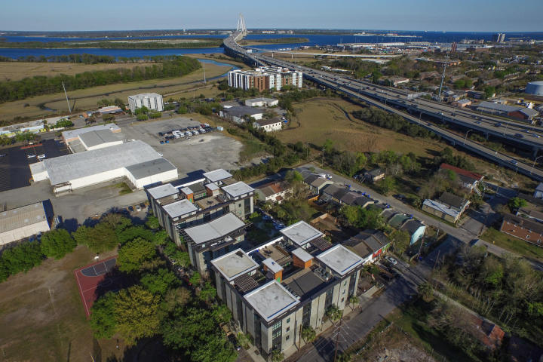
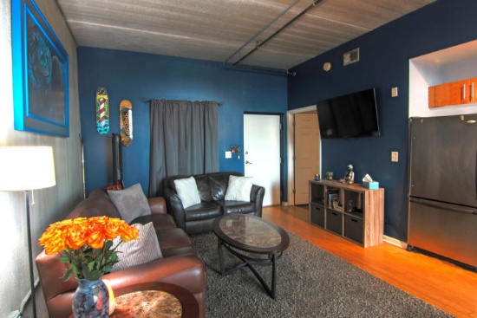
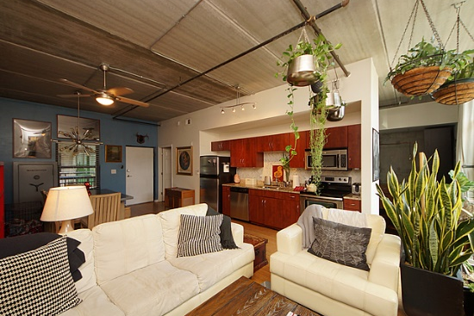
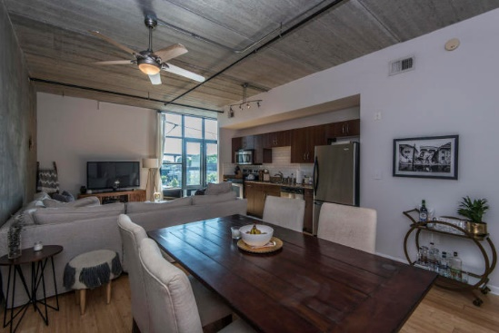
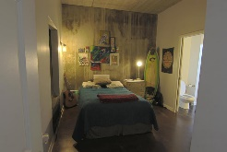

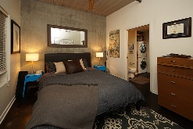
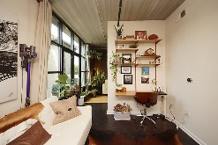
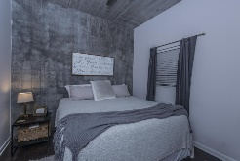
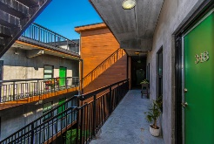
1 Cool Blow Open Houses
Saturday, Sept 8th ~ 11-1
Refreshments will be served!
** Agents: please plan to show your pocket card at the gate **
#133
MLS# 18021470
$315,000
Kelly Mast
843-810-0664
kelly@wavelandproperties.com
Waveland Properties
#137
MLS# 18024344
$294,500
Di Johnson
843-270-6448
dijohnsonsc@gmail.com
AgentOwned Preferred Group
#348
MLS# 18013633
$295,000
Clay Cunningham
843-345-4647
clay@carolinaone.com
Carolina One Real Estate

