Slide 1
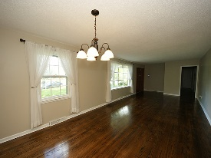
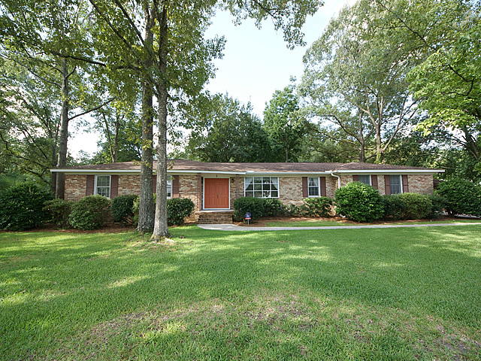
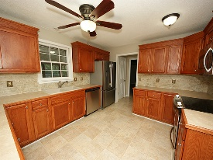
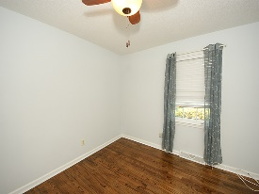
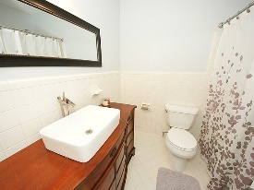
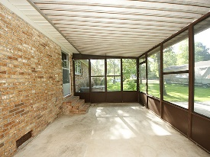
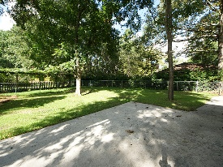
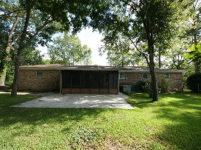


We are priced to sell!
1 Milano Street
Otranto
Hanahan, SC 29410
Open House Canceled!
Under Contract In 3 Days!
MLS# 16021978 | $225,000
4 Bed / 3 Bath
Desirable home in established Otranto! Elegance describes this beautifully remodeled ranch style house. Brilliant hardwood floors, smooth ceilings, new kitchen cabinets, back splash, remodeled bathrooms, new fixtures, fresh paint and a new roof was installed in 2011. This home features 4 bedrooms, 3 full bathrooms and a large screened in porch and oversized patio. All of this charm sits on a spectacular corner lot.
Connie White, Broker
C: 843-532-3356
conniesyouragent@gmail.com
Charleston Homes
111 Spring Hall Dr
Goose Creek, SC 29445

